Slide 1
Unit 11
Acids & Bases

Slide 2
Arrhenius Acids and Bases

Slide 3
Lesson Objectives
Define Arrhenius acids and bases.
Identify general properties of acids and bases.
Determine the products of a neutralization reaction.

Slide 4
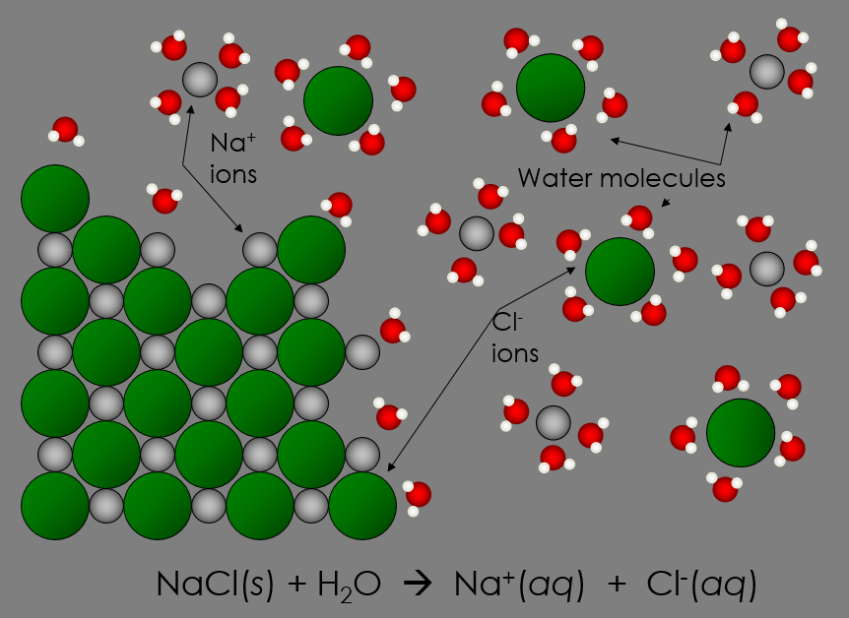
Electrolytes
An electrolyte is a substance that when dissolved in water produces ions capable of conducting electricity.
EX. NaCl → Na⁺ + Cl⁻
Notes:
https://www.youtube.com/watch?v=4WillWjxRWw

Slide 5
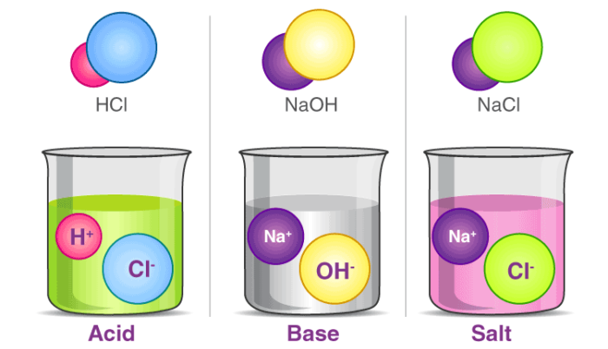
Electrolytes
Acids and bases are also electrolytes. They produce ions.

Slide 6
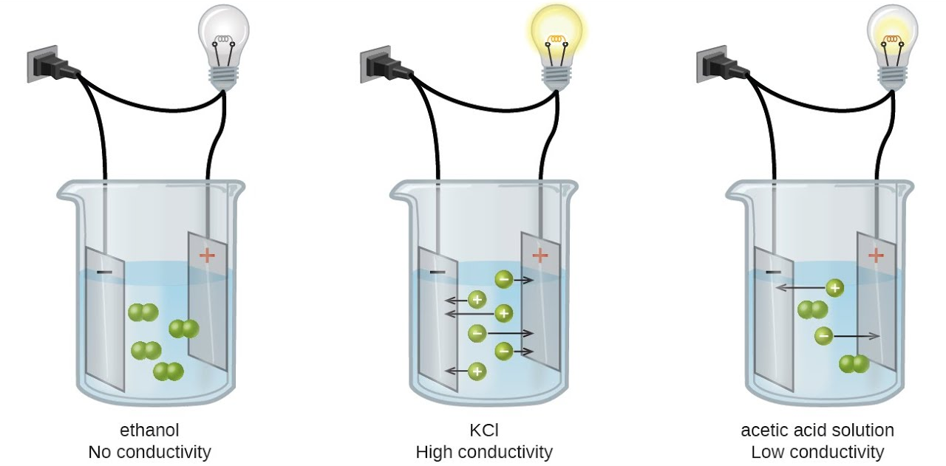
Electrolytes & Conductivity

Slide 7
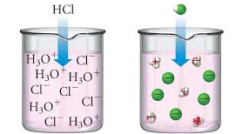
Arrhenius Acids
An Arrhenius acid yields H⁺ as the only positive ions in an aqueous solution. [The hydrogen ion may also be written as H₃O⁺ (hydronium).]
HCl (aq) → H⁺ + Cl⁻
HCl (aq) + H₂O (l) → H₃O⁺ + Cl⁻

Slide 8
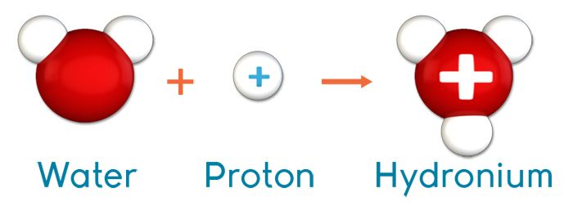
H⁺ = H₃O⁺

Slide 9
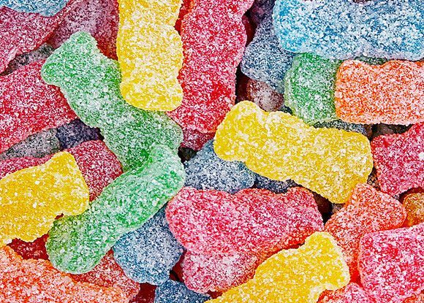
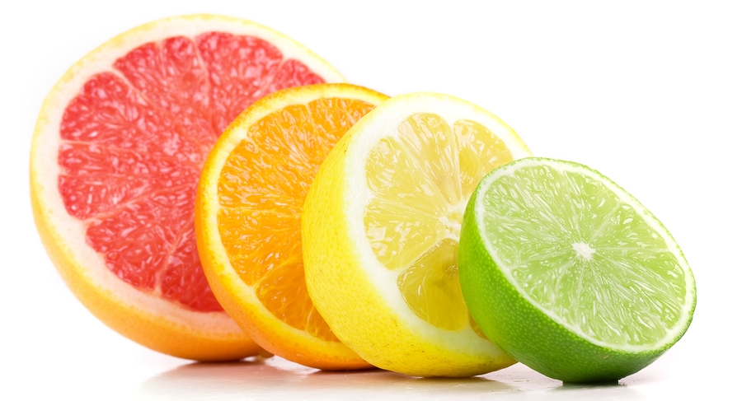
Properties of Acids
Sour taste
Can burn your skin
Has a pH lower than 7
Reacts vigorously with active metals to release H₂(g)

Slide 10
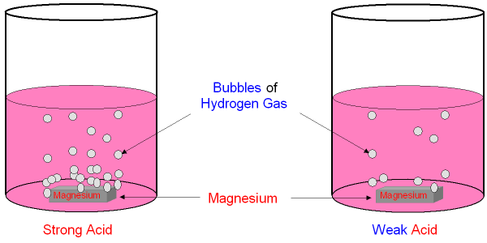
Acids react with most metals
One hydrogen will be replaced by a more active metal. (Unreactive metals include Cu, Ag, and Au.)
2HCl + Mg → MgCl₂ + H₂(g)
2HCl + Zn → ZnCl₂ + H₂

Slide 11
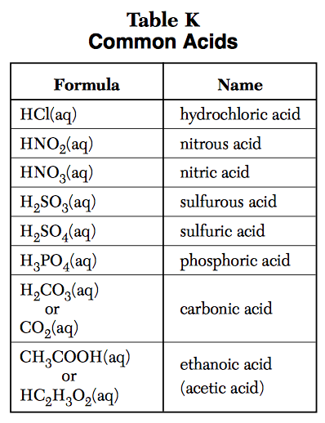
Common Acids
Located in TABLE K in the reference table.

Slide 12
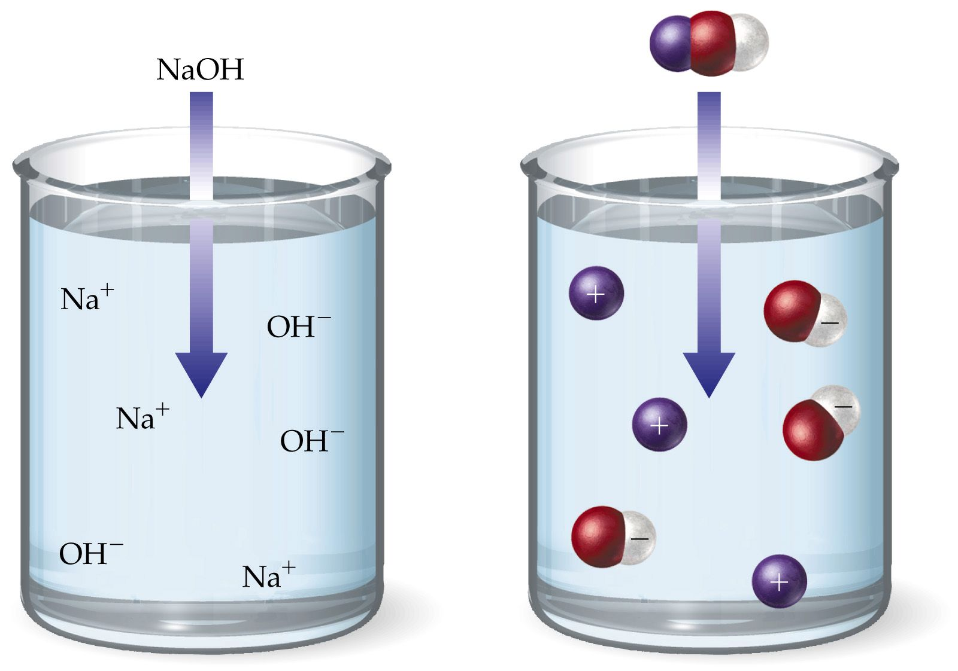
Arrhenius Bases
An Arrhenius base yields OH⁻ (hydroxide) as the only negative ion in an aqueous solution.
NaOH (aq) → Na⁺ + OH⁻
Notes:
Hydroxide on Table E

Slide 13
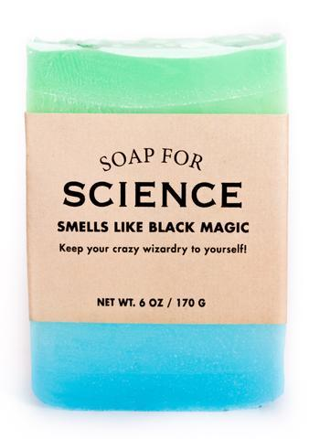
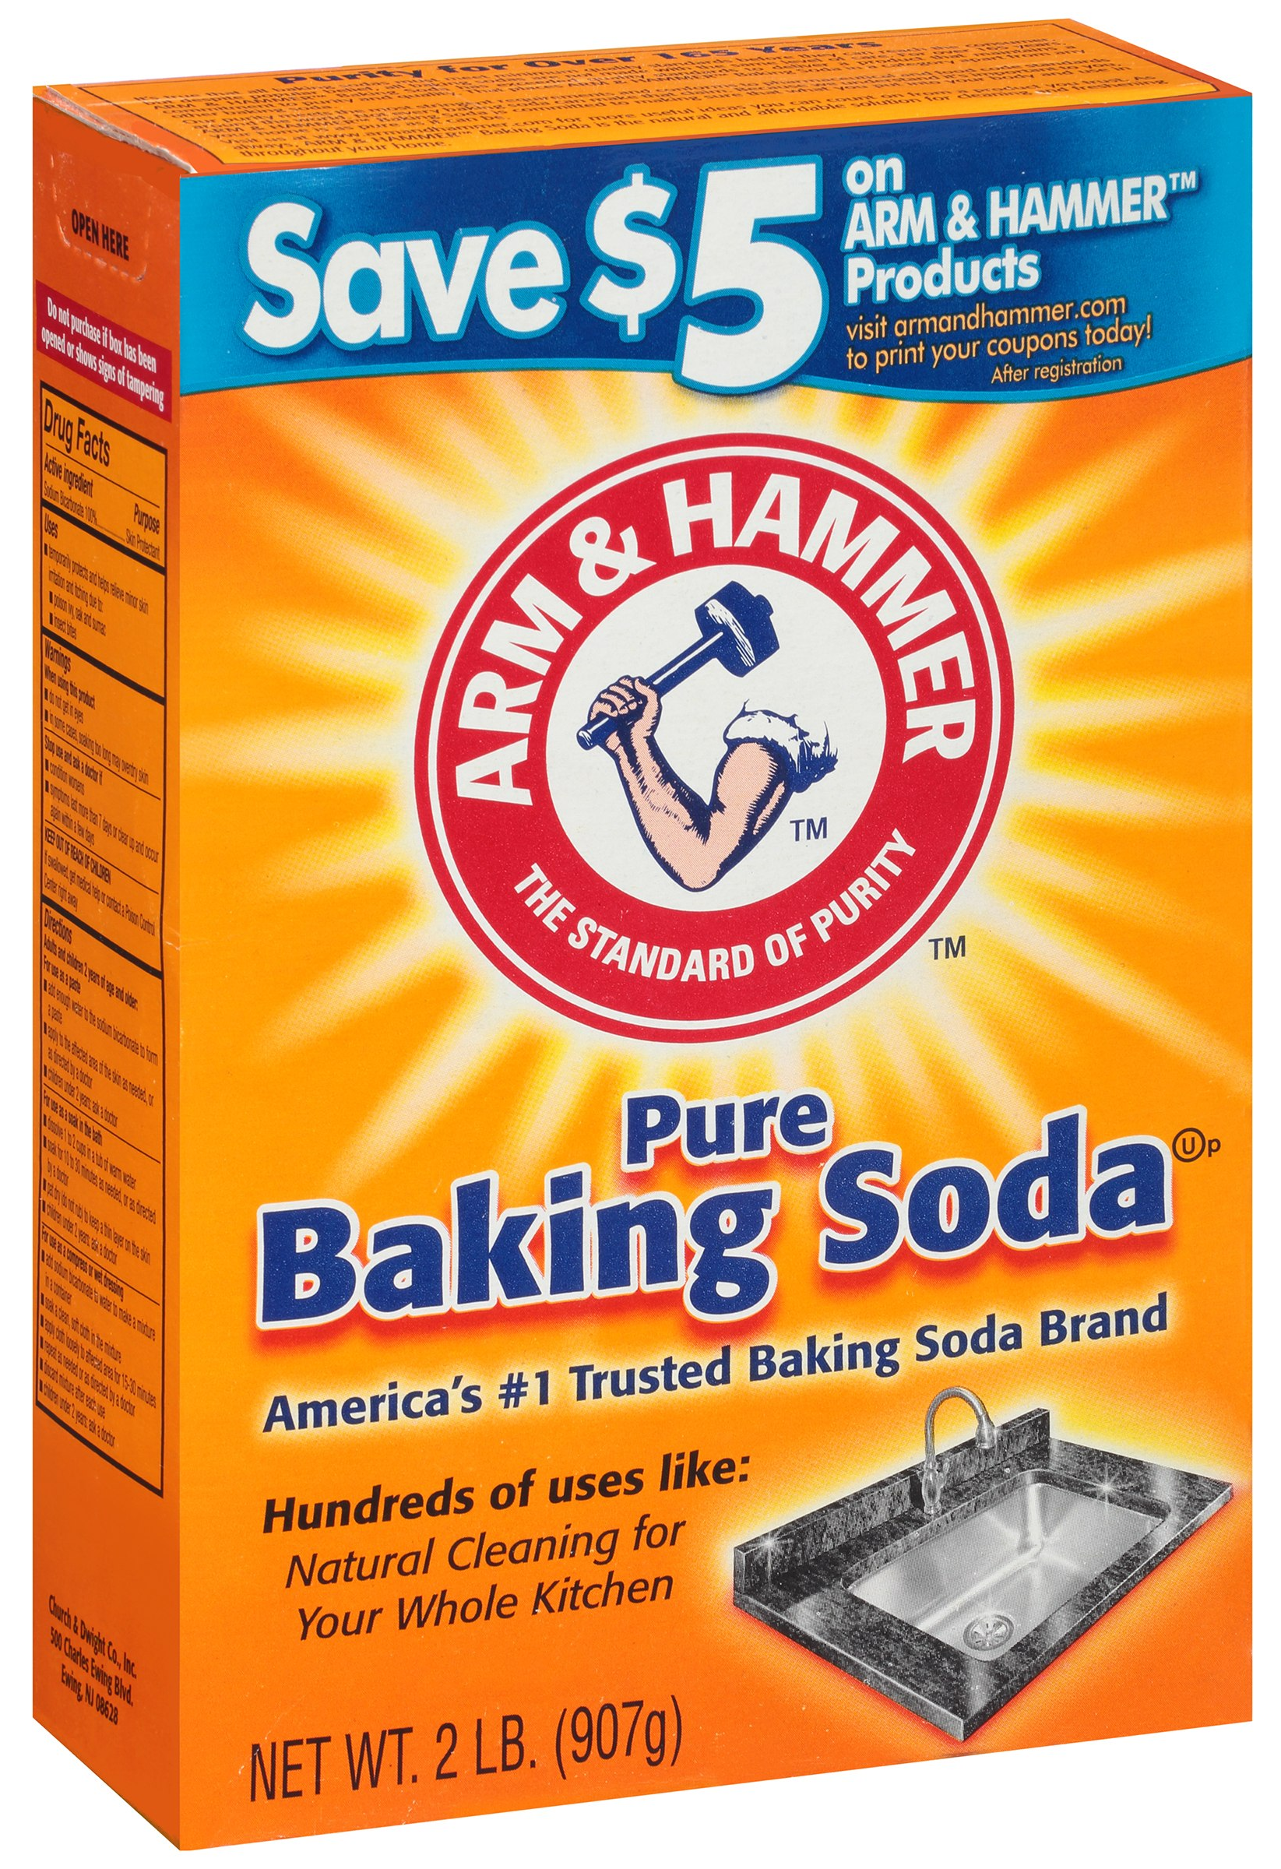
Properties of Bases
Tastes bitter or chalky
Feels slippery or soapy
Can be corrosive
Has a pH greater than 7

Slide 14
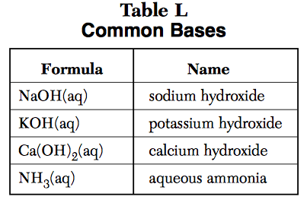
COmmon Bases
Located in TABLE L on the reference table.
Notes:
Talk about nh3 in next lesson

Slide 15
Neutralization Reaction
In the process of neutralization, an acid and a base react to form a salt and water.
HCl(aq) + NaOH(aq) → NaCl(s) + H₂O(l)

Slide 16
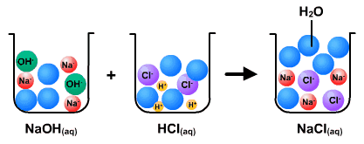
Neutralization
The acid loses its low pH and properties and the base loses it’s high pH and properties to form a salt and water.
The salt and water are neutral with a pH = 7

Slide 17
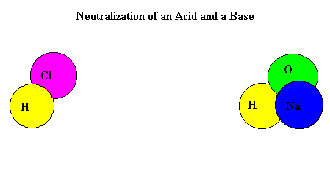
Neutralization

Slide 18
Acid + Base → Salt + Water
HCl + NaOH → NaCl + H₂O
HNO₃ + KOH → KNO₃ + H₂O
H₂SO₄ + Ca(OH)₂ → CaSO₄ + 2H₂O
All neutralization reactions…

Slide 19
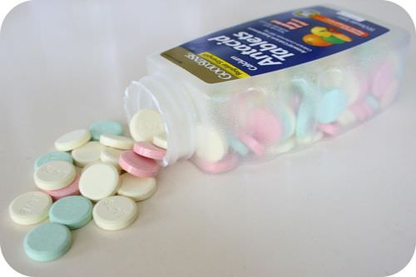
Neutralization example

Slide 20
Define Arrhenius acids and bases.
Identify general properties of acids and bases.
Determine the products of a neutralization reaction.

Slide 21
Alternate Theory of
Acids & Bases

Slide 22
Lesson Objectives:
Define Bronsted Lowry acids and bases.
Compare Arrhenius and Bronsted Lowry acids and bases.
Define amphiprotic substances.

Slide 23
Alternate Acid Base Theory
There are alternate theories used to define acids and bases.
In addition to the Arrhenius theory, there is the Brønsted Lowry theory.
This theory can help explain why NH# is a base with out the hydoxide ion in the formula.

Slide 24
Brønsted Lowry Theory
Acids donate H⁺ ions
Bases accept H⁺ ions
"BAAD” = Bases Accept Acids Donate

Slide 25
Examples
The H₂O (acid) donates a H⁺ to NH₃
NH₃ (aq) + H₂O (l) → NH₄⁺(aq) + OH⁻ (aq)
The NH₃ (base) accepts a H⁺ from water.
H
H
N
H
+
H
H
H
N
H
+
H
O
O
H
H
Notes:
Arrows are tracking proton movement

Slide 26
Brønsted–Lowry: BAAD
Acid: Proton donor
Base: Proton acceptor
Protons refer to hydrogen ions.
H⁺
H

Slide 27
What Happens When an Acid Dissolves in Water?
Water acts as a Brønsted–Lowry base and removes a proton (H⁺) from the acid.
As a result, the conjugate base of the acid and a hydronium ion are formed.

Slide 28
Conjugate Acids and Bases:
Reactions between acids and bases always yield their conjugate bases and acids.

Slide 29
Find the conjugate acid:
NH₃
HS⁻
HSO₄⁻
H₂PO₄⁻
Bases gain H+ to become a conjugate acid!
NH₄⁺
H₂S
H₂SO₄
H₃PO₄

Slide 30
Find the conjugate base:
HClO₄
HCl
H₂SO₄
H₃PO₄
Acids lose H+ to become a conjugate base!
ClO₄⁻
Cl⁻
HSO₄⁻
H₂PO₄⁻

Slide 31
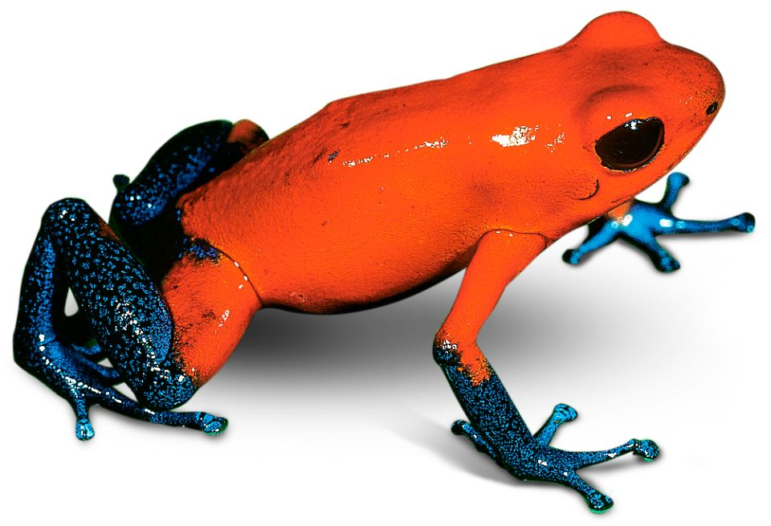
Amphiprotic
An amphoteric substance that is able to act as an acid and a base. So it can donate OR accept a proton.
Examples: H₂O, HSO₄⁻, HCO₃⁻
These all have hydrogen ions to donate and a negative charge.

Slide 32
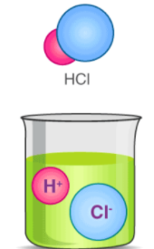
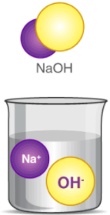
Acid
Base
Arrhenius
H⁺ in H₂O
Bronsted Lowry
H⁺ donor
Arrhenius
OH⁻ in H₂O
Bronsted Lowry
H⁺ acceptor
H⁺
H⁺

Slide 33
You Should Be Able To…
Define Bronsted Lowry acids and bases.
Compare Arrhenius and Bronsted Lowry acids and bases.
Define amphiprotic substances.
Compare stength and concentration

Slide 34
Strength and Concentration

Slide 35
Lesson Objectives:
Compare stength and concentration

Slide 36
Acid and Base Strength
Strong acids and bases are completely dissociated in water to make a lot of H⁺ or OH⁻. These create normal neutralization reactions.
Weak acids and bases only dissociate partially in water to make a small amount of H⁺ or OH⁻.
How is strength different from concentration?

Slide 37
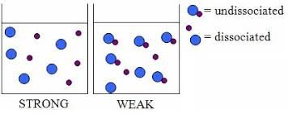
Strength vs. Concentration
Concentration is measured in molarity. (Molarity=mol/L) 1M and higher is considered concentrated.
Strength refers to the ability of the acid or base to dissociate into its ions.

Slide 38
Strong Acids and Bases
Strong Acids: HCl, HBr, HI, HNO₃, HClO₄, H₂SO₄, H₃PO₄
Lose 100% of their H⁺ ions to conduct electricity and react strongly.
Strong Bases: LiOH, NaOH, KOH, RbOH, CsOH, Ca(OH)₂, Ba(OH)₂
Lose 100% of their OH⁻ ions to conduct electricity and react strongly.

Slide 39
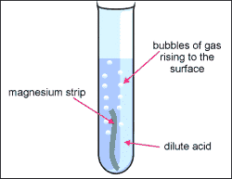
Acids react with metals
Strong acids produced more H₂ than weak acids when they react with the same metal.

Slide 40
Electrolytes & Conductivity
HCl
Notes:
Collision theory- more particles more interactions

Slide 41
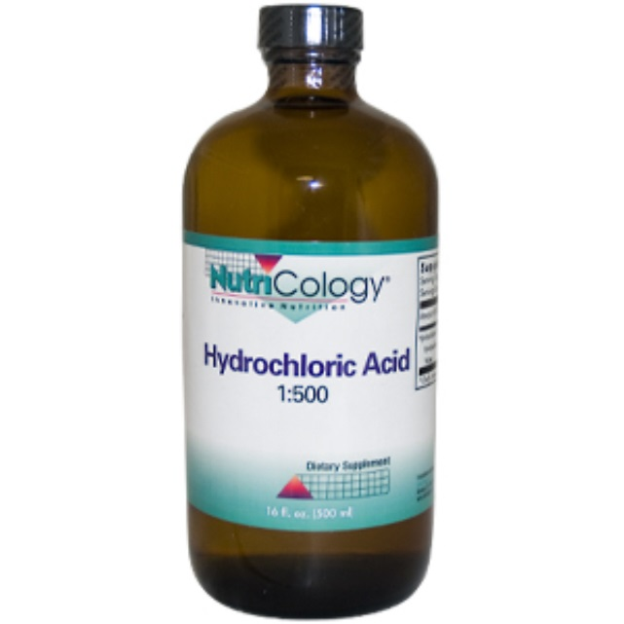
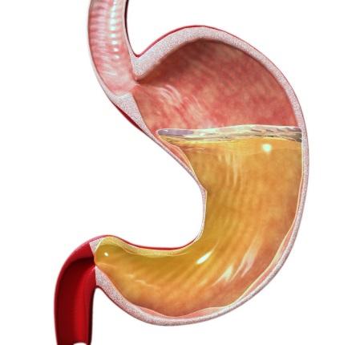
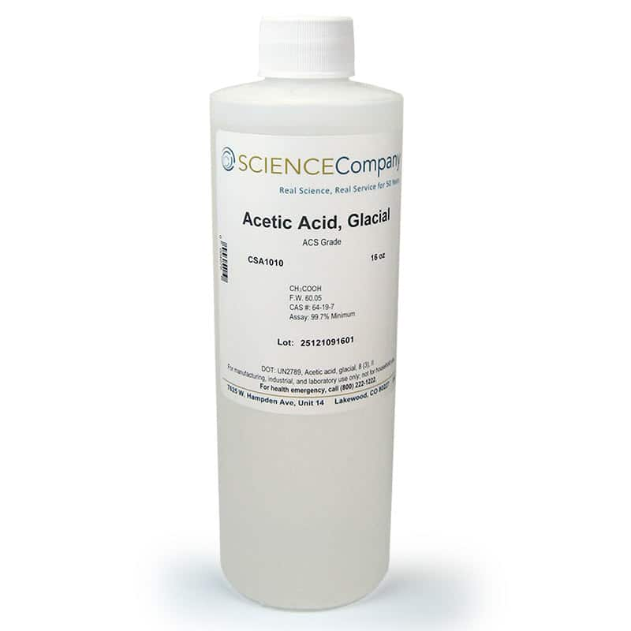
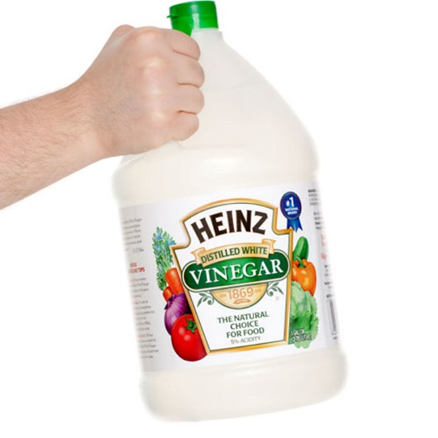
Strength versus Concentration
For each decided if they are weak or strong, and dilute or concentrated.
1.50M HCl 0.20M HCl 18M HC₂H₃O₂ 0.80M HC₂H₃O₂

Slide 42
Factors Affecting Acid Strength
The more polar the bond between H and it’s neighboring element (or the weaker the H-X bond/IMF) the more acidic the compound (it will lose H⁺ better because the other bond is more attracted).

Slide 43
Factors Affecting Acid Strength
In oxyacids, in which an OH is bonded to another atom, Y, the more electronegative Y is, the more acidic the acid.

Slide 44
Factors Affecting Acid Strength
For a series of oxy-acids, acidity increases with the number of oxygen atoms. The increased polarity and strength of the O-X bonds makes the O-H bonds will be weaker and lose H⁺ easier.

Slide 45
Compare concentration to strength

Slide 46
pH

Slide 47
Lesson Objectives
Identify acids and bases based on pH values.
Calculate pH based on change of hydronium ion concentration.

Slide 48
The pH scale
The pH scale provides a way to quantify acidity or basicity based on hydrogen, or hydronium, ion concentration.
Notes:
Anything in a solution of water has a pH value

Slide 49
The pH Scale
The pH scale ranges from 0 - 14. The ratio of H⁺ and OH⁻ determines pH.
0= very acidic [H⁺] > [OH⁻]
7= neutral [H⁺] = [OH⁻]
14= very basic [H⁺] < [OH⁻]

Slide 50
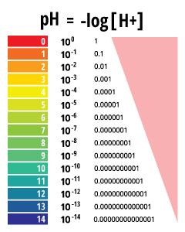
How to Calculate pH
pH=-log[H⁺]
Since pH is logarithmic, there is a 10-fold difference in [H⁺] for every pH level.

Slide 51
Example
A solution with a pH of 6 has 1000 times less hydrogen (hydronium) ions than a solution with pH 3.
*Hint* Remember which way the pH level is going:
higher pH = basic = less [H⁺]
lower pH = acidic = more [H⁺]

Slide 52
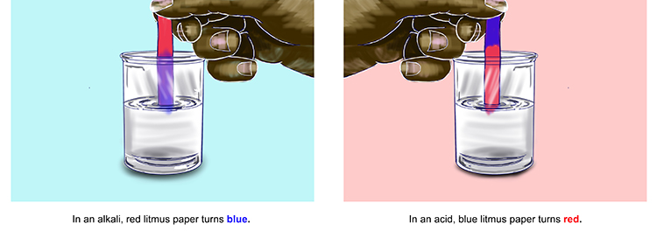
How Do We Measure pH?
For less accurate measurements, one can use litmus paper
OH⁻
H⁺
OH⁻
H⁺

Slide 53
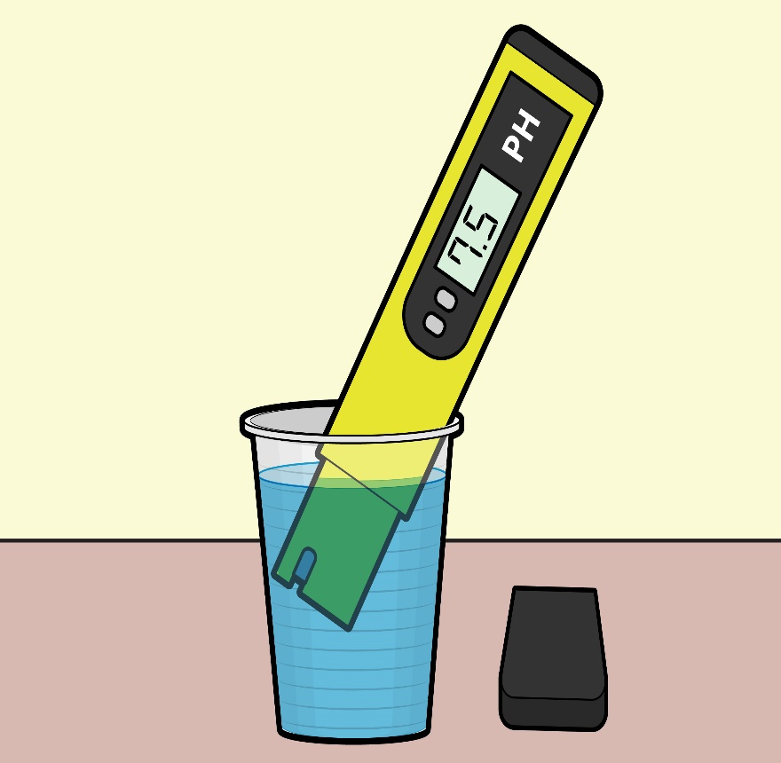
How Do We Measure pH?
Indicators and pH papers like litmus can be used to measure relative pH values.
For more accurate measurements, one uses a pH meter, which measures the voltage in the solution.

Slide 54
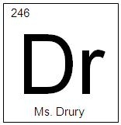
Earth’s Natural Litmus
Hydrangeas are blue when the acidity of the soil is between 5-5.5 and red if the acidity is between 6.5-7.5. A mix of colors can be seen between 5.5-6.5.

Slide 55
Ion-Product Constant
Write the equilibrium expression for water’s ionization reaction: H₂O → H₃O⁺ + OH⁻ K_{c} = [H₃O⁺] [OH⁻]
This special equilibrium constant Is the ion-product constant for water, K_{w} K_{w} = 1.0 × 10⁻¹⁴
Now calculate the [H₃O⁺] and [OH⁻]. In pure water,
K_{w} = [H₃O⁺] [OH⁻] = 1.0 × 10⁻¹⁴ [H₃O⁺] = (1.0 × 10⁻¹⁴)^{1/2} = 1.0 × 10⁻⁷
Because in pure water [H₃O⁺]=[OH⁻], What is the pH of water? How?

Slide 56
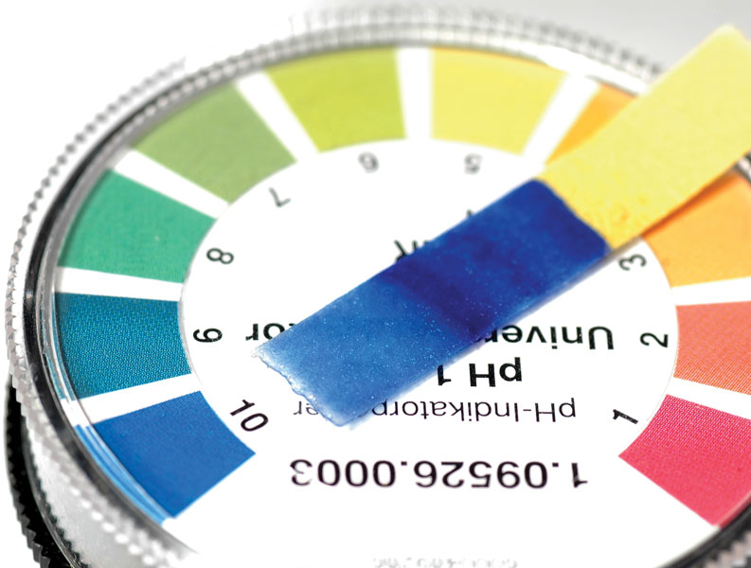
Other “p” Scales
The “p” in pH tells us to take the negative log of the quantity (in this case, hydrogen ions).
pH = -log [H₃O⁺]
pOH= -log [OH⁻]
pH + pOH = 14
[H₃O⁺][OH⁻] = 1.0x10⁻¹⁴

Slide 57
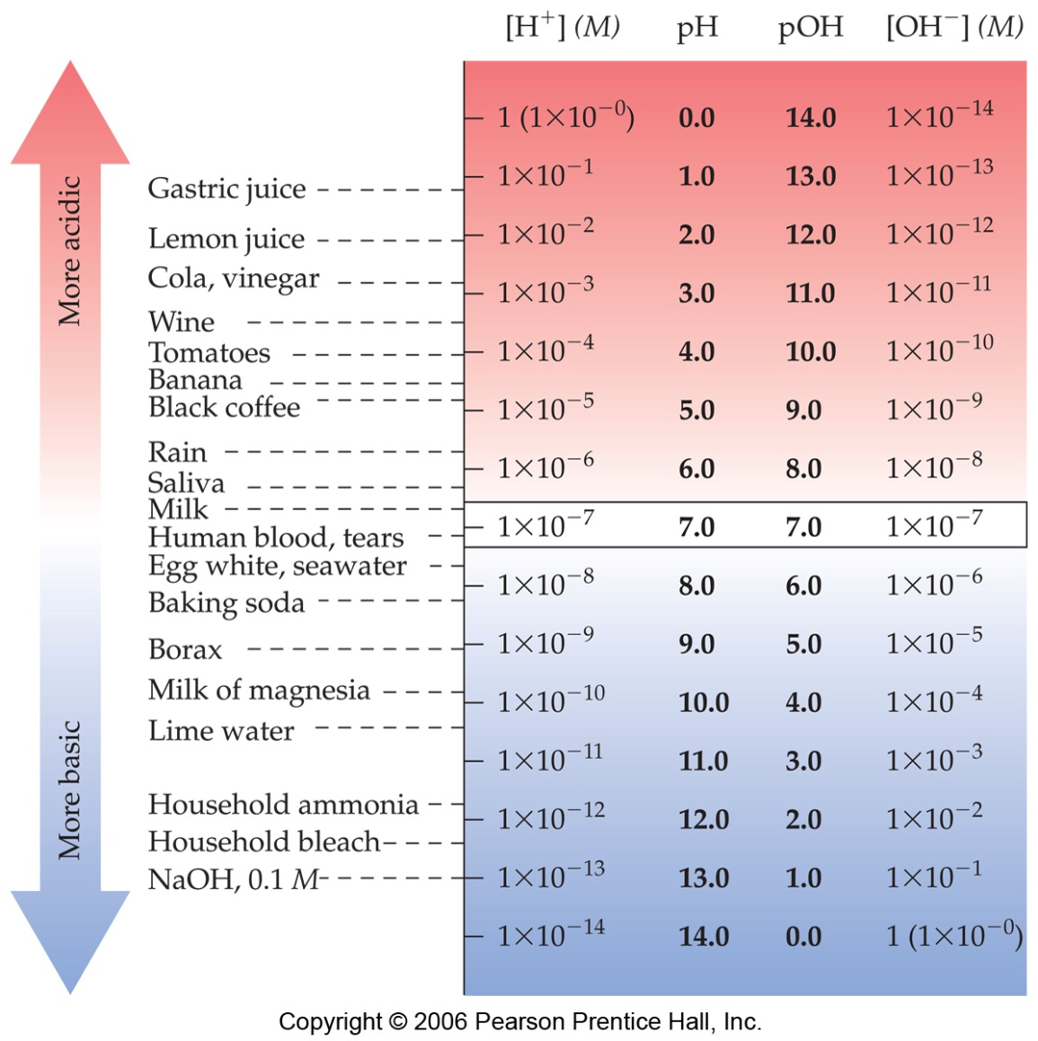

Slide 58
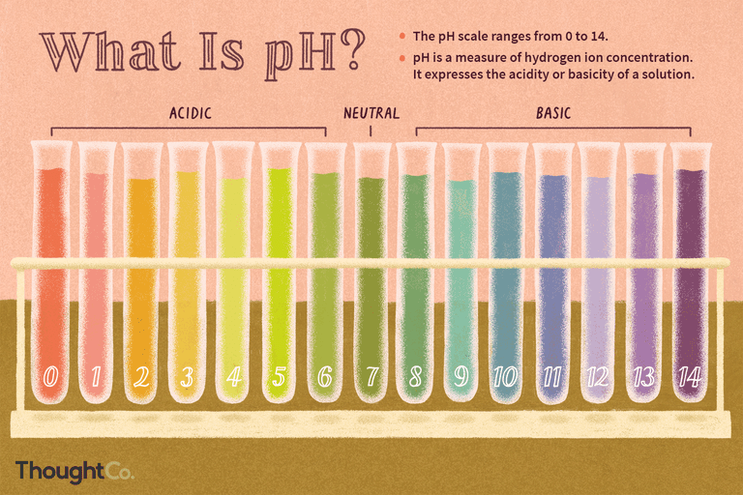
pH and pOH
If the [H₃O⁺] = 1x10⁻³ the pH is 3
If the [H₃O⁺] = 1x10⁻⁹ the pH is 9
If the [OH⁻] = 1x10⁻⁴ the pOH is 4
If the [OH⁻] = 1x10⁻¹² the pOH is 12
If the pH is 3 the pOH is 11
If the pOH is 12 the pH is 2

Slide 59
Strong Acids
You will recall that the seven strong acids are HCl, HBr, HI, HNO₃, H₂SO₄, H₃PO₄, and HClO₄.
These are, by definition, strong electrolytes and exist totally as ions in aqueous solution.
For the monoprotic strong acids, [H₃O⁺] = [acid].
To calculate the pH for strong acids use pH = -log [H₃O⁺]

Slide 60
pH of Strong Acids
If the concentration of HA is 2.5x10⁻³M calculate the pH.
-log(2.5x10⁻³) = 2.60
If the concentration of HA is 3.5x10⁻⁸M calculate the pH.
-log (3.5x10⁻⁸) = 7.46

Slide 61
Strong Bases
Strong bases are the soluble hydroxides, which are the alkali metal and heavier alkaline earth metal hydroxides (Ca⁺² and Ba²⁺).
Again, these substances dissociate completely in aqueous solution. And [Base] = [OH⁻]
pH = 14-(-log[OH⁻])

Slide 62
pH of Strong Bases
If the concentration of MOH is 1.5x10⁻⁴M calculate the pH.
14-[-log(1.5x10⁻⁴)] = 10.18
If the concentration of MOH is 2.2x10⁻¹³ M calculate the pH.
14-[-log (2.2x10⁻¹³)] = 1.34

Slide 63
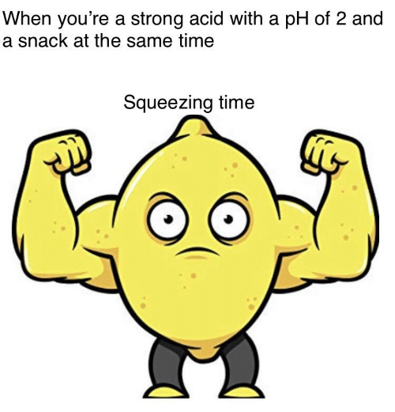
Think
What’s another way to calculate the pH of 2.2x10⁻¹³ M MOH?
1.0x10⁻¹⁴/2.2x10⁻³ = 0.045
-log(0.045) = 1.34

Slide 64
pH square

Slide 65
Identify acids and bases based on pH values.
Calculate pH based on change of hydronium ion and hydroxide ion concentration.

Slide 66
pH of Weak Acids and Bases

Slide 67
Weak Acids
For a generalized acid dissociation,
the equilibrium expression would be
This equilibrium constant is called the acid-dissociation constant, K_{a}.
HA(aq) + H₂O(l)
A⁻(aq) + H₃O⁺(aq)
[H₃O⁺] [A⁻]
[HA]
K_{a} =

Slide 68
Dissociation Constants
The greater the value of K_{a}, the stronger the acid. The strongest acids don’t report Ka values.

Slide 69
Weak Acids
Recall that strong acids completely dissociate, or break down into ions. Therefore the pH is found by taking the –log of the concentration of the acid.
Weak acids do not fully break down. Only a very small portion dissociate into ions. Therefore, we must calculate the number of ions that are present after equilibrium is established and then take the –log of the ions.

Slide 70
Calculating pH from K_{a}
Calculate the pH of a 0.30 M solution of acetic acid, HC₂H₃O₂, at 25°C.
HC₂H₃O₂(aq) + H₂O(l) H₃O⁺(aq) + C₂H₃O₂⁻(aq)
K_{a} for acetic acid at 25°C is 1.8 × 10⁻⁵.
First, write the Ka expression:
[H₃O⁺] [C₂H₃O₂⁻]
[HC₂H₃O₂]
K_{a} =

Slide 71
Calculating pH from K_{a}
The acid will barely dissociate, so put the initial (given) acid concentration in as the equilibrium acid concentration. Solve for the ions.
[H₃O⁺] [C₂H₃O₂⁻]
[HC₂H₃O₂]
(x)²
(0.30)
K_{a} =
1.8 × 10⁻⁵ =
Now we know the ions, we can solve like a strong acid:
(1.8 × 10⁻⁵) (0.30) = x²
2.3 × 10⁻³ = x
2.64
pH = −log [H₃O⁺] = −log (2.3 × 10⁻³) =

Slide 72
Example 1
Calculate the pH of 0.50M HF. (Ka=6.8x10⁻⁴)
[H₃O⁺] [F⁻]
[HF]
(x)²
(0.5)
K_{a} =
6.8 × 10⁻⁴ =
(6.8 × 10⁻⁴) (0.5) = x²
3.4 × 10⁻⁵ = x²
5.8 × 10⁻³ = x
[H⁺] = 5.8 × 10⁻³ M
pH = −log (5.8 × 10⁻³)=
2.23

Slide 73
Example 2
Calculate the pH of 0.90M HF. (Ka=6.8x10⁻⁴)
(x)²
(0.9)
[H₃O⁺] [F⁻]
[HF]
6.8 × 10⁻⁴ =
K_{a} =
(6.8 × 10⁻⁴) (0.9) = x²
6.1 × 10⁻⁴ = x²
2.4 × 10⁻² = x
[H⁺] = 2.4 × 10⁻² M
pH = −log (2.4 × 10⁻²)= 1.61
Notice increasing the concentration
decreased the pH

Slide 74
Weak Bases
Bases react with water to produce hydroxide ion.
[HB] [OH⁻]
[B⁻]
K_{b} =

Slide 75
Weak Bases
K_{b} can be used to find [OH⁻] and, through it, pH of weak bases.

Slide 76
What is the pH of a 0.15 M solution of NH₃?
NH₃(aq) + H₂O(l)
NH₄⁺(aq) + OH⁻(aq)
[NH₄⁺] [OH⁻]
[NH₃]
(x)²
(0.15)
K_{b} =
1.8 × 10⁻⁵ =
(1.8 × 10⁻⁵) (0.15) = x²
2.7 × 10⁻⁶ = x²
1.6 × 10⁻³ = x
[OH⁻] = 1.6 × 10⁻³ M
pOH = −log (1.6 × 10⁻³)= 2.80
pH = 14.00 − 2.80 = 11.20

Slide 77
K_{a} and K_{b}
K_{a} × K_{b} = K_{w} = 1.0x10⁻¹⁴
(Remember [H⁺][OH⁻] = 1.0x10⁻¹⁴

Slide 78
You should be able to…
Calculate the pH of weak acids and bases.

Slide 79
indicators

Slide 80
Lesson Objectives
Determine relative acidity or basicity based on pH indicators from Table M.

Slide 81
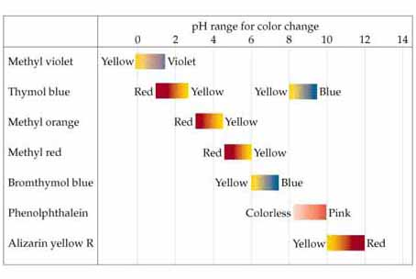
Indicators
Indicators for pH are color changing compounds added in small amounts of solution so that the pH can be determined visually.

Slide 82
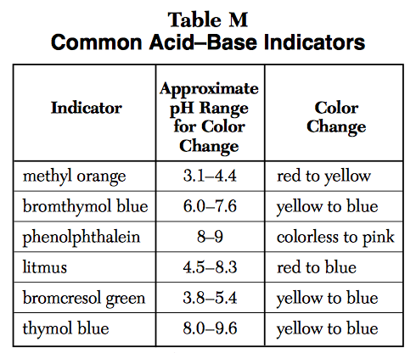
Table M
How to use:
If pH is lower than range = color on the left
If pH is higher than range = color on the right
If pH is between the range = blend of colors
Notes:
Equilibrium shifts

Slide 83
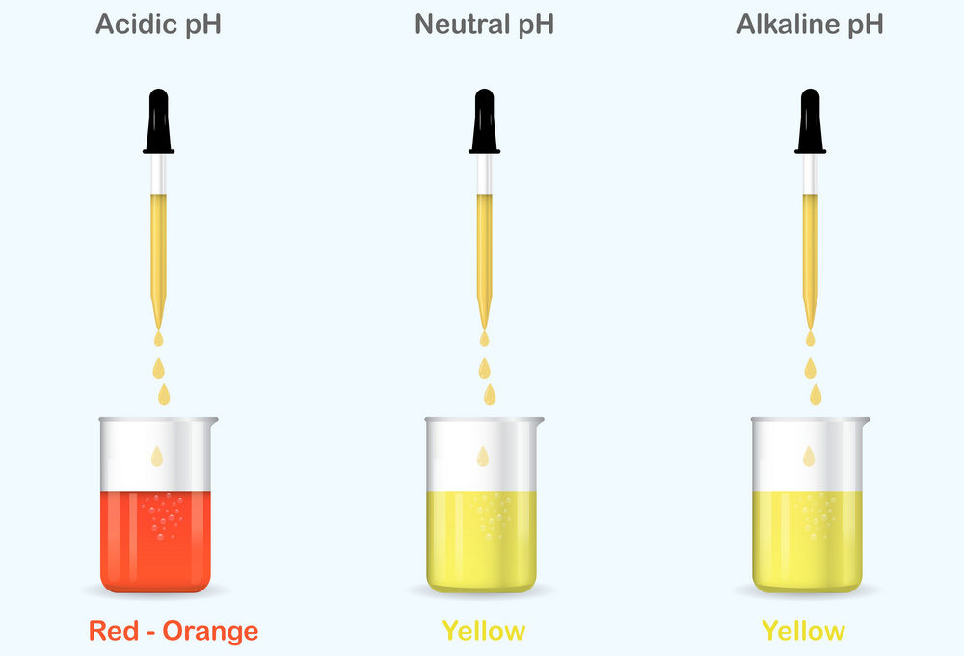
Methyl Orange
H⁺
H⁺
OH⁻
H⁺
OH⁻
OH⁻

Slide 84
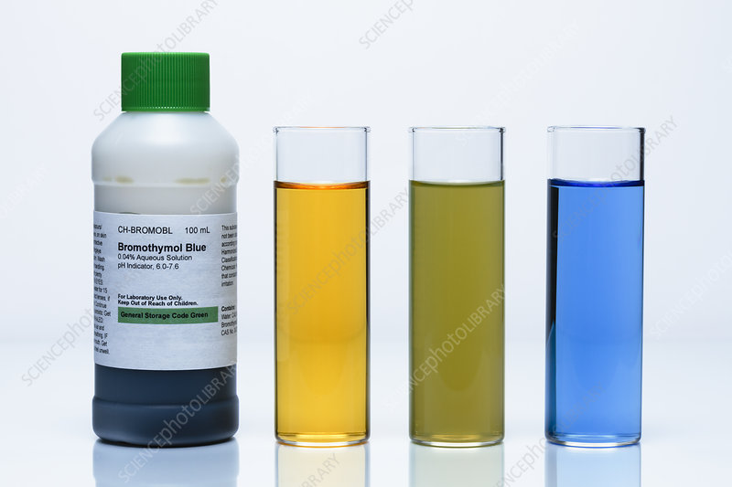
Bromothymol Blue
OH⁻
OH⁻
H⁺
H⁺
H⁺
H⁺
OH⁻
OH⁻
OH⁻
H⁺
H⁺
H⁺
H⁺
OH⁻
OH⁻
H⁺
OH⁻
OH⁻

Slide 85
Example (I do)
A solution turns blue when litmus indicator is added. Is the solution acidic or basic?
The solution is basic (pH above 8.3)

Slide 86
Example (We do)
A solution turns blue when bromothymol blue is added and turns yellow when thymol blue is added. What is the pH range for this solution?
pH between 7.6-8.0
Notes:
Left hand number, left number. Right number, right color
Pool pH strips- or indicators to test

Slide 87
Determine relative acidity or basicity based on pH indicators from Table M.

Slide 88
Neutralization & Titration

Slide 89
Lesson Objectives:
Determine the products of a neutralization reaction.
Calculate the concentration of an unknown solution following a titration reaction.
Calculate the concentration of an unknown solution following a titration reaction with a diprotic solution.

Slide 90
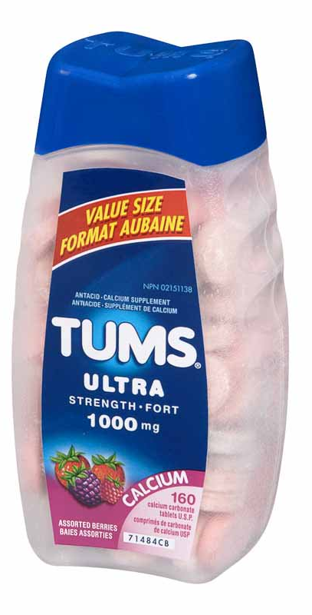
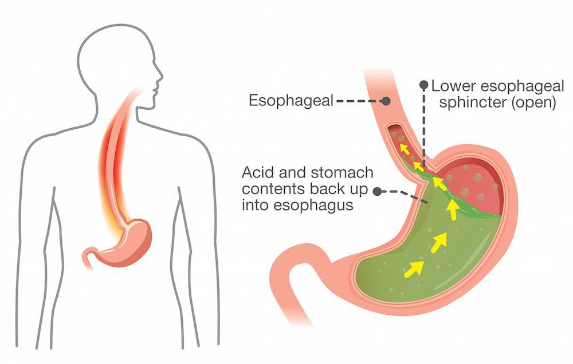
Neutralization Reaction
In the process of neutralization, an acid and a base react to form a salt and water. Recal “salt” is used to refer to any ionic compound.
Notes:
Tums = calcium carbonate

Slide 91
Neutralization Reaction
In the process of neutralization, an acid and a base react to form a salt and water.
HCl (aq) + NaOH (aq) → NaCl (s) + H₂O (l)

Slide 92
Neutralization Reaction
HCl + NaOH → NaCl + H₂O
Let’s break this down….
The hydrogen ions (H⁺) neutralize the hydroxide ions (OH⁻) making water. The leftover ions make a salt.

Slide 93
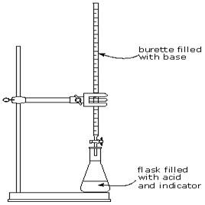
Titrations
A titration is a laboratory process in which a volume of solution of known concentration is used to determine the concentration of an unknown solution. This is done by neutralization.
Indicators are used to determine when the solution has reached the equivalence point, or neutralization point, at which the moles of acid equals moles of base.
The endpoint is when the indicator actually changes color.
You want the endpoint close to the equivalence point.

Slide 94
Set up
A titration requires a special piece of equipment called a burette.
To monitor the neutralization, an indicator is used.

Slide 95
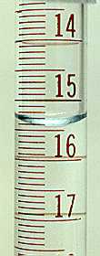
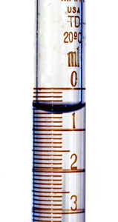
Reading a Burette
Read the burette volumes.
0.6mL
15.4mL
How much acid was released?
15.4-.6 = 14.8mL released from the burette.

Slide 96
OH⁻
OH⁻
OH⁻
OH⁻
OH⁻
OH
OH⁻
Equivalence Point: Neutralized!!
OH⁻
OH⁻
H⁺
OH⁻
H⁺
H⁺
H₂O
H₂O
H₂O
H₂O
H⁺
H⁺
H⁺
H₂O
H₂O

Slide 97
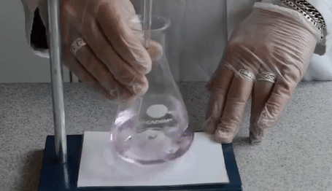
Titration

Slide 98
Titration Calculation
Use Table T!!

Slide 99
Titration Calculation (I do)
If 5.0 milliliters of a 2.0 M HCl solution is required to neutralize exactly 10 milliliters of NaOH, what is the concentration of the base?
M_{a}V_{a}=M_{b}V_{b}
(2 M HCl)(5 ml HCl)=M_{b}(10 ml NaOH)
M_{b}= 1M NaOH

Slide 100
Titration Calculation (We do)
What is the concentration of a solution of HI if 50 ml of HI is titrated to completion with 25 ml of 0.2 M KOH?
M_{a}V_{a}=M_{b}V_{b}
(M_{a})(50 ml HI)=(0.2M KOH)(25 ml KOH)
M_{a}= 0.1M HI

Slide 101
A bit more challenging
A neutralization reaction occurs when H⁺ ions and OH⁻ ions combine together. A 1:1 ratio is needed to make water.
If an acid or base has more than one mole of these ions, it will require twice as much of the other ion to neutralize it.
#M_{a}V_{a}=M_{b}V_{b}#

Slide 102
OH⁻
OH⁻
OH⁻
OH⁻
OH⁻
Endpoint: Neutralized!!
OH⁻
OH⁻
H⁺
H₂O
H₂O
H⁺
H⁺
H₂O
H⁺
H₂O
H₂O
OH⁻
H₂O
H⁺
H⁺
H⁺
H₂O
H₂O
H⁺
H₂O
H⁺
H₂O
H₂O
H⁺
H⁺
H⁺
H₂O
H₂O

Slide 103
Example
Given 15 ml of 2 M H₂SO₄, what volume of 3 M NaOH is required to neutralize the acid?
#M_{a}V_{a}=M_{b}V_{b}#
(2)(2 M)(15 ml)=(3 M)(V_{b})(1)
V_{b}= 20 ml NaOH

Slide 104
Determine the products of a neutralization reaction.
Calculate the concentration of an unknown solution following a titration reaction.
Calculate the concentration of an unknown solution following a titration reaction with a diprotic solution.

Slide 105
Titration Curves

Slide 106
Lesson Objectives:
Identify titration curves and equivalence points.

Slide 107
Titration of Strong Acid with Strong Base
From the start of the titration to near the equivalence point, the pH goes up slowly.
Just before and after the equivalence point, the pH increases rapidly.

Slide 108
Titration of Strong Acid with Strong Base
At the equivalence point, moles acid = moles base, and the solution contains only water and the salt. The pH equals 7.

Slide 109
Titration of Weak Acid with Strong Base
Now, the conjugate base of the acid affects the pH when it is formed. It creates a buffer!
The pH at the equivalence point will be >7.
The weak acid’s titration curve starts at a higher pH and has a slight bump.

Slide 110
Titration of Weak Base with Strong Acid
Again, the conjugate acid affects the pH at the beginning of the reaction due to the formation of a buffer.
The pH at the equivalence point in these titrations is < 7.
The pH starts very high with a base and should have a slight bump.

Slide 111
Identify titration curves and equivalence points

