Slide 1
Thermodynamics

Slide 2
Entropy

Slide 3
Objectives
You should already be able to…
Define heat and energy
By the end of the video you should be able to…
Describe what Entropy is, how it is measured, and compare samples.
Calculate ΔS_{rxn} using ΔS_{f}
Calculate ΔS_{rxn} using Hess’ Law

Slide 4
Spontaneous Processes
Spontaneous processes are those that can proceed without any outside intervention.
The gas in vessel B will spontaneously effuse into vessel A, but once the gas is in both vessels, it will not spontaneously change.

Slide 5
Spontaneous Processes
Processes that are spontaneous at one temperature may be nonspontaneous at other temperatures.
Above 0°C it is spontaneous for ice to melt.
Below 0°C the reverse process is spontaneous.

Slide 6
Spontaneous Processes
Spontaneity depends on two important issues:
Entropy can be thought of as a measure of the randomness of a system.
Enthalpy is the heat change of a reaction.

Slide 7
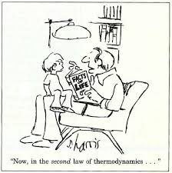
Second Law of Thermodynamics
The second law of thermodynamics states that the entropy of the universe increases for spontaneous processes.

Slide 8
Entropy is dependant on:
Temperature (phase changes) S(g) > S(l) > S(s)
The number of independently moving molecules
Ssolute < Ssolution
The change in phase usually has a larger affect than the number of molecules.
Polarity provides order to the particles because they align themselves like poles of magnets. Entropy decreases when polar molecules form.

Slide 9
Third Law of Thermodynamics
The entropy of a pure crystalline substance at absolute zero is 0.

Slide 10
Standard Entropy
These are molar entropy values of substances in their standard states.
Standard entropies tend to increase with increasing molar mass.

Slide 11
Standard Entropies
Larger and more complex molecules have greater entropies.

Slide 12
Examples
Which has a greater entropy?
NaCl_{(s)} or NaCl_{(aq)}
CO_{2(s)} or CO_{2(g)}
KI_{(aq)} at 45C or 100C
Is the entropy positive (increasing) or negative?
2H_{2(g)} + O_{2(g)} 🡪 2H₂O_{(l)}
NH₄Cl_{(s)} 🡪 NH_{3(g)} + HCl_{(g)}

Slide 13
Entropy
Like total energy and enthalpy, entropy is a state function (dependant on only final and initial conditions, not the changes it takes in between).
Entropy changes for a reaction can be estimated in the same manner by which ΔH is estimated:
ΔS_{rxn}° = ΣS_{f}°(products) - ΣS_{f}°(reactants)

Slide 14
Entropy of Formation Example
Given the values below, calculate the ΔS°_{rxn} of:
C₃H_{8(g)} + 5O_{2(g)} 🡪 3CO_{2(g)} + 4H₂O(l)
C₃H₈ S° = 269.9 J/mol K
CO₂ S° = 213.6 J/mol K
H₂O S° = 69.91 J/mol K
O₂ S° = 205.0 J/mol K
[3(213.6) + 4(69.91)] - [ 269.9 + 5(205.0)] = -374.5 J/mol K
Notice all numbers are nonzero and the units are J/mol K
This only tells us that this reaction decreases in entropy or disorder which may be unfavorable.

Slide 15
YOU MUST BE ABLE TO:
Describe what Entropy is, how it is measured, and compare samples.
Calculate ΔSrxn using ΔSf
Calculate ΔSrxn using Hess’ Law

Slide 16
Gibbs free Energy

Slide 17
Objectives
You should already be able to…
Define enthalpy and entropy
By the end of the video you should be able to…
Describe what Gibbs Free Energy is, how it is measured, and compare samples.
Calculate ΔG_{rxn} using ΔG_{f}
Calculate ΔG_{rxn} using Hess’ Law
Calculate ΔG_{rxn} using ΔG= ΔH-TΔS
Calculate ΔG_{rxn} using ΔG = ΔG° + RT lnQ
Calculate ΔG_{rxn} using ΔG = −RT lnK

Slide 18
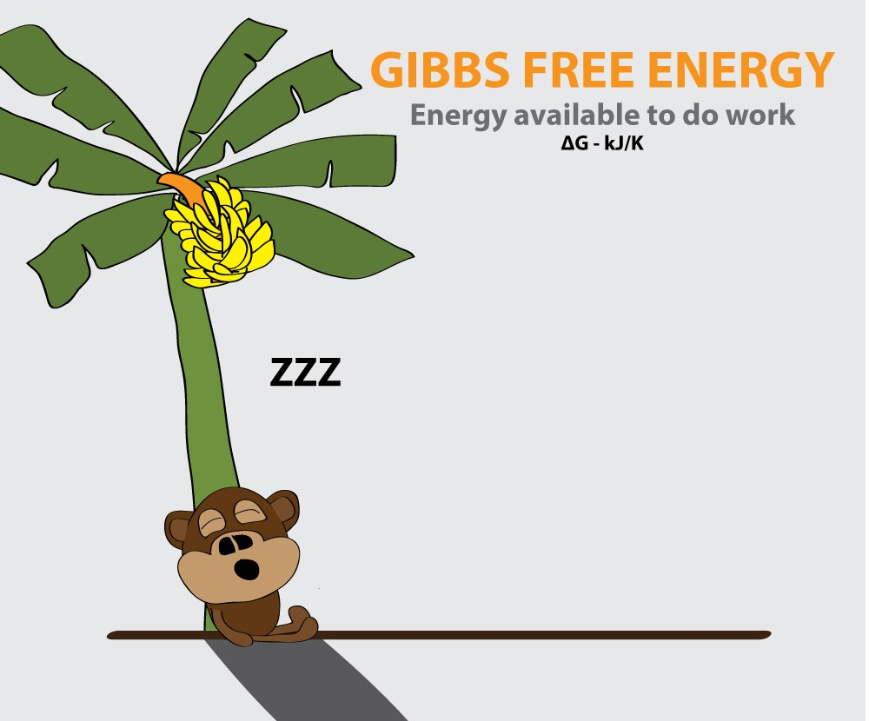
Standard Free Energy Changes
Just like the standard enthalpies and entropies of formation, the standard Gibbs free-energy:
ΔG° = ΣΔG°(products) − ΣΔG°(reactants)
_{r}
_{f}
_{f}
This number can tell you if a reaction is spontaneous or not at a given temperature.
if ΔG°_{rxn} is negative it is spontaneous.
if ΔG°_{rxn} is positive it is not spontaneous.

Slide 19
Gibbs Free Energy of Formation Example
C₃H₈ ΔGf° = -23.47 kJ/mol
CO₂ ΔGf° = -394.4 kJ/mol
H₂O ΔGf° = -237.13 kJ/mol
Given the values below, calculate the ΔG°_{rxn} of:
C₃H_{8(g)} + 5O_{2(g)} 🡪 3CO_{2(g)} + 4H₂O(l)
[3(-394.4) + 4(-237.13)] - [ -23.47 + 5(0)] = -2108.3 kJ/mol
Notice all elements are zero and the units are kJ/mol
This only tells us that this reaction is favorable and spontaneous at THIS temperature. But there is another way…

Slide 20
Gibbs in action Example
Recall from previous lessons:
C₃H_{8(g)} + 5O_{2(g)} 🡪 3CO_{2(g)} + 4H₂O(l)
ΔH°_{rxn} = -2220.0 KJ/mol
Δ S°_{rxn} = -374.5 J/mol
ΔG°_{rxn} = -2108.3 kJ/mol
You can also calculate G using the equation ΔG= ΔH-TΔS
ΔG = -2220.0 – 298(-.3745) = -2108.4kJ/mol
Notice the ΔS had to be modified for units.

Slide 21
Gibbs changes with Temperature ΔG= ΔH −TΔS

Slide 22
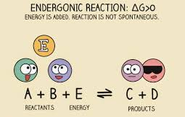
Free Energy and Equilibrium
Under any conditions, standard (298K and 1atm) or nonstandard, the free energy change can be found this way:
ΔG = ΔG° + RT lnQ

Slide 23
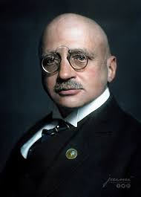
Gibbs and Q Example
Calculate the Gibbs Free Energy of the Haber process at 273K, when [H₂]=1.0M. [N₂]=0.050M and [NH₃]=1.50M. ΔG_{f}° of NH₃ = -33kJ/mol
ΔG = ΔG° + RT lnQ
X = -33000+(8.314)(273) ln (1.50)²
(0.05)(1.0)³
X=-24360J/mol = -24.360kJ/mol
Notice the Units had to match R (8.314J/Kmol).

Slide 24
Free Energy and Equilibrium
ΔG = ΔG° + RT lnQ
At equilibrium, Q = K, and ΔG = 0.
The equation becomes
0 = ΔG° + RT lnK
Rearranging, this becomes
ΔG° = −RT lnK

Slide 25
G and K
Recall that if K>1 the products are favored.. If K<1 the reactants are favored.
If G<1 (or negative) the reaction is spontaneous in the forward direction. If G>1 (or positive) the reaction is spontaneous in the reverse direction.
So, G and K are related. When G is negative, K is over 1. When G is positive, K is less than 1.
If K is 1, what is G and what does that mean?

Slide 26
Gibbs Final Example
The value of equilibrium constant for a reaction equals 45 at 298K. At the same temperature, the reaction not at equilibrium has Q=35. Determine the Gibbs value at 298K and show that the value of G indicates the same direction as Q states.
Q<K which predicts the reaction will proceed forward.
ΔG° = −RT lnK = -8.314(298)ln(45) = -9.43KJ/mol
G is negative, which is spontaneous and favors the forward direction.
ΔG = ΔG° + RT lnQ
= -9430 + 8.314(298)ln(35)
= -620KJ/mol

Slide 27
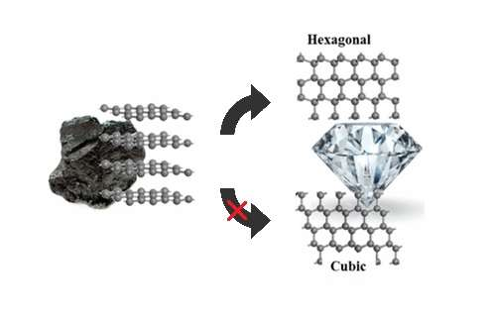
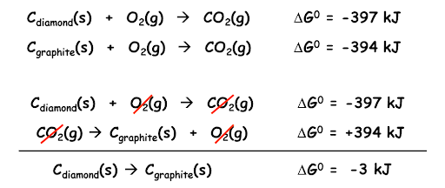
One last thing…
Both Gibbs Free Energy and Entropy can be calculated using Hess’s law like Enthalpy.

Slide 28
YOU MUST BE ABLE TO:
Describe what Gibbs Free Energy is, how it is measured, and compare samples.
Calculate ΔG_{rxn} using ΔG_{f}
Calculate ΔG_{rxn} using Hess’ Law
Calculate ΔG_{rxn} using ΔG= ΔH-TΔS
Calculate ΔG_{rxn} using ΔG = ΔG° + RT lnQ
Calculate ΔG_{rxn} using ΔG = −RT lnK

Slide 29
Electrochemistry

Slide 30
Redox Reactions

Slide 31
Objectives
You should already be able to...
Identify redox reactions.
Assign oxidation numbers for elements and compounds.
By the end of this video you should be able to...
Identify which species are oxidizing and which species are reducing; as well as oxidizing and reducing agents.
Balance redox reactions in acidic and basic solutions.

Slide 32
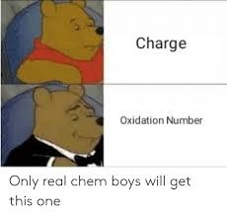
Electrochemical Reactions
In electrochemical reactions, electrons are transferred from one species to another.
In order to keep track of what loses electrons and what gains them, we assign oxidation numbers.

Slide 34
Oxidation and Reduction
A species is oxidized when it loses electrons.
Here, zinc loses two electrons to go from neutral zinc metal to the Zn²⁺ ion.
A species is reduced when it gains electrons.
Here, each of the H⁺ gains an electron and they combine to form H₂.

Slide 35
Oxidation and Reduction
What is reduced is the oxidizing agent.
H⁺ oxidizes Zn by taking electrons from it.
What is oxidized is the reducing agent.
Zn reduces H⁺ by giving it electrons.

Slide 36
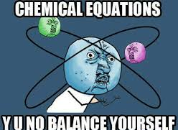
Balancing Oxidation-Reduction Equations like: MnO₄⁻+ C₂O₄²⁻⎯→ Mn²⁺ + CO₂(aq)
The easiest way to balance the equation of an oxidation-reduction reaction is via the half-reaction method or “ion exchange.”
This involves treating (on paper only) the oxidation and reduction as two separate processes, balancing these half reactions, and then combining them to attain the balanced equation for the overall reaction.

Slide 37
Half-Reaction Method
Assign oxidation numbers to determine what is oxidized and what is reduced.
Write the oxidation and reduction half-reactions. (Use the whole compound)
Balance each half-reaction.
Balance elements other than H and O.
Balance O by adding H₂O.
Balance H by adding H⁺.
Balance charge by adding electrons.

Slide 38
Half-Reaction Method
Multiply the half-reactions by integers so that the electrons gained and lost are the same.
Add the half-reactions, subtracting things that appear on both sides.
Make sure the equation is balanced according to mass and charge.

Slide 39
Half-Reaction Method
Consider the reaction between MnO₄⁻ and C₂O₄²⁻ :
MnO₄⁻(aq) + C₂O₄²⁻(aq) ⎯⎯→ Mn²⁺(aq) + CO₂(aq)

Slide 40
Half-Reaction Method
First, we assign oxidation numbers.
+7
+3
+2
+4
MnO₄⁻ + C₂O₄²⁻ ⎯⎯→ Mn²⁺ + CO₂
Since the manganese goes from +7 to +2, it is reduced.
Since the carbon goes from +3 to +4, it is oxidized.

Slide 41
Oxidation Half-Reaction
+ 2e⁻
C₂O₄²⁻ ⎯⎯→ CO₂
To balance the carbon we add a coefficient of 2
The oxygen is now balanced as well. To balance the charge, we must add 2 electrons to the right side.
2

Slide 42
Reduction Half-Reaction
5e- +
8H⁺ +
+ 4 H₂O
MnO₄⁻ ⎯⎯→ Mn²⁺
The manganese is balanced. To balance the oxygen, we must add 4 water molecules to the right side.
To balance the hydrogen, we add 8 H⁺ to the left.
To balance the charge, we add 5 e⁻ to the left side.

Slide 43
Combining the Half-Reactions
Now we evaluate the two half-reactions together:
C₂O₄²⁻ ⎯⎯→ 2 CO₂ + 2 e⁻
5 e⁻ + 8 H⁺ + MnO₄⁻ ⎯⎯→ Mn²⁺ + 4 H₂O
To attain the same number of electrons on each side, we will multiply the first reaction by 5 and the second by 2.
5 C₂O₄²⁻ ⎯⎯→ 10 CO₂ + 10 e⁻
10 e⁻ + 16 H⁺ + 2 MnO₄⁻ ⎯⎯→ 2 Mn²⁺ + 8 H₂O

Slide 44
Combining the Half-Reactions
10 e⁻ + 16 H⁺ + 2 MnO₄⁻ + 5 C₂O₄²⁻ ⎯⎯→ 2 Mn²⁺ + 8 H₂O + 10 CO₂ +10 e⁻
The only thing that appears on both sides are the electrons. Subtracting them, we are left with:
16 H⁺ + 2 MnO₄⁻ + 5 C₂O₄²⁻ ⎯⎯→ 2 Mn²⁺ + 8 H₂O + 10 CO₂
Always check to see if it is balanced for mass and charge!

Slide 45
Balancing in Basic Solutions
If a reaction occurs in a basic solution, one can balance it as if it occurred in an acid solution.
Once the equation is balanced, add OH⁻ to each side to “neutralize” the H⁺ in the equation and create water in its place.
If this produces water on both sides, you might have to subtract water from each side.

Slide 46
Balancing in Basic Solutions
2H₂O
MnO₄⁻ + CN⁻ 🡪 CNO⁻ + MnO₂
MnO₄⁻ 🡪 MnO₂
CN⁻ 🡪 CNO⁻
H₂O + 2MnO₄⁻ + 3CN⁻ 🡪 3CNO⁻ + 2MnO₂ + 2OH⁻
4H₂O
2(
)
3e⁻ +
4OH⁻ +
4H⁺ +
+ 2H₂O
+ 4OH⁻
3(
)
2OH⁻ +
H₂O +
+ 2H⁺
+ 2OH⁻
+ 2e⁻
2H₂O

Slide 47
You must be able to…
Identify which species are oxidizing and which species are reducing; as well as oxidizing and reducing agents.
Balance redox reactions in acidic and basic solutions.

Slide 48
Electrochemical Cells

Slide 49
Objectives
You should already be able to...
Identify and balance redox reactions.
Assign oxidation numbers for elements and compounds.
By the end of this video you should be able to...
Identify the anode and cathode in a voltaic cell.
Explain the use of a salt bridge.
Explain how a battery works in terms of electron and ion transfer.
Calculate the cell’s (batteries’) voltage or EMF.

Slide 50
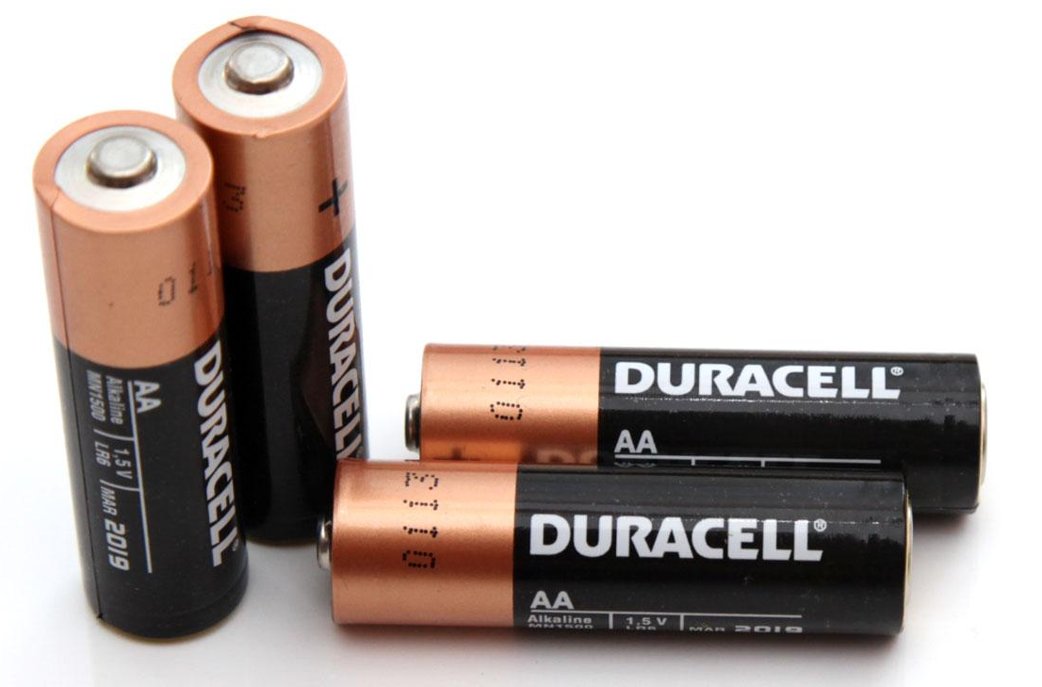
Question of the video:
What is the voltage of a standard AA Duracell battery?

Slide 51
Voltaic Cells
In spontaneous oxidation-reduction (redox) reactions, electrons are transferred and energy is released.

Slide 52
Voltaic Cells
We can use that energy to do work if we make the electrons flow through an external device.
We call such a setup a voltaic cell.

Slide 53
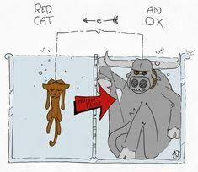
Voltaic Cells
The oxidation occurs at the anode which is negative.
The reduction occurs at the cathode which is positive.
Electrons move from the anode to the cathode.

Slide 54
Voltaic Cells
Once one e- flows from the anode to the cathode, the charges in each beaker would not be balanced and the flow of electrons would stop. Therefore, we use a salt bridge to keep the charges balanced.
Cations move toward the cathode.
Anions move toward the anode.

Slide 55
Voltaic Cells
As the electrons reach the cathode, cations in the cathode are attracted to the now negative cathode.
The electrons are taken by the cation, and the neutral metal is deposited on the cathode. (The cathode gains mass)

Slide 56
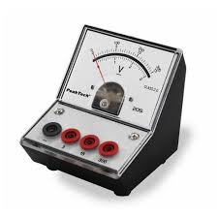
Electromotive Force (emf)
A voltmeter may be placed on the wire connecting the anode and cathode in order to determine the cell’s voltage.
The potential difference between the anode and cathode in a cell is called the electromotive force (emf).
It is also called the cell potential, and is designated E_{cell}.

Slide 57
Cell Potential
J
C
1 V = 1
Cell potential is measured in volts (V).

Slide 59
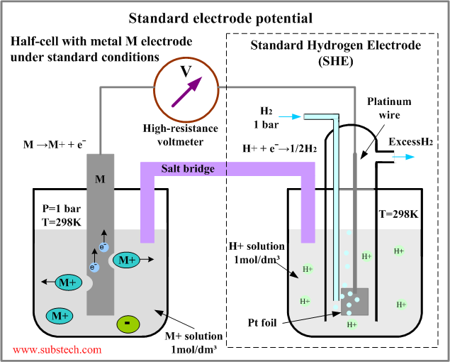
Standard Hydrogen Electrode
The values are referenced to a standard hydrogen electrode (SHE).
By definition, the reduction potential for hydrogen is 0 V:
2 H⁺ + 2 e⁻ ⎯⎯→ H₂
_{* At 1atm and 1M solution}

Slide 60
Standard Reduction Potentials
Reduction potentials for many electrodes have been measured and tabulated.

Slide 61
Standard Cell Potentials
The cell potential at standard conditions can be found through this equation:
We do not multiply any voltages (unlike enthalpies). This is because voltage is dependant on radius of the atoms, not the amount of atoms (intensive or extensive???) However, the length of time the battery works IS dependant on amount of atoms. (This is why car batteries range in price thought they are all made out of the same metals!)
E_{cell}
= E_{red} (cathode) − E_{red} (anode)
°
°
°

Slide 62
Cell Potentials
For the oxidation in this cell,
For the reduction,
°
E_{red} = −0.76 V
°
E_{red} = +0.34 V
E_{cell}
=
E_{red}
c − a
°
°
= +0.34 V − (−0.76 V)
= +1.10 V

Slide 63
Examples
Find the voltage: Cathode-Anode
Zn Zn⁺² H⁺ H₂
H₂ H⁺ Cu⁺² Cu
Zn Zn⁺² Cu⁺² Cu
Can Sn reduce Zn⁺² spontaneously?
Calculate the electromotor force of a cell with an Mg electrode in Mg(NO₃)₂ and Ag in AgNO₃.
0- -.76 = .76V
.34-0 = .34V
.34- -.76 = 1.10V
No. Sn is better at reducing ( a higher reduction voltage) so zinc would oxidize spontaneously, not reduce.
0.80- -2.37 = 3.17V

Slide 64
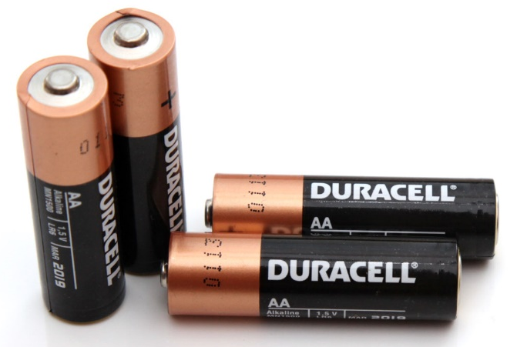
Question of the video:
What is the voltage of a standard AA Duracell battery?
The AA anode is Zn and the cathode is MnO₂.(The electrolyte or “salt bridge” is KOH)
Zn(s) + 2OH⁻(aq) → ZnO(s) + H₂O(l) + 2e⁻ Eox° = +1.28 V
2MnO₂(s) + H₂O(l) + 2e⁻ → Mn₂O₃(s) + 2OH⁻(aq) Ered° = +0.15 V
Zn(s) + 2MnO₂(s) ⇌ ZnO(s) + Mn₂O₃(s) Ecell° = +1.43 V

Slide 65
You must be able to…
Identify the anode and cathode in a voltaic cell.
Explain the use of a salt bridge.
Explain how a battery works in terms of electron and ion transfer.
Calculate the cell’s (batteries’) voltage or EMF.

Slide 66
E, K, G

Slide 67
Objectives
You should already be able to...
Identify and balance redox reactions.
Assign oxidation numbers for elements and compounds.
Calculate voltage
Define Gibbs free energy and equilibrium
By the end of this video you should be able to...
Calculate the Gibbs Free Energy of a cell using
ΔG = −nFE
Calculate the equilibrium constant of a reaction in a cell.
Predict is a cell is spontaneous using voltage, Gibbs Free Energy, and/or the equilibrium constant.
Identify concentration cells and explain how that may give a voltage using the Nernst Equation.

Slide 68
Question of the video:
Recall the voltage of AA batteries was 1.43V. How is that related to the Gibbs free energy and the equilibrium constant?
Zn(s) + 2MnO₂(s) ⇌ ZnO(s) + Mn₂O₃(s)

Slide 69
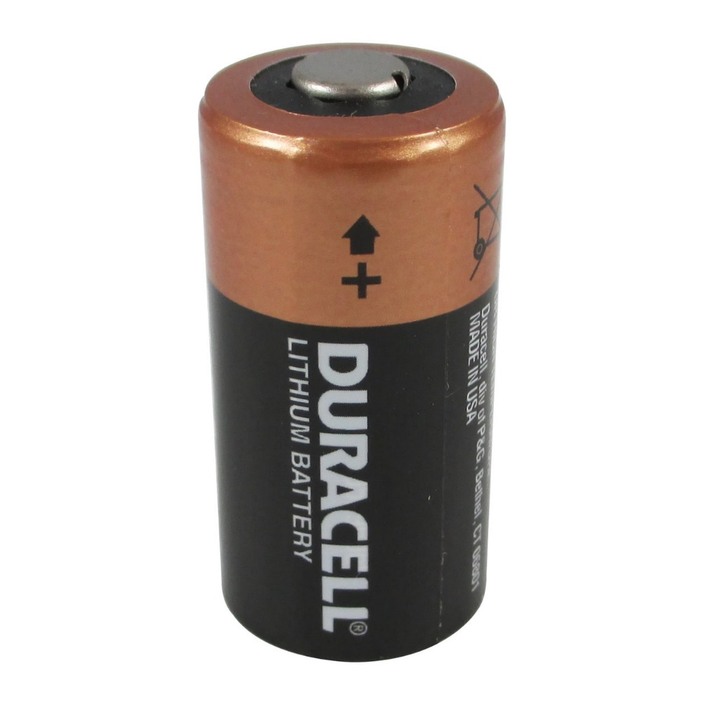
Free Energy
ΔG for a redox reaction can be found by using the equation:
ΔG = −nFE
where n is the number of moles of electrons transferred, and F is a constant, the Faraday.
1 F = 96,485 C/mol = 96,485 J/V-mol

Slide 70
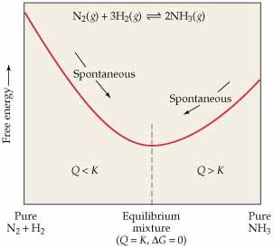
Voltage and K
The emf can be related to the equilibrium constant using this equations:
ΔG = −nFE ΔG =-RTlnK

Slide 71
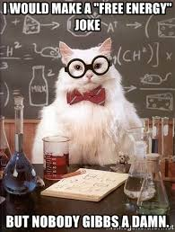
Examples Assume all are at 25C.
Calculate the G for 2Au + 3Ca⁺² 🡪 2Au⁺³ + 3Ca
Calculate the G for 2Al⁺³ + 3Mg 🡪 3Mg⁺² + 2Al
G= -(6)(96500)(-2.87-1.50) = 2530000 J
G= -(6)(96500)(-1.6--2.37) = -411000J

Slide 72
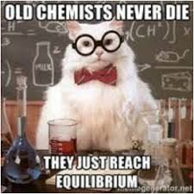
Examples Assume all are at 25C.
Calculate the K for Cu⁺² + Sn 🡪 Sn⁺² + Cu
Calculate the K for Fe⁺² + 2Ag 🡪 2Ag⁺ + Fe
G= -(2)(96500)(.34--.14) = -92640 J
-92640=-8.314(298)lnK K= 1.73x10¹⁶
G= -(2)(96500)(-.44-.80) = 239320 J
239320=-8.314(298)lnK K= 1.12x10⁻⁴²

Slide 73
Summary of G, K and E
Spontaneous | -G | +E (voltage of battery) | K>1 (product favored)
Non Spontaneous | +G | -E (voltage needed) | K<1 (reactant favored)

Slide 74
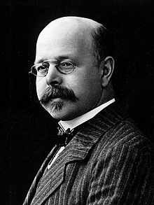
Nernst Equation
RT
nF
E = E° −
ln Q

Slide 75
Examples
RT
nF
ln Q
E = E° −
Predict if Co + Fe⁺² 🡪 Co⁺² + Fe is spontaneous when [Co⁺²]=.15M and [Fe⁺²]=.68M at 25C.
Predict if Cd + Fe⁺² 🡪 Cd⁺² + Fe is spontaneous when [Cd⁺²]=0.10M and [Fe⁺²]=0.60M at 30C.
E = (-.44- -.28) – [8.314(298)]/[2(96500)] ( ln[.15/.68])
-0.16V no.
E = (-.44- -.40) – [8.314(298)]/[2(96500)] ( ln[.10/.60])
-.017V no.

Slide 76
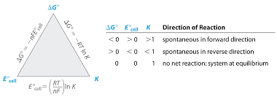
EKG correlation

Slide 77
Concentration Cells
You can have the same substance at both electrodes as long as the concentrations are different. A voltage will be read until the concentrations equalize.
Oxidation always take place at the more dilute solution in a concentration cell. The anode must increase in concentration so
Ni 🡪 Ni⁺²+2e.

Slide 78
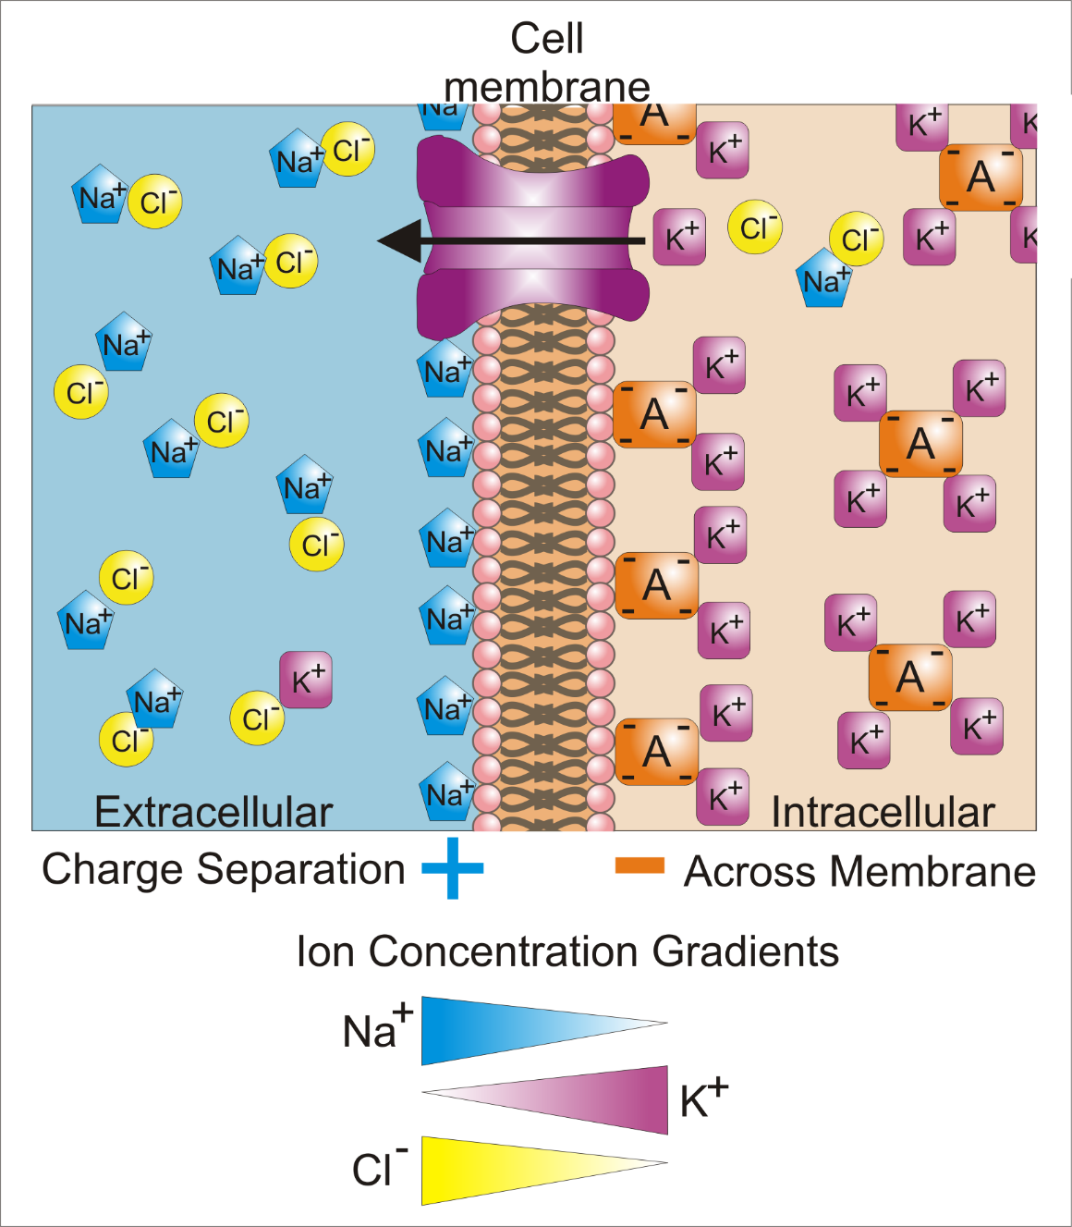
RT
nF
E = E° −
ln Q
If Zn/Zn⁺² (0.10M)//Zn⁺²(1.0M)/Zn
calculate the voltage at 25C.
E= 0 – [8.314(298)] ln (.1/1)
[2(96500)]
E= 0.0296V

Slide 79
Question of the video:
Recall the voltage of AA batteries was 1.43V. How is that related to the Gibbs free energy and the equilibrium constant?
Zn(s) + 2MnO₂(s) ⇌ ZnO(s) + Mn₂O₃(s)
∆G° = -nFE =-2(96500)(1.43) = -276000J/mol
(very favorable: have free energy to release)
∆G°=-RTlnK = -276000 = -8.314(298)lnK
lnK = 11.14
K= 6.89x10⁴ (very favorable: product heavy)

Slide 80
You must be able to…
Calculate the Gibbs Free Energy of a cell using
ΔG = −nFE
Calculate the equilibrium constant of a reaction in a cell.
Predict is a cell is spontaneous using voltage, Gibbs Free Energy, and/or the equilibrium constant.
Identify concentration cells and explain how that may give a voltage using the Nernst Equation.

Slide 81
Electrolysis

Slide 82
Objectives
You should already be able to...
Identify and balance redox reactions.
Assign oxidation numbers for elements and compounds.
By the end of this video you should be able to...
Identify and explain how electrolytic cells work.
Compare and contrast voltaic and electrolytic cells.
Calculate the amperage, voltage, length of time, or the amount of mass generated during electrolysis.

Slide 83
Question of the video:
The lithium-ion battery in a digital camera is .93A. How many gams of Li⁺ ions ,must migrate from the anode to the cathode to produce this energy in one hour?

Slide 84
Electrolytic Cells
If you want to make a non-spontaneous cell operate you can apply voltage to send electrons in the opposite direction. AN OX RED CAT still applies, but electrons may travel from cathode to anode so their charges are reversed (cathode – and anode +). This may be used to revitalize a dead battery.

Slide 85
Electrolytic Cells
Electrolytic cells can also be used to plate substances such as silverware.
The power strip forces electrons to travel to the spoon. The spoon is negative and will attract Silver ions. The silver ions will reduce onto the spoon, plating it.
Remember: reduction takes place at the cathode, which is negative. In this case, electrons travel from anode to cathode. Cathodes increase in mass.

Slide 86
Electrolysis of water
Water and other solutions can be electrolyzed in order to break them into their pure elemental state.
2H₂O 🡪 2H₂ + O₂
Notice more oxygen is being formed.
H⁺ is reduced to H₂ at the cathode
O⁻² is oxidized to O₂at the anode.

Slide 87
Electrolysis of Salts
A brine solution, NaCl_{(aq)}, is zapped with electricity to separate. However, the diagram shows H₂ and Cl₂ gases evolve, Not sodium metal. The Na⁺ ions stay in solution. Why?
Using your reduction tables, Water is better at reducing than sodium so the water in the solution reduces instead of sodium.
2H₂O + 2e⁻ 🡪 H₂ + 2OH⁻ -.83V
Na⁺ + e⁻ 🡪 Na -2.71V

Slide 88
Electrolysis of Salts
Chlorine is worse at oxidizing than H₂O, however, the solution is basic so the H₂O reaction will not work as well.
Cl₂ + 2e⁻ 🡪 2Cl⁻ 1.36V
O₂ + 4H⁺ + 4e⁻ 🡪 2H₂O 1.23V
So, just because electricity is used to separate a salt, it doesn’t mean the salt will separate. The water may get in the way! ☹

Slide 89
Impurities
If a mixture of metals need to be purified, the mixture can be connected to the anode where oxidation occurs.
The element better at reduction will be forces to oxidize by the battery. Then it will reduce onto the pure metal cathode. Thus, a separation of the two metals will occur.

Slide 90
Comparison
Voltaic
Electrolytic
An Ox, Red Cat
Electrons flow A🡪 C
Spontaneous
Makes electric
Salt bridge
Anode -, cathode +
Chemical energy spontaneously changes to electricity
An Ox, Red Cat
Electrons flow A🡪 C
Not Spontaneous
Needs electric
No Salt bridge, same container
Anode +, cathode –
Electric energy changes to chemical energy

Slide 91
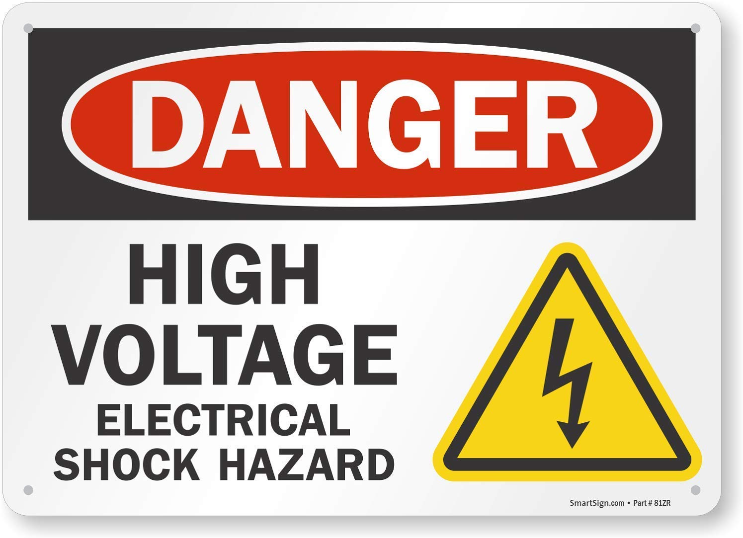
Voltage Needed
To reverse a spontaneous reaction, it takes more voltage that that reaction normally creates.
Similarly, to make a non-spontaneous reaction occur, you need a voltage higher that one calculated by subtracting the anode emf from the cathode emf.

Slide 92
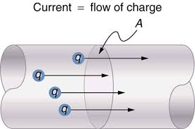
Current
Any time electrons are flowing through a wire, a measureable current (I) is created measured in amps.
I=q/t q = charge(coulombs-C) t = time(s)
One mole of electrons creates 96,500C or 1 Faraday(F).
I just remember Coulombs = Amps * Time (s)
-OR-
C=ATs

Slide 93
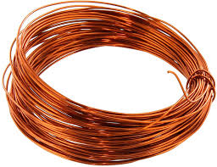
Examples
How many moles of electrons are transferred when a current of 12 amps is applied for 16 hours?
How many grams of copper will be deposited by the passage of 3.0A for 2 hours?
(12)(16*60*60)=691200C
691200C/96500 = 7.2 moles of electrons
(3)(2*60*60) = 21600C/96500C = 0.224moles of electrons
Cu⁺² + 2e⁻ 🡪 Cu 0.224/2 (63.5g) = 7.11g Cu

Slide 94
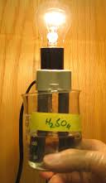
Examples
3. 1.26A ran for 7.44 hours in sulfuric acid. Calculate the volume of a gas evolved at STP.
1.26(7.44*60*60) = 33747C/96500C = 0.350 moles of e-
Anode: 2H₂O 🡪 O₂ + 4H⁺ + 4e⁻
Cathode: 2H⁺ +2e⁻ 🡪 H₂
Overall: 2H₂O 🡪 2H₂ + O₂
2(
)
0.350 moles of e/4e- = 0.0875 (2H₂)(22.4L) = 3.92L

Slide 95
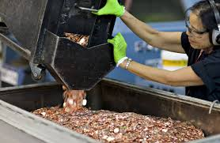
Electrolysis: Coating a penny
4. To coat a penny, 0.10 grams of Cu must be deposited from Cu⁺² ions. If the current is 2A, how long would the battery need to be operating?
0.10g/63.55g = 0.00157 moles Cu * 2 mole e- = 0.00315mole e-
0.00315mole e- * 96500 = 304C
304C = 2A (x) x = 152s

Slide 96
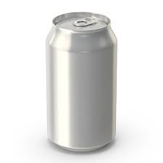
Aluminum Can
A standard Aluminum soda can contains about 15.0 grams of Aluminum coating. If it is plated using 10A, how long will it take to create the can?
We need more Amps and use pure ore (Al₂O₃) from Arizona and Puerto Rico. This amount of energy needed to make a can should make you want to recycle!!!
15.0g/26.98g = .556 mol Al x 3e- = 1.67 mole e-
1.67 e- * 96500 = 161000C
161000C = 10A (x) x = 16100s (4.5h)

Slide 97
Question of the video:
The lithium-ion battery in a digital camera is .93A. How many gams of Li⁺ ions ,must migrate from the anode to the cathode to produce this energy in one hour?
C=At(s)
C=(.93)(3600) = 3337C
3348C x 1mole e- x 1 mole Li⁺ x 6.94g = 0.241g
96500C 1 mole e- 1 mole Li

Slide 98
You must be able to…
Identify and explain how electrolytic cells work.
Compare and contrast voltaic and electrolytic cells.
Calculate the amperage, voltage, length of time, or the amount of mass generated during electrolysis.

