Slide 1
Organic Chemistry Introduction
Video 10.1

Slide 2
Organic versus Hydrocarbon
Organic molecules must have the element C.
Hydrocarbons can only have the elements H and C.
Therefore hydrocarbons are organic but not all organic compounds are hydrocarbons:
CH₄ is a hydrocarbon and is organic
CCl₄ is organic but not a hydrocarbon
O₂ is neither organic nor a hydrocarbon

Slide 3
Organic molecules
Found in fossil fuels, plants and animals.
Examples include gasoline, oil, kerosene, butane, propane…

Slide 5
Hydrocarbon Properties
Mostly insoluble (nonpolar)
Non-electrolytes (do not conduct electricity)
React very slowly because they are covalent (nonmetals only).
As size increases, the melting point and boiling point of the hydrocarbons increase.
Small hydrocarbons may be gases and large hydrocarbons may be solids at room temperature.

Slide 6
Organic Molecules
Table P shows your prefixes to determine how many Carbon atoms a compound has.

Slide 7
Give the prefix for the following:
C₂H₆
C₃H₆
C₄H₆
C₅H₁₂
C₆H₁₂
C₇H₁₄
C₈H₁₈
C₉H₁₆
C₁₀H₂₀
Eth
Prop
But
Pent
Hex
Hept
Oct
Non
Dec

Slide 8
Saturation
Compounds like fats that are saturated have many hydrogen atoms. This requires single bonds. Alkanes are saturated with single bonds.
Compounds that are unsaturated have double and triple bonds, therefore, they have less hydrogen atoms. Alkenes and alkynes are unsaturated.

Slide 10
Cyclic hydrocarbons
To name them, use the prefix “cyclo”:
A four member ring is cyclobutane
A five member ring is cyclopentane
A six member ring in cyclohexane

Slide 11
benzene
An important aromatic hydrocarbon is benzene.
It has alternating double and single bonds.
It is very stable and gives off pleasant odors like cinnamon and vanilla. (“aroma”)

Slide 12
Other groups
More groups can be on the ring/branch such as:
F fluoro
Cl chloro
Br bromo
I iodo

Slide 13
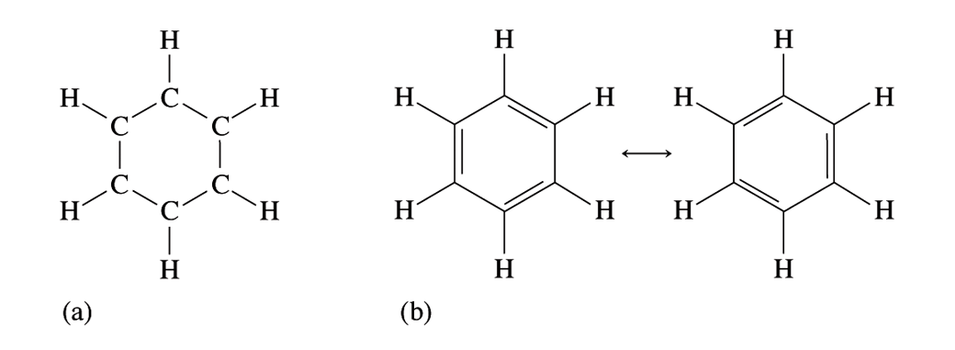
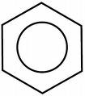
Benzene substitution
The benzene ring consists of 6 carbons in a ring of alternating double and single bonds.
When substituted once, just use prefixes such as methylbenzene:

Slide 14
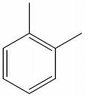
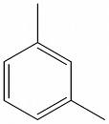
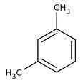
Benzene substitution
When the benzene is substituted twice you can number the groups:
1,2 dimethyl benzene 1,3 dimethyl benzene
Name:
1, 3 di methyl benzene!

Slide 15
Halides
Chloro-Fluoro-Carbons destroy the ozone layer
1, 2 dibromo ethane

Slide 16
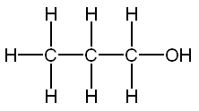
Alcohol
Suffix: -ol
Flammable, soluble

Slide 17
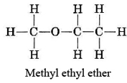
Ether
Suffix: -ether
Anesthetic, soluble

Slide 19
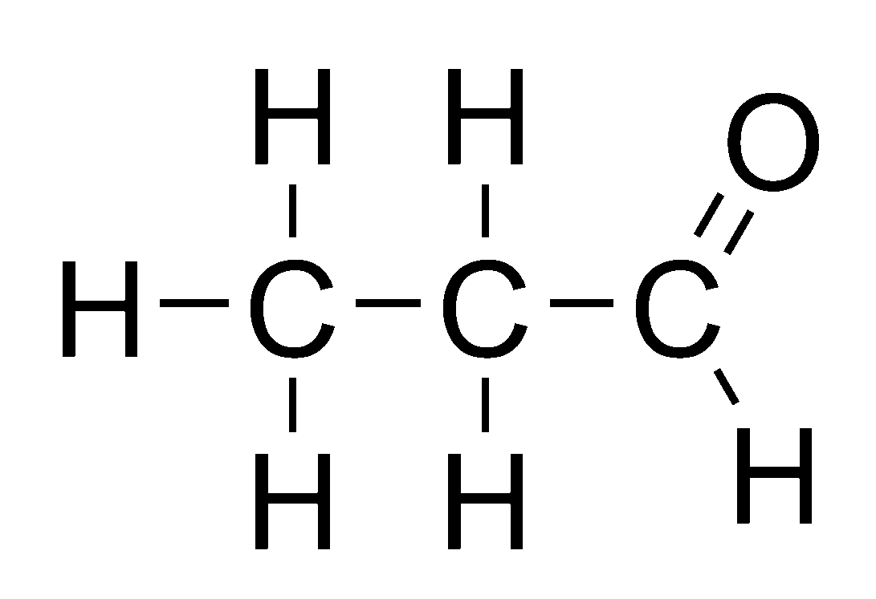
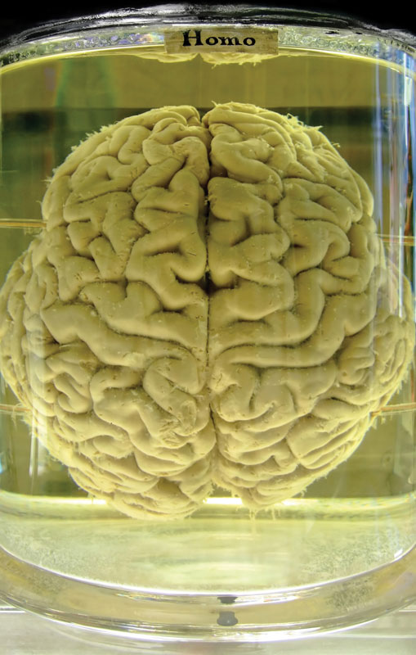
Aldehyde
Suffix: -al
Soluble, preserve specimens

Slide 20
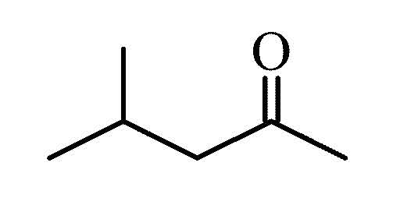
Keytone
Suffix: -one
Dissolves substances that water will not

Slide 21
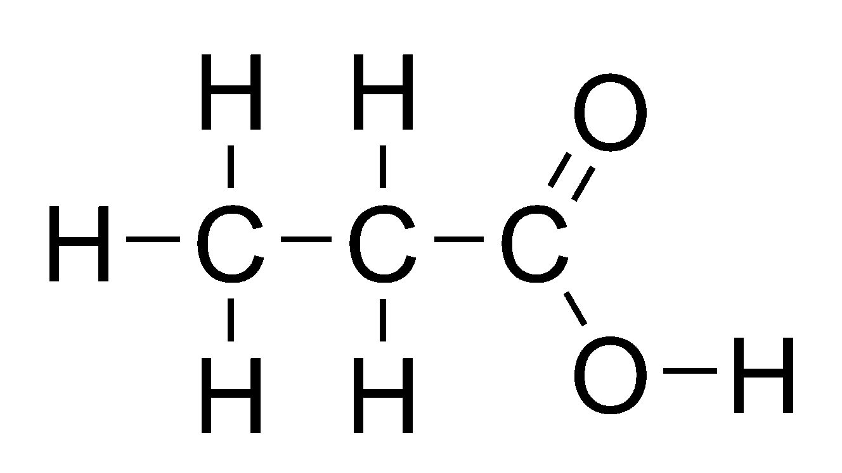
acids
Suffix: -anoic acid
Weak acids, edible.

Slide 22
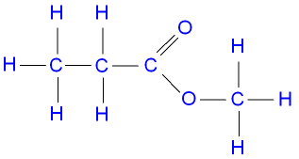
Esters
Suffix: -anoate
Smells great (perfumes, foods)

Slide 23
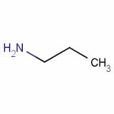
Amine
Nitogen is present
Prefix: amino-
Found in proteins: DNA

Slide 24
Amine

Slide 25
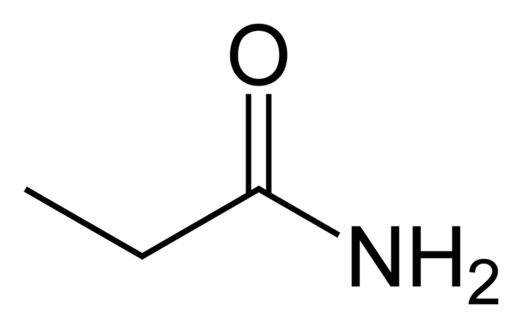
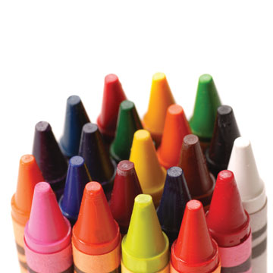
Amide
Suffix: -amide
Used in dyes

Slide 26
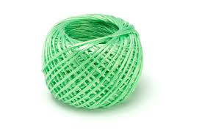
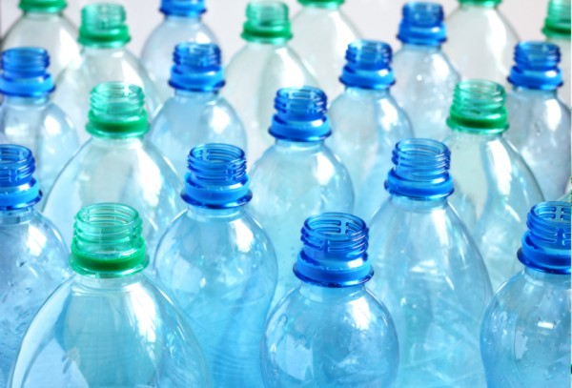
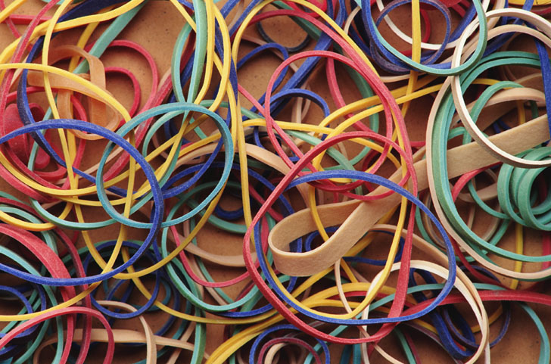
Polymers
Long Carbon chains
(C₂H₄)_{n}
Used in all plastics, runner, nylons…

Slide 27
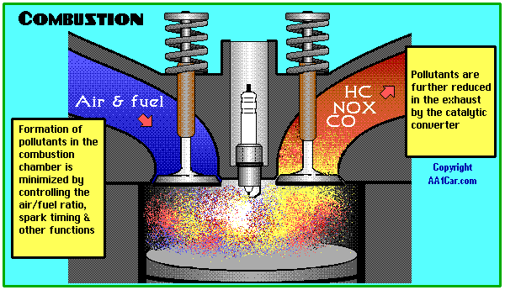
Combustion
An organic compound is burned in the presence of oxygen to form CO₂ and H₂O only.
CH₄ + 2O₂ → CO₂ + 2H₂0

Slide 28
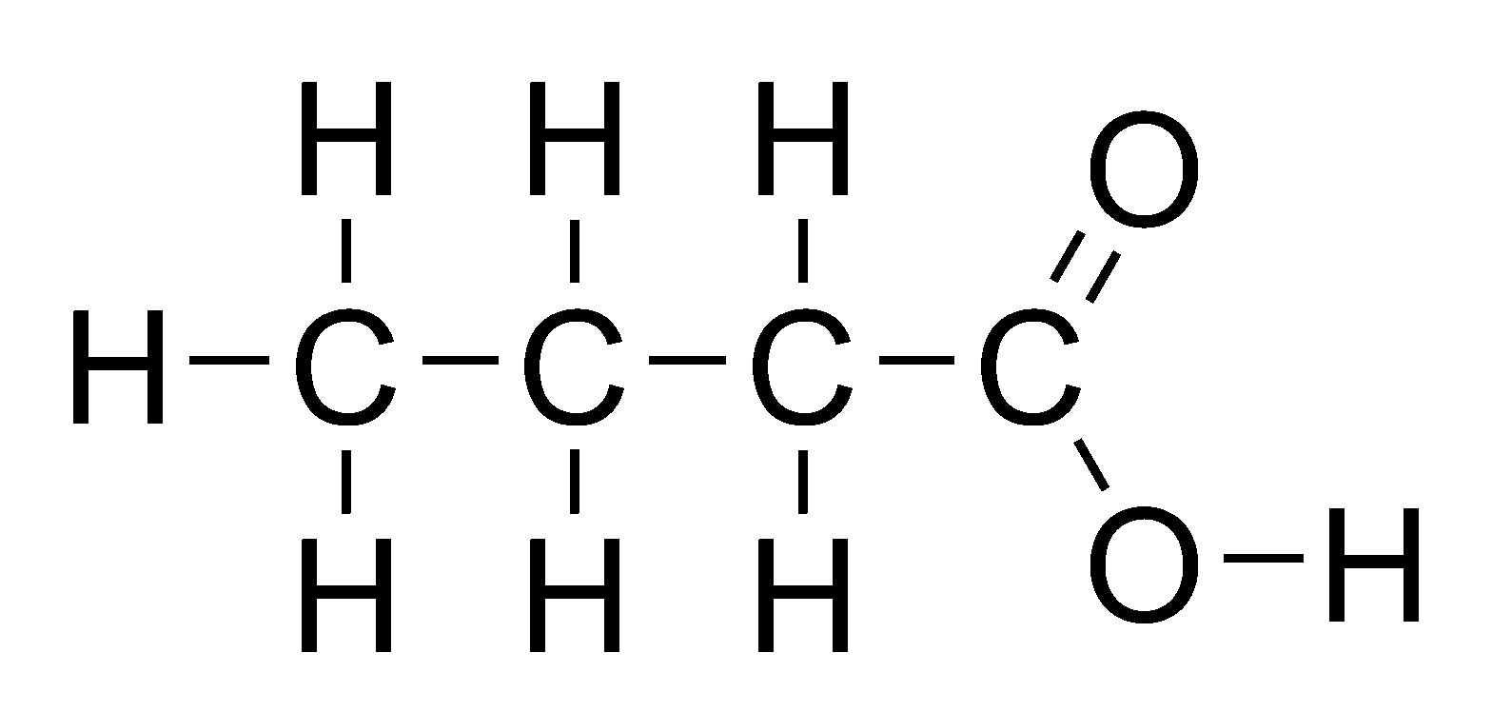
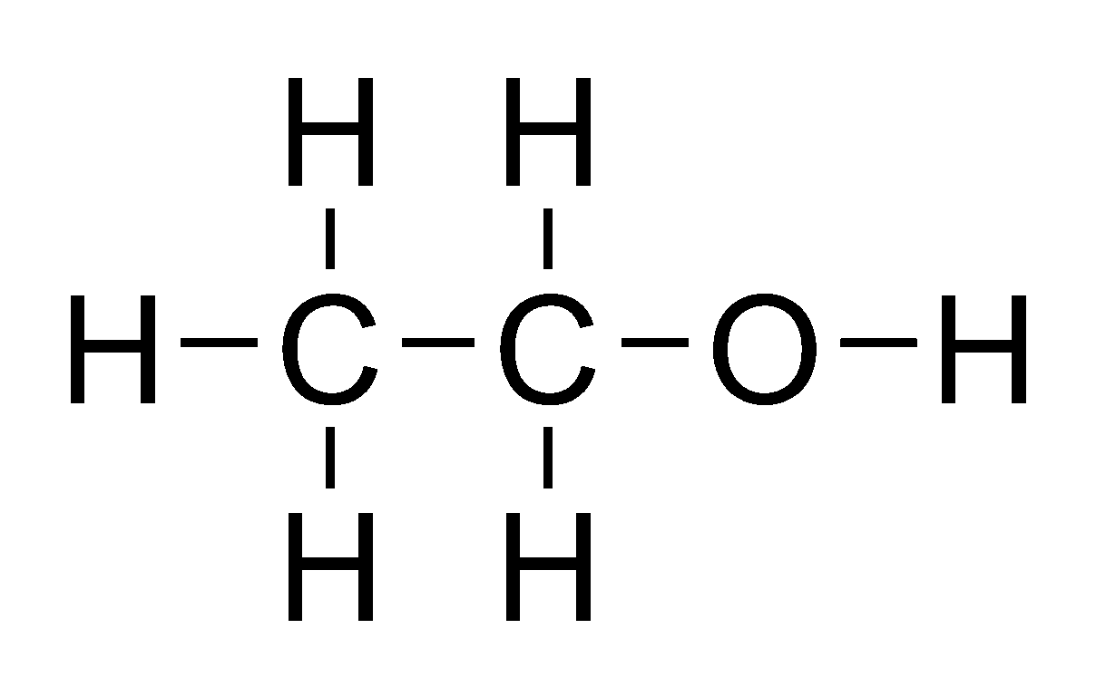
Esterification
An ester is formed after the reaction of an organic acid and an alcohol
C₃H₆COOH + C₂H₅OH → C₃H₆COOC₂H₅ + H₂O

Slide 29
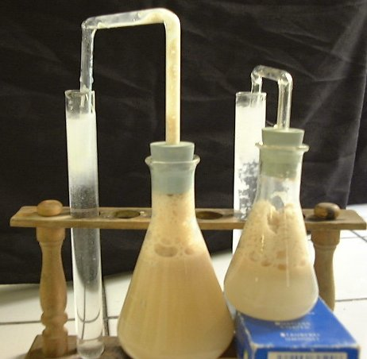
Fermentation
Alcohol is formed from the decomposition of sugar. This takes a long time so yeast is often used as a catalyst. The sugar can be from grapes, rice, etc.
C₆H₁₂O₆→ 2C₂H₅OH + 2CO₂

Slide 30
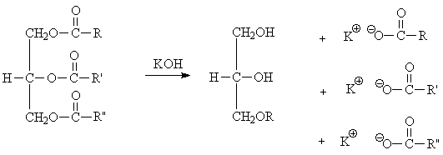
Saponification
Saponification: Bases added to fats yield glycerol and soap. Look for large molecules and bases!

Slide 31
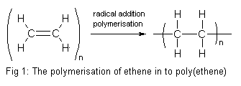
Polymerization: used in plastics
Addition Polymerization: Adding two small alkenes (such as ethene) together by breaking the double bond, to create a large chain.

Slide 32
Polymerization
Condensation Polymerization: Adding acids and alcohols by extracting water.

Slide 33
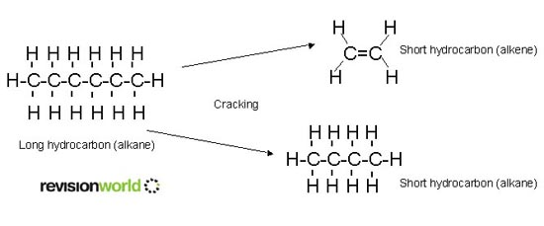
Cracking
Breaking large hydrocarbons into smaller chains by heating them.
Fossil fuels are cracked into many components such as octane (gasoline) propane, etc.

