Slide 1
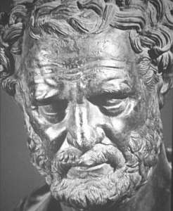
HISTORY OF THE ATOM
460 BC
Democritus develops the idea of atoms
He pounded up materials in his pestle and mortar until he had reduced them to smaller and smaller particles which he called:
ATOMA
(greek for indivisible)

Slide 2
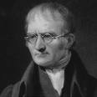
Dalton (1808)
Experiments lead to his discoveries:
Elements are made up of identical atoms which cannot be created or destroyed.
They can combine to form compounds in whole number ratios.
Chemical reactions involve the breaking or creating of bonds but never changing elements into new elements.

Slide 3
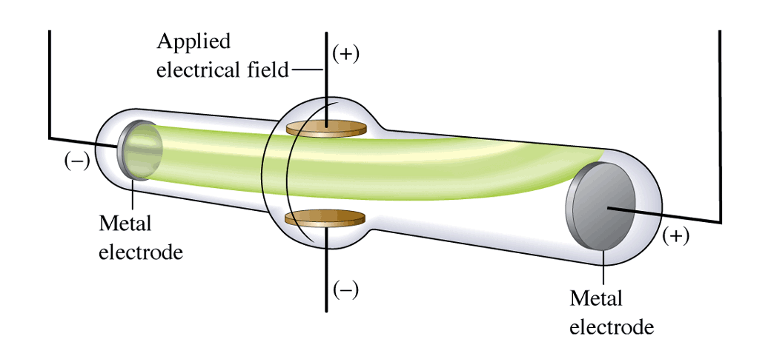
J.J. Thompson (1898-1903)
Discovered negatively charged particles called electrons using the cathode ray tube.

Slide 4
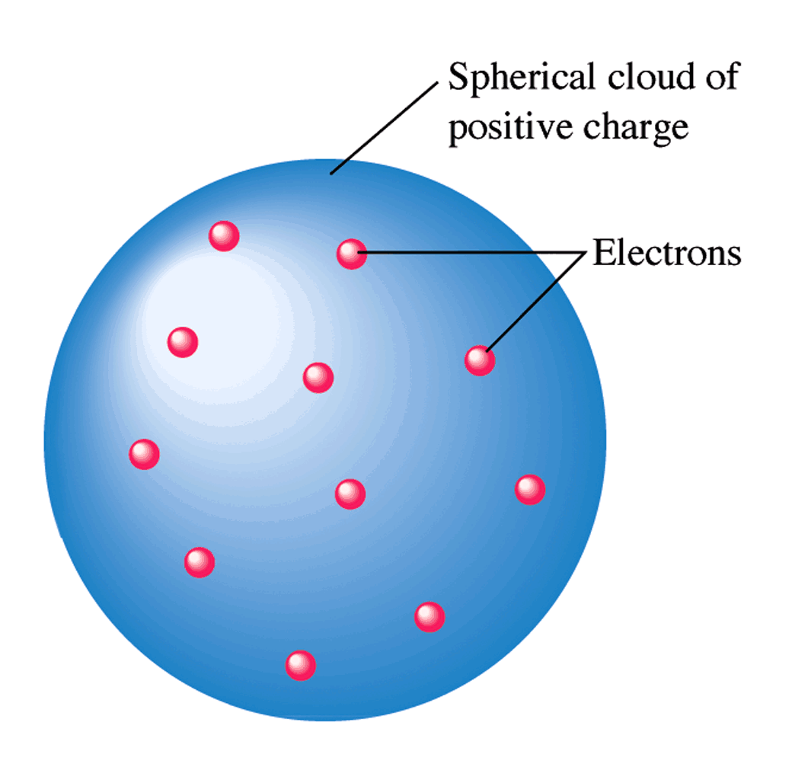
J.J. Thompson
Constructed the plum pudding model.
Assumed there was positive charge since the atom is neutral.

Slide 5
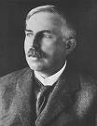
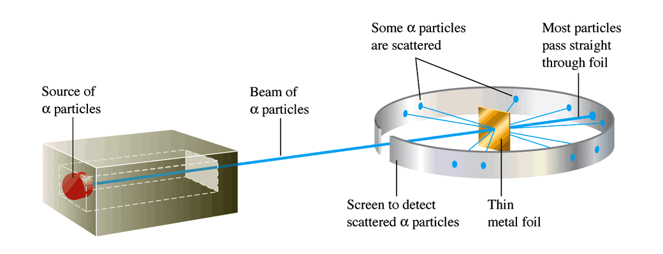
Rutherford (1911)
Shot high speed alpha particles (⁴₂He) at gold foil believing they would be deflected.
Some were deflected. He discovered a dense positive nucleus. where protons and neutrons are stored.

Slide 6
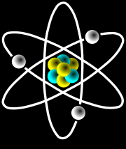
Rutherford
But most particles went straight through. He theorized the atom is mostly empty space.
Created the nuclear model of the atom.

Slide 7
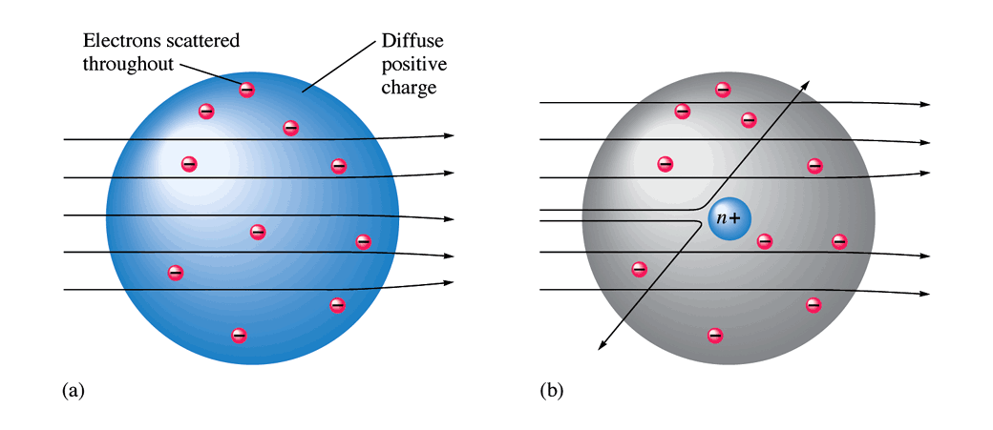

Slide 8
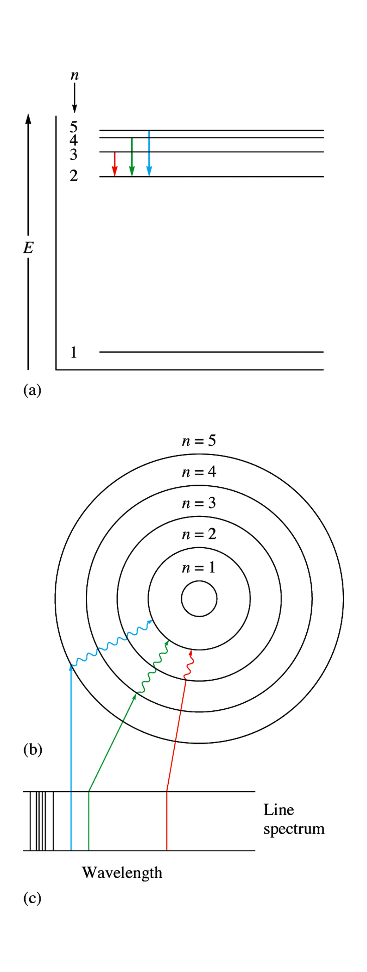
Neils Bohr
Rutherford’s model couldn’t explain why electrons didn’t collapse into the nucleus.
Bohr proposed that electrons move in specific paths called orbitals.

Slide 9
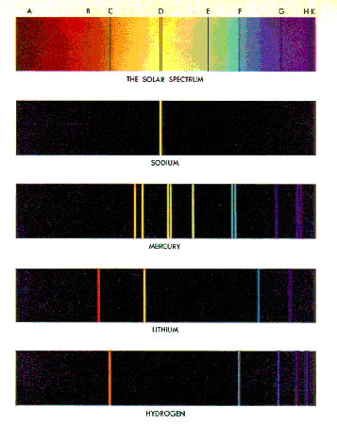
Neils Bohr
Energy can be added or removed, forcing electons to change orbitals and producing light spectra.

Slide 10
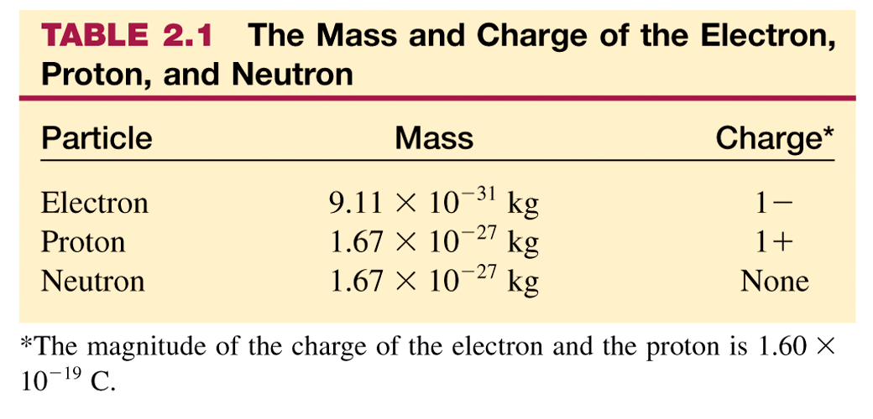

Slide 11
Subatomic Particles
 | Location | Charge | Mass
Protons (p⁺) | Nucleus | +1 | 1 a.m.u.
Neutrons (nº) | Nucleus | 0 | 1 a.m.u.
Electrons (e⁻) | Orbitals | -1 | 0

Slide 12
Vocabulary
Atomic Number: number of protons/ the identity of an element. The periodic table is arranged by atomic number.
Mass Number: number of p⁺ and n⁰. The mass number is a whole number (not reported on the periodic table. Depends on the atom).

Slide 13
Atomic Notation:
Subtract atomic number from mass number to find the ________________
Number of neutrons

Slide 14
Practice
How many protons, neutrons and electrons are in the following elements, given the mass number:
a. C mass = 12
b. N mass = 15
c. F mass = 19
d. Na mass = 23

Slide 15
Practice

Slide 16
Atoms
Protons are positive and electrons are negative. Atoms are neutral which means they must have an equal number of protons and neutrons.

Slide 17
Cations
If an atom loses one or more electrons, it will have more protons than electrons and will have a positive charge. These are called cations. Metals tend to form cations.

Slide 18
Anions
If an atom gains one or more electrons, it will have more electrons than protons. These ions are called anions and have a negative charge. Non metals tend to form anions.

Slide 19
Isotopes Vocabulary
Isotopes: Two atoms of the same element have the same number of p⁺ but different number of n⁰, therefore, different mass number.
Atomic Mass: Weighted average of masses of all naturally occurring isotopes of an element.

Slide 20
Isotopes
H-1, H-2, and H-3 are isotopes. Write their isotopic notation and calculate their number of neutrons.
Do the same for O-16, O-17, and O-18.
Cr-50, Cr-52, and Cr-53 are isotopes. The atomic mass of chromium is about 51.9 grams. Which isotope is more abundant?

Slide 21
Element | Protons + | Neutrons | Electrons- | Atomic # | Mass#
N |  |  |  |  | 14
 | 7 | 8
 |  | 12 | 10
 |  |  |  | 5 | 10
C |  | 8
S |  |  |  |  | 32
 | 10 |  |  |  | 21
 |  |  | 15 |  | 31
Are any isotopes?

Slide 22
Bohr Diagrams
Bohr stated that atoms must be in specific paths called orbitals. This lead to the “planetary model’ of the atom.

Slide 23
Bohr Diagrams
Each electron has a specific amount of energy that keeps it away from the nucleus. The farther away the electron, the more energy it has.
Electrons start in the lowest energy level permitted, called ground state. Energy can be absorbed and electrons will move up to a higher level, called the excited state.

Slide 24
Bohr Diagrams
3. The first energy level can only hold 2 electrons. The second level can hold 8 electrons. The third can hold 18.
2-8-18-32
The element’s electron configuration shows how many electrons are in each level in the ground state. Configurations are on the bottom of each element box on the periodic table.

Slide 25
Bohr Diagrams
5. The outer electrons in the diagrams or the last number in the configuration are called the valence electrons.
Elements with the same number of valence electrons are in the same group of the periodic table and they will have very similar properties.

Slide 26
Draw the Bohr Diagrams for:
Hydrogen
Helium
Lithium
Berylium
Which have the same number of valence electrons?

Slide 27
Draw the Bohr Diagrams for:
Sodium
Potassium
Neon
Carbon
Which have the same number of valence electrons?

Slide 28
Draw the Bohr Diagrams for:
Sulfur
Nitrogen
Phosphorous
Bromine
Which have the same number of shells?

Slide 29
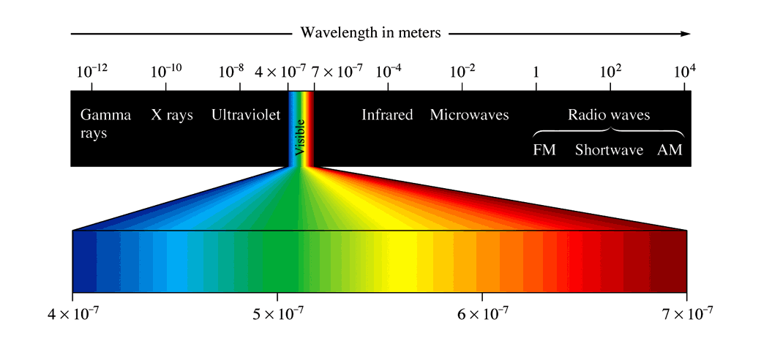
Light Spectra and Bohr
Energy is released in quanta (packets) to produce light.
When light is passed through a prism, colors may be seen at various wavelengths.
Bohr measured the energy emitted to create his quantum model of the atom.

Slide 30
Neils Bohr
Energy can be added or removed, forcing electrons to change orbitals and producing light spectra.

Slide 31
Spectra
Spectra is often referred to as the “fingerprint of elements.” Just like all people had different, identifying fingerprints, elements can be identifies using spectra.
The noble gases (group 18) do not react with other elements but were identified using spectra.

Slide 32
The Quantum Mechanical Model
The newest of all the theories of atoms in called the quantum mechanical model (QMM).
This theory states that there is actually no way of knowing where electrons are at any time due to their small size and quick movements.
Therefore, we can only provide a probability of finding an electron in a specific area.
Protons and neutrons are still in the nucleus.

Slide 33
QMM

