Slide 1
Welcome to the AP Chemistry Exam Review
Unit 1: Stoichiometry (moles), Atomic Structure, Periodic Table
Unit 2: Bonding
Unit 3: IMF and Matter
Unit 4: Net Ionic equations
Unit 5: Kinetics (rates)
Unit 6: Heat
Unit 7: equilibrium
Unit 8: Acids and Bases
Unit 9: Thermo and electro (redox)
Kristen Drury
William Floyd High School

Slide 2
Unit 1 Stoichiometry

Slide 3
Stoichiometry
The Mole represents 6.02x10²³ particles such as atoms and molecules.
Molar Mass (aka gram formula mass or molecular mass) is the mass of one mole of a substance.
Element’s molar masses are reported on the periodic table.

Slide 4
Molar Mass Examples: Elements
What is the molar mass of iron?
What is the molar mass of copper?
55.85 g/mol
63.55 g/mol

Slide 5
Molar Mass Examples: Compounds
What is the molar mass of water?
H₂O = 2(1.008) + 16.00 =
18.016g/mol
What is the gram-formula-mass of calcium chloride?
CaCl₂ = 40.1 + 2(35.5) =
111.1 g/mol

Slide 6
Dimensional Analysis
Start with the number given as a numerator over 1.
MULTIPLY by a new fraction
Place a conversion with the same unit on the denominator of the new fraction.
Multiply numerators, divide denominators.
Check SF
Calculate the mass of 6.00 moles of Neon.
6.00 moles
1
20.18g =
1 mole
X
121.08 g
= 121 g

Slide 7
Dimensional Analysis
2. Calculate the mass of 0.0230 moles of NH₃.
0.0230 moles
1
17.034 g =
= 0.392 g
1 mole
0.391782 g
X

Slide 8
Dimensional Analysis
3. Determine the number of moles in 8.00 grams of Helium.
8.00 g
1
1 mole =
2
4.00 g
= 2.00 mol
X

Slide 9
Dimensional Analysis
4. Determine the number of moles in 8.00 grams of CCl₄.
8.00 g
1
1 mole =
153.81
0.05201222 mol
= 0.0520 mol
X

Slide 10
Mole Road Map
Gram formula mass
mass
Atoms or molecules: use 6.02x10²³
particles

Slide 11
Examples
1. Calculate the number of molecules in 4.00 moles of Lithium sulfide, Li₂S.
2. Calculate the number of atoms in question 1.
4.00 moles
1
6.02x10²³ molecules =
2.41x10²⁴ molecules
X
1 mole
2.41x10²⁴ molecules
1
3 atoms =
7.22x10²⁴ molecules
1 molecule
X

Slide 12
Examples
3. How many moles are present in 1.20x10²⁴ molecules of H₂O_{(l)}?
1.20x10²⁴ molecules 1
1 mole =
2.00 moles
X
6.02x10²³

Slide 13
Balancing Reactions
3
2
___ N₂ + ____H₂ 🡪 ____ NH₃
___Li + ____O₂ 🡪 ___Li₂O
4
2

Slide 14
Limiting Reagents Examples
1. S + 3F₂ 🡪 SF₆
Suppose you have 4 moles of sulfur and 2 moles of fluorine, which is the limiter and which is in excess? How many moles of SF₆ can be produced?
4S produces 4 SF₆
2F₂ produces 0.6 moles of SF₆
(F₂ Limiter!)

Slide 15
Limiting Reagents Examples
2. 2NH₃ + CO₂ 🡪 (NH₂)₂CO + H₂O
If 637.2 grams of ammonia react with 1142 grams of carbon dioxide, find the limiting reactant and the mass of urea produced.
1,123 g urea
637.2g NH₃
1
1 mole NH₃ x
1 mole urea x
60.062 g. =
17.034g
2 mole NH₃
1 mole urea
X
1,559 g urea
1142g CO₂
1
1 mole CO₂ x
1 mole urea x
60.062 g. =
44.01g
1 mole CO₂
1 mole urea
X
1,123 g urea

Slide 16
Percent Yield
In a lab, you may not create the exact amount you should have due to errors in the lab. Percent Yield calculates how close you were to the theoretical (calculated) amount you should have created.
Percent yield = Actual mass created x 100
Theoretical mass

Slide 17
If in the previous lab, only 1000.g were created, what was the percent yield?
Recall, the calculated or theoretical yield was 1123g.
1000/1123 x 100 = 89.0%
Percent yields over 85% are generally considered accurate enough.

Slide 18
Percent Composition
% By mass: mass part x 100
total mass
Find the % by mass of H in phosphoric acid.
H₃PO₄ 3(1.0) x 100
3(1.0)+32.1+4(16.0)
= 3.02%

Slide 19
Empirical Formulas
Empirical formula refers to any molecular formula in it’s reduced form.
Are these empirical? If not, reduce them:
C₄H₈
C₆H₁₂O₆
N₃O₆
Na₂(OH)₂
CH₂
CH₂O
NO₂
NaOH

Slide 20
Molecular Formulas
Molecular Formulas are some multiple of the empirical formula.
If the empirical formula is CH₄ a molecular formula could be CH₄, C₂H₈, C₃H₁₂ etc.
A compound whose empirical formula is NH₃ has a mass of 34 g/mol. What is the molecular formula?
NH₃ = 17.0 g/mol 34/17 = 2
2NH₃ = N₂H₆

Slide 21
Steps:
Find the mass of the empirical formula.
Divide the mass given by the empirical mass.
Distribute your answer through the empirical formula.
If a compound has a mass of 45 g/mol and an empirical formula of CH₃, what is the molecular formula?
CH₃ = 15 g/mol 45/15 = 3
3CH₃ = C₃H₉
Copy this?

Slide 22
Example 1
A sample of nitrogen and oxygen contains 1.52 g N and 3.47g O and a molar mass of about 90 grams. Find the empirical and molecular formulas.
1.52g N / 14.01 g = 0.108 mol N
3.47g O / 16 g = 0.216 mol O
.216/.108 = 2
NO₂ empirical formula
NO₂ = 46g/mol. Molecular formula = N₂O₄

Slide 23
Molarity
The amount of solute (dissolvable substance) in a solvent (does the dissolving like water) is known as concentration and can be represented many ways.
Molarity is the moles of solute per liter of solution. Find this on your reference tables!
The units for molarity are mol/L or mol.L⁻¹ or just M.
If you don’t know what this means, maybe write a note to ask me in class…

Slide 24
Molarity (M)
mol of solute
L of solution
M =
Because volume is temperature dependent, molarity can change with temperature.

Slide 25
Examples may need a calculator or can be estimated
If 100. grams of KF are dissolved in 300.ml of water, what is the molarity?
Calculate the volume needed to create a 2.0M solution with 3.5 moles of Li₂O.
100g/58.1g =1.72mol
5.70M
1.72mol/.300L =
2.0M=3.5mol/x
X = 1.8L

Slide 26
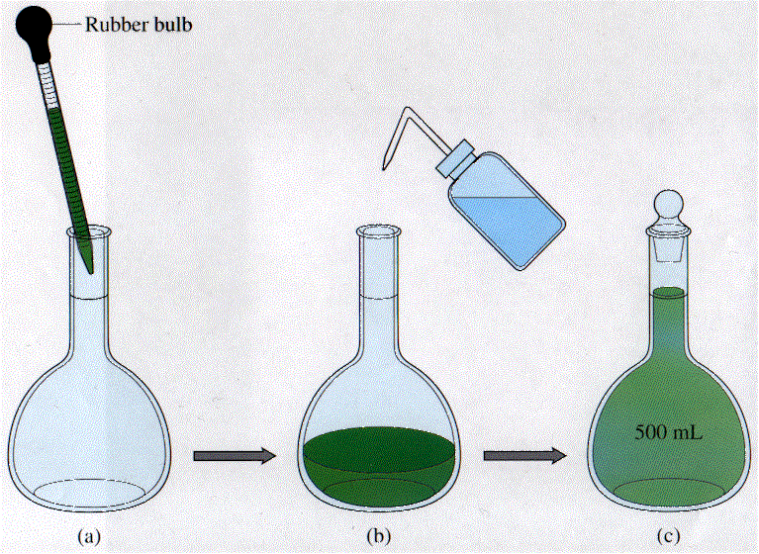
Dilutions
A dilution is a procedure for preparing a less concentrated solution from a more concentrated (or stock) solution. Use the formula: M₁V₁ = M₂V2 🡨 Not on the reference tables!

Slide 27
Calculations
240mL of a 3.5M solution is diluted to 300 mL of solution. Calculate the new molarity.
7.8L of 2.0M solution is diluted by the addition of 10.0L of water. Calculate the new molarity.
3.5(240) = x(300)
2.8M
2.0(7.8) = x(17.8)
0.88M

Slide 28
What you need to say…
Write this!
If a question asks you how to dilute a solution make sure you mention…
Measure the amount of water needed using a pipet (it is pretty accurate and if not use the cylinder). Place into the volumetric flask (most accurate!!!)
Start with the highest molarity of solute: Measure the concentrated solution with the pipet (or cylinder).
Always add the acid to the water (the acid is more dense and will sink to the bottom resulting in less splashing and can be added slowly to reduced the amount of heat generated at a time).
Add small drops of water using a dropper until the solutions meniscus reaches the mark on the flask.

Slide 29
Diatomic Molecules
Diatomic molecules are the more reactive nonmetals that react with themselves, forming two atoms bonded together. Only these seven elements do this:
Br₂ I₂ N₂ Cl₂ H₂ O₂ F₂

Slide 30
Unit 1 Atomic Theory

Slide 31
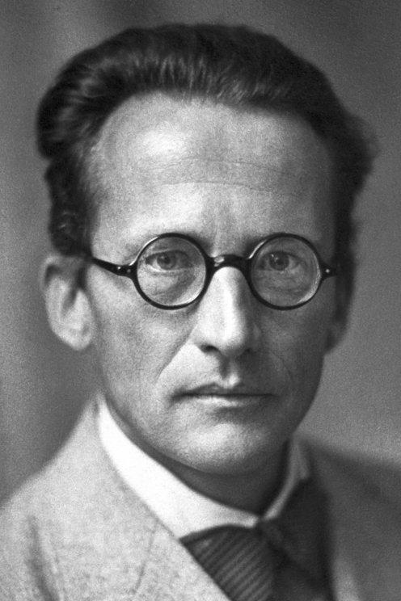
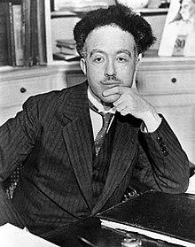
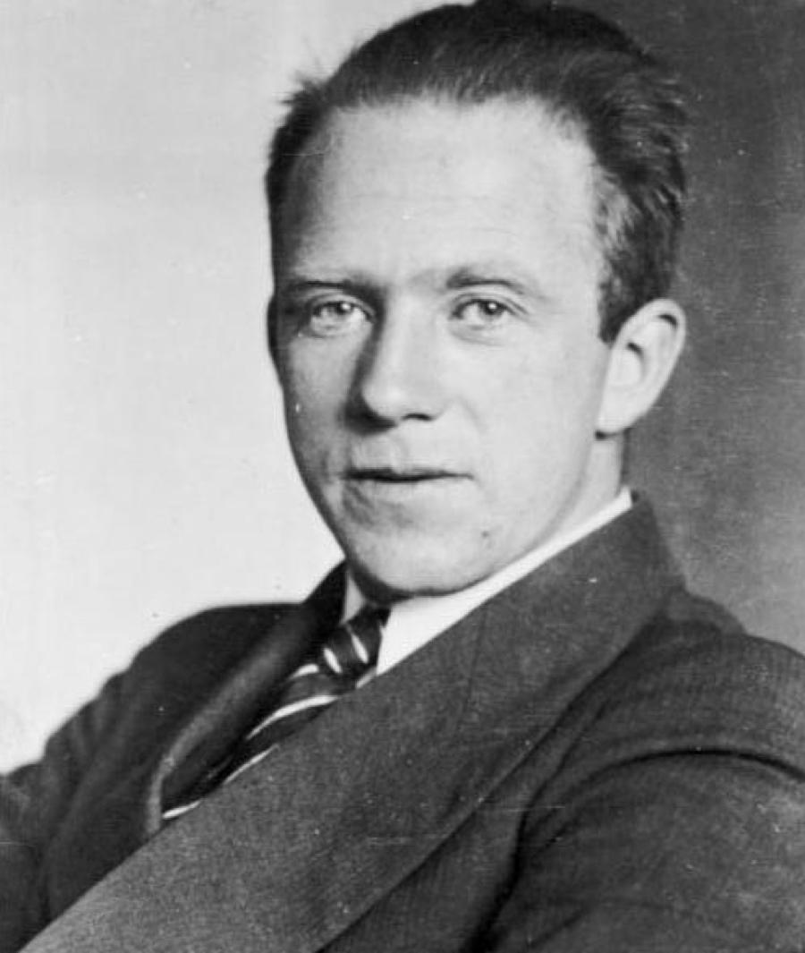
Quantum Mechanical Model
Schrodinger, de Brogli, and Heisenberg solved mathematical equations to describe the behavior of e⁻ in the H atom as being both particle and wavelike, which lead to the quantum mechanical model.

Slide 32
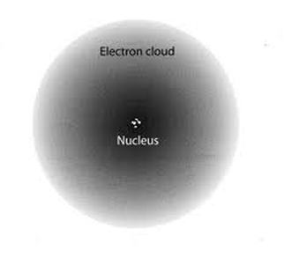
Quantum Mechanical Model
The QMM specifies that each e⁻ has a specific energy, however, they do not follow a specific path. Instead, there are areas of probable e⁻ location, which are called orbitals.

Slide 33
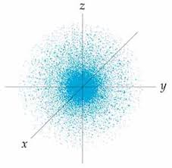
Quantum Mechanical Model
The scientists chose to study the hydrogen e⁻ with the lowest energy (ground state), which they labeled 1s. They found that the e⁻ is moving but not necessarily in circles.

Slide 34
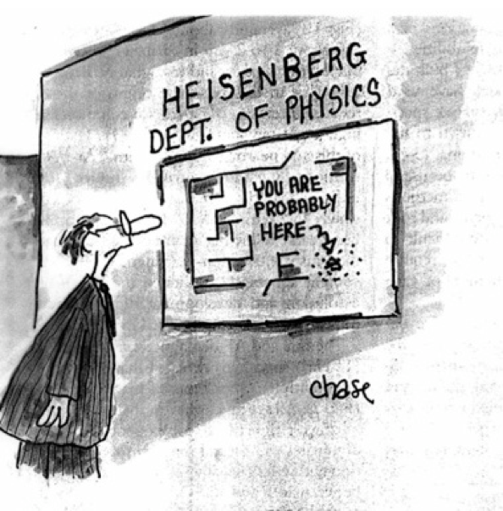
Heisenberg Uncertainty Principle
It’s impossible to know both the location of an e⁻
and its velocity (speed) at the same time.
It is more probable to find an e⁻ near the nucleus. The size of the 1s orbital is described as the radius of a sphere that encloses 90% of the total e⁻ probability.

Slide 35
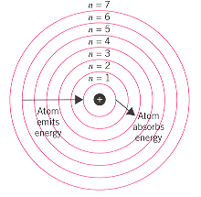
Quantum Mechanical Model
These calculations continued until they could describe any e⁻ from any element.
The first number in an electron configuration represents the overall energy level and corresponds to the row/period that the element can be found in. This is the energy level.

Slide 36
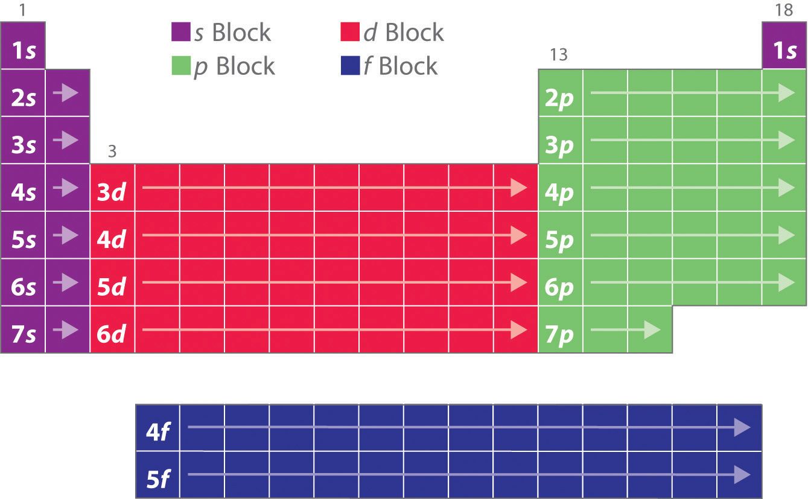
Quantum Mechanical Model
The letter represents the sublevel the electron is in, which correlates to an area of the periodic table. It will tell you the shape of the orbital. (s is spherical, p is lobes and d has 2 lobes).
s p d f

Slide 37
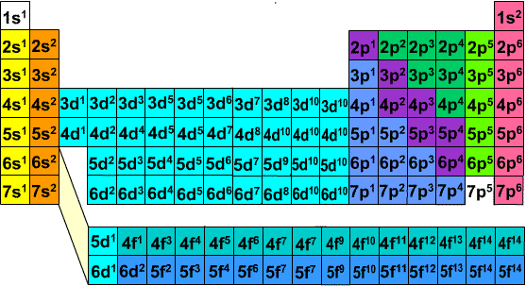
Quantum Mechanical Model
The superscript represents the number of electrons in that sublevel.

Slide 38
S p d orbitals

Slide 39
S orbitals
1s
2s
3s
Highest magnification
Lowest magnification

Slide 40
P orbitals

Slide 41
P orbitals
2p
3p
4p
Highest magnification
Lowest magnification

Slide 42
D orbitals

Slide 43
D orbitals
3d
4d
Highest magnification
Lowest magnification

Slide 44
Aufbau Principle
As protons are added one by one to the nucleus to build up the elements, so are e⁻.
1s² 2s² 2p⁶ 3s² 3p⁶ 4s² 3d¹⁰ 4p⁶ 5s² 4d¹⁰ 5p⁶ 6s² 4f¹⁴ 5d¹⁰ 6p⁶ 7s² 5f¹⁴ 6d¹⁰ 7p⁶

Slide 45
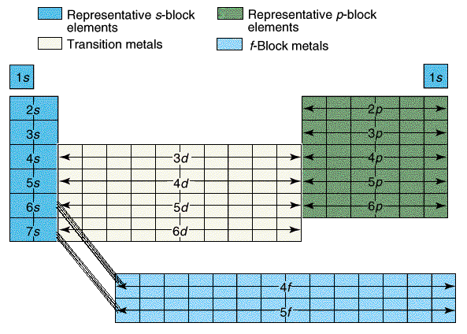
Examples
The configuration for Be ends at 2s and the second element in.
Be is 1s² 2s²
The configuration for Sulfur ends at 3p⁴.
S is 1s² 2s² 2p⁶ 3s² 3p⁴
Ti is 1s² 2s² 2p⁶ 3s² 3p⁴ 4s² 3d¹

Slide 46
Problems?
Try to write electron configurations in the order of the periodic table, denoting the increase in overall energy of the sublevels as you progress through an electron configuration.
This shows that 4s is in fact a lower energy level than 3d.

Slide 47
Orbital Energies

Slide 48
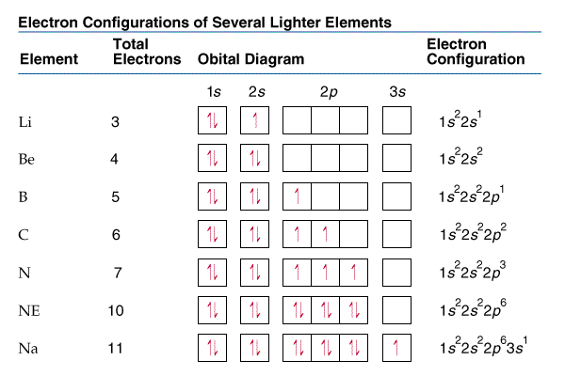

Slide 49
Hund’s Rule
Notice that Carbon’s 6th arrow is in the second p orbital.
Hund’s Rule states the lowest energy configuration is one having the maximum number of unpaired electrons allowed by Pauli Principle in a particular set of degenerate orbitals. They should have parallel spins.
In English? Put one up
arrow in each box
before any get two.

Slide 50
Examples
How many unpaired electrons does Nitrogen have?
How many unpaired electrons does Carbon have?

Slide 51
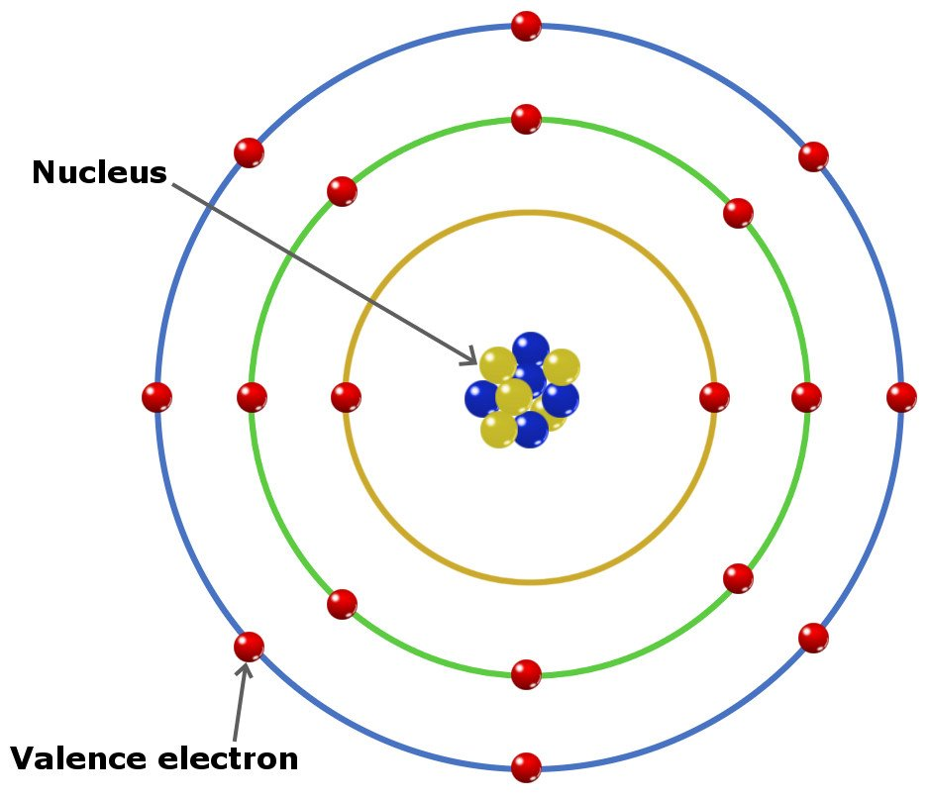
Valence electrons
Valence e⁻ are e⁻ in the outermost principal energy level. The rule still holds: the elements in the same group have the same number of valence e⁻. Therefore, Nitrogen with a configuration of 1s²2s²2p³ and Phosphorous with a configuration of 1s²2s²2p⁶3s²3p³ both have 5 valence e⁻ because they are both in group 15.

Slide 52
Ions
When ions form, electrons are added or subtracted to the valence shell.
Fluorine is 1s² 2s² 2p⁵
The F⁻ is 1s² 2s² 2p⁶
Manganese is 1s² 2s² 2p⁶ 3s² 3p⁶ 4s² 3d⁵
The Mn⁺² ion is 1s² 2s² 2p⁶ 3s² 3p⁶ 3d⁵

Slide 53
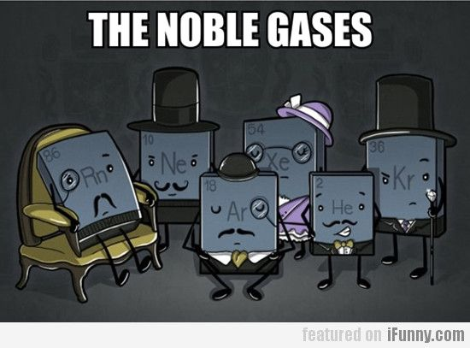
Noble Gas Shortcut
Larger elements will have extremely long configurations. A shortcut is to use noble gas configurations.
Sodium has 11e- and a configuration of 1s²2s²2p⁶3s¹ or [Ne]3s¹.
Sulfur has 16e- and a configuration of 1s²2s²2p⁶3s²3p⁴ or [Ne]3s²3p⁴.

Slide 54
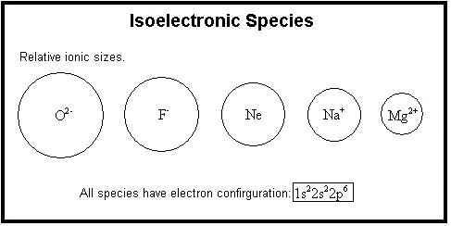
Isoelectronic
When two ions or atoms have the same number of electrons.
Example: Ar and K⁺¹.
Argon: 1s² 2s² 2p⁶ 3s² 3p⁶
Potassium: 1s² 2s² 2p⁶ 3s² 3p⁶ 4s¹
Potassium Ion: 1s² 2s² 2p⁶ 3s² 3p⁶

Slide 55
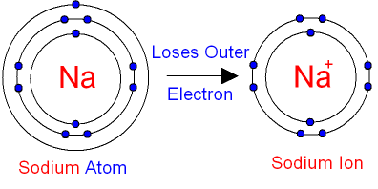
Ionization Energy
IE: The energy needed to remove the valence electron for a gaseous ground state element creating a positive ion.
The second ionization energy corresponds to the removal of the second valence electron (after the first IE)…
Would the second IE require more or less energy than the first and why?

Slide 56
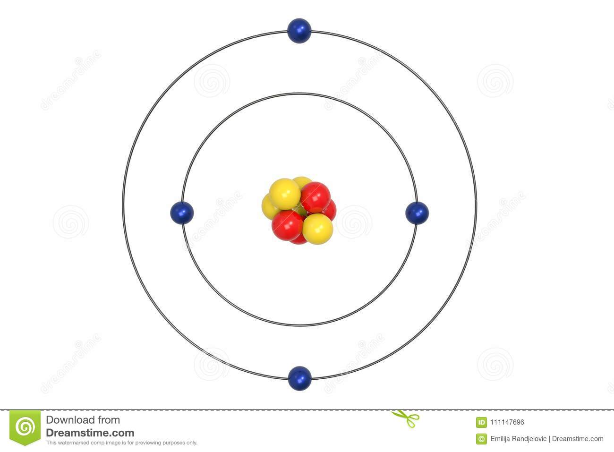
Ionization Energy
As electrons are removed for an atom, the atom’s nucleus can tighten the pull on the fewer electrons, creating a smaller radius and a tighter hold on the valence electrons. Therefore, the second IE will always be greater than the first IE.
1st IE
2nd IE

Slide 57
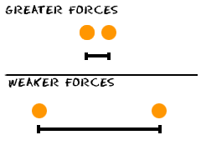
Coulomb’s Law
Opposites attract (protons and electrons), Likes repel (p/p or e/e)
The closer the particles are, the more force the particles have on each other.
E = k Q₁Q₂
r
Q =charge of particle
r = distance between particles.

Slide 58
Ionization Energy Trends E=kQ₁Q₂/r
Hydrogen only has one proton pulling on the one electron.
Helium has two protons pulling on the same level of electrons. The size gets smaller (r), so the energy (E) required increases.

Slide 59
Ionization Energy Trends E=kQ₁Q₂/r
Lithium has added a whole new energy level. The electrons between the nucleus and the valence shell shield the valence shell for the pull of the protons. Therefore, the atom is larger (r) and the energy (E) required decreases.

Slide 60
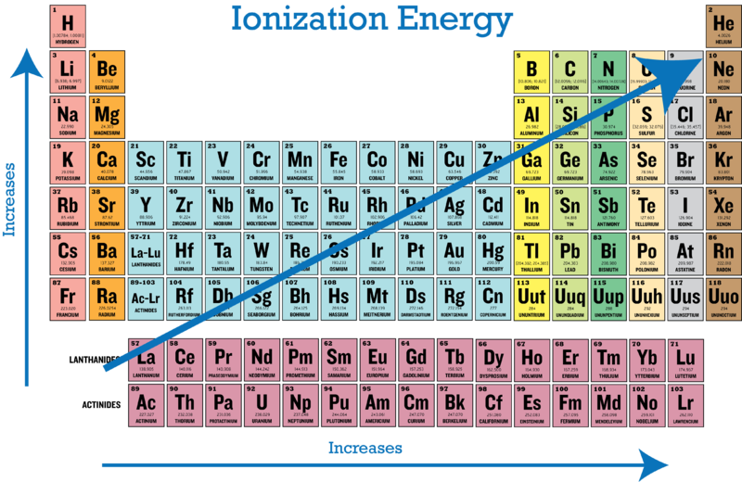
Ionization Energy Trends Summary
Across a period, increases in protons (nuclear charge) increases the attraction for electrons and decreases the radius of the atom (or distance r from the nucleus to the valence), therefore increasing the columbic force and IE increases.
Down a group, more energy levels are created, increasing the distance (r) from the valence shell to the nucleus, thus decreasing the columbic force and decreasing the IE.

Slide 61
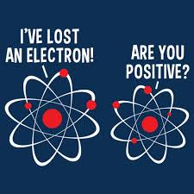
Binding Energy
Binding Energy: The minimum energy required to eject a given electron from the atom corresponding to the sublevel in which the electron resides.

Slide 62
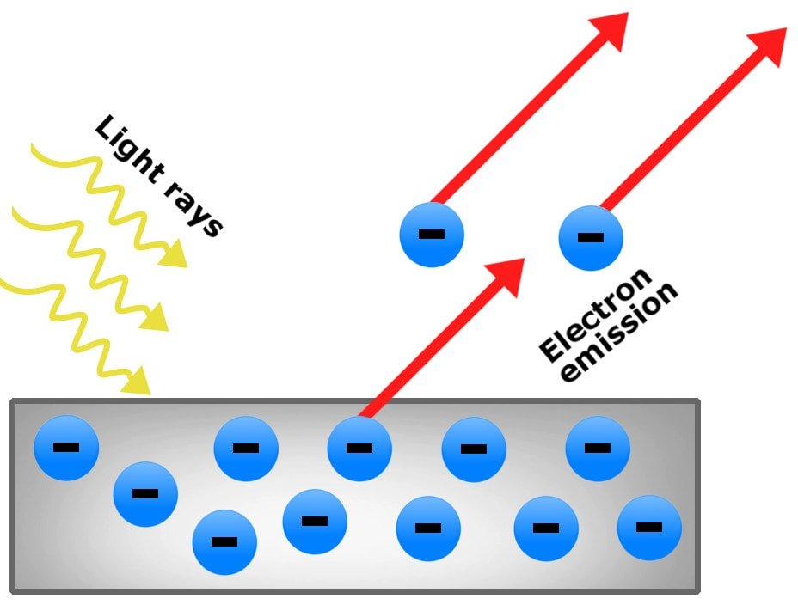
Photoelectric Effect
The photoelectric effect is the emission of electrons when light hits a material.

Slide 63
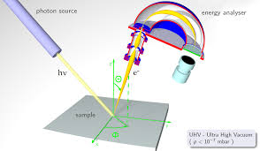
PES
Photoelectric spectrums are created when each electron from an atom are removed (IE) one by one. The sample is bombarded by photons of light which makes the atom emit the valence electron. The energy required in graphed.

Slide 64
PES Hydrogen 1s¹
This graph corresponds to the energy needed to remove hydrogen’s only valence electron, 1s.
1
Energy: High to low

Slide 65
PES Helium 1s²
This graph corresponds to the energy needed to remove helium’s valence electrons from 1s.
2
1
Energy: High to low

Slide 66
PES Berylium 1s²2s²
This graph corresponds to the energy needed to remove Beryllium’s valence electrons from 1s and 2s.
2
1
Energy: High to Low

Slide 67
PES Carbon 1s²2s²2p²
This graph corresponds to the energy needed to remove Carbon’s valence electrons from 1s, 2s and 2p.

Slide 68
PES: What is the electron configuration? Which element is it?
2p⁶
3p⁴
Sulfur
2s²
1s²
3s²

Slide 69
Bohr and PES of Carbon
Why was Bohr revised?

Slide 70
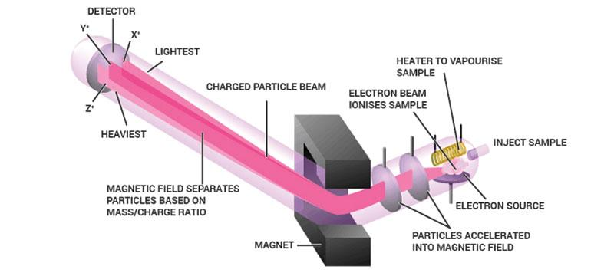
How does it work?

Slide 72
Chlorine Mass Spec Analysis
Atomic Mass = (mass)(abundance) = (mass)(abundance)….
(34.97)(.7576) + (36.96)(.2424) = 35.45amu

Slide 73
Mass Spec Analysis: What element is this?
Mo

Slide 74
Mass Spec Analysis: diatomic Bromine

Slide 75
ER
ER is energy that exhibits wave like behavior and travels through space at the speed of light
(c = 3x10⁸m/s)
Wavelength(λ):distance between 2 peaks.
Frequency(v): waves per second

Slide 76
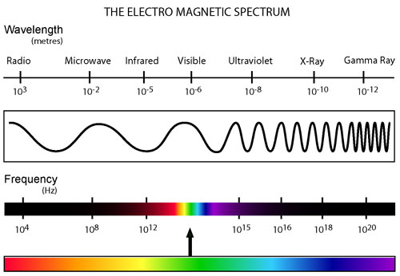

Slide 77
ER examples
c=λv
If the wavelength is 650nm, calculate the frequency of light with units.
If the frequency is 200.s⁻¹, calculate the wavelength.
v = 4.6x10¹⁴s⁻¹
(3.0x10⁸m/s) = (650x10⁻⁹m)(v)
(3.0x10⁸m/s) = (λ)(200./s)
λ = 1.5x10⁶m

Slide 78
Planck
Matter can transform into energy but only in packets of energy called quantum. Planck found that these energy packets are in multiples of hv.
∆E=hv
h=Planck’s constant = 6.63x10⁻³⁴Js

Slide 79
Planck
CuCl in fireworks give off blue light with a wavelength of 450nm. What is the amount of energy emitted?
c = λv
(3.0x10⁸ m/s) = (450x10⁻⁹m)(v)
v = 6.7x10¹⁴/s
E = hv
E = (6.626x10⁻³⁴J/s)(6.7x10¹⁴/s)
E = 4.4x10⁻¹⁹J

Slide 80
Einstein
Einstein stated that ER or light is a stream of particles called photons.
Between Plank and Einstein, light is both wave-like and particle-like.
E= hv = hc/λ
Because v=c/λ

Slide 81
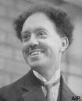
deBroglie
If light is both wave and particle-like, can matter be both as well?
deBroglie found electrons (which are particles) are so small that they have a measurable wavelength! So, YES!
λ=h/mυ υ= velocity

Slide 82
Remember Light Spectra and Bohr?
Energy is released in quanta (packets) to produce light.
When light is passed through a prism, colors may be seen at various wavelengths.
Bohr measured the energy emitted to create his quantum model of the atom.

Slide 83
Light Spectra and Bohr
E_{n}= -2.178x10⁻¹⁸J
n²
n= energy level

Slide 84
Unit 1 Periodicity

Slide 85
Atomic Radius
The size of the atom in the ground state.
Across a period, the radius decreases due to a higher nuclear charge (more protons) pulling the electrons in tighter.

Slide 86
Atomic Radius
Down a group, the radius increases due to more energy levels, electron-electron repulsions, and shielding of the kernel electrons.

Slide 88
Atomic Radius Examples
Predict the trend in radius for Be, Mg, Ca and Sr.
Predict the trend for N, O, F and Ne.
Predict the trend in radius for Be⁺², Mg⁺², Ca⁺² and Sr⁺².
Be, Mg, Ca, and Sr increase due to increased number of principle energy levels, therefore a weaker pull on further electrons.
N, O, F, and Ne decrease due to a stronger nuclear charge pulling in valence electrons tighter.
That order. The fact that they all have lost 2e- doesn’t really change the answer in this case.

Slide 89
Ionic Radius
When atoms gain electrons, the size ___________.
When the atom loses electrons, the size ____________.
increases
decreases

Slide 90
Ionic Radii
When species are isoelectronic their size comes down to nuclear charge. Species with stronger nuclear charges are smaller.
Example: S⁻², Cl⁻, Ar, K⁺, and Ca⁺² all have 18 electrons. So which is smaller?
Ca⁺² because it has the most protons pulling on the same number of electrons.

Slide 91
Ionization Energy
The energy needed to remove an electron from the valence shell of a gaseous atom or ion in the ground state.
Across a period, IE increases because electrons are more tightly bound to a stronger nuclear charge, therefore they are harder to remove.
Down a group, IE decreases because electrons are less bound to the nucleus due to higher shielding from the nucleus by more inner electrons.
Formula Examples: X⁻ 🡪 X + e⁻ or X 🡪 X⁺ + e⁻

Slide 92
More Examples
1. Aluminum’s IE: 1st: 580 kJ/mol
2nd: 1,815
3rd: 2,740
4th: 11,600
Explain the sudden increase in IE at the 4th IE.
2. Why is Na IE higher than K?
3. Why is the IE of O lower than F?
Al: 1s²2s²2p⁶3s²3p¹
When the 4th e- is removed, it is removed from an octet in a inner energy level.
Na has less shielding, it’s e- are closer to the nucleus and bound tighter.
F has a stronger nuclear charge, so e- are bound tighter.

Slide 93
Exceptions
Only worry about these exceptions when specifically asked:
Be 🡪 B: according to the rule, IE should increase, however, the filled 2s of Be is full and stable and to remove an electron would be much harder than removing the 2p¹ electron.

Slide 94
Exceptions
N 🡪 O: according to the rule, IE should increase, however, the half filled 2p orbital with parallel spins of N is more stable than the 2p⁴ electron which is more easily removed.
These rules also apply to lower elements in the same groups.

Slide 95
Electronegativity
Ability of an atom to attract electrons.
Across a period, electronegativity increases due to stronger nuclear charge and needing to fill the octet.
Down a group, electronegativity decreases due to higher shielding from the nucleus by inner electrons.
These values range from 0-4 and are not energy values.
Notice the trend and explanations are similar to IE.
Example: X + e⁻ 🡪 X⁻ or X⁺ + e⁻ 🡪 X

Slide 96
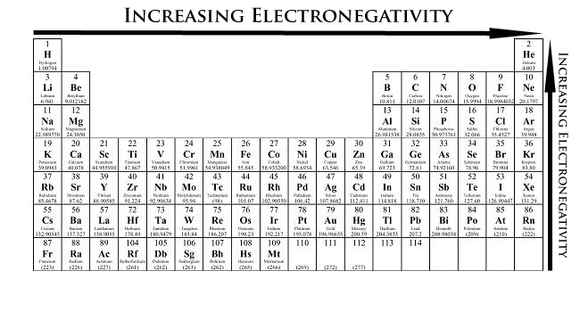
Electronegativity
Fluorine has the highest electronegativity, and one of the highest IE so the trends increase across a period and decrease down a group. BUT THAT IS JUST A MEMORIZATION TOOL! If you are asked to explain you must recite the reasons using nuclear charge and shielding/energy levels.

Slide 97
Electronegativity
0 .4 .5 1.7 1.8 4
Non-Polar Covalent Polar Covalent Ionic
(shares e- equally (shares e- unequally (transfers e- from
due to similar EN due to a small difference metal to nonmetal due to
values) in EN values) great EN differences,

Slide 98
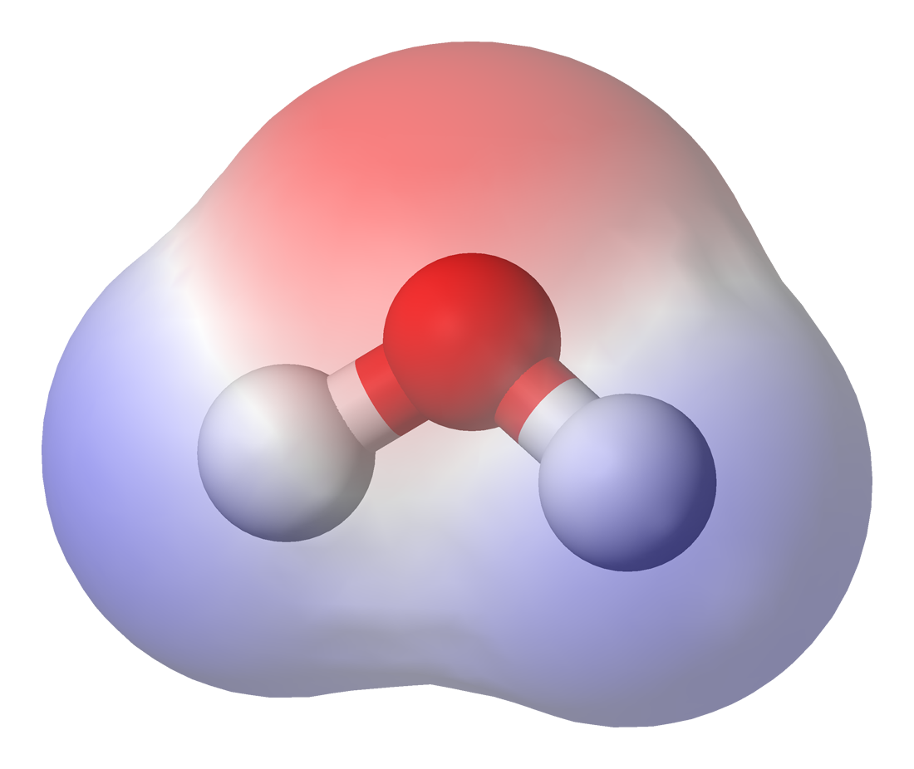
Using the Regents reference tables determine the electronegativity differences required to make a compound polar, nonpolar, or ionic.
Examples:
H₂ has nonpolar bonds
CH₄ has nonpolar bonds
HCN has nonpolar bonds
CO₂ has polar bonds
CCl₄ has polar bonds
HF has polar bonds
NaI has ionic bonds
KF has ionic bonds
Differences:
0.0
0.4
0.4
0.8
0.6
1.8
1.8
3.2

Slide 99
Unit 2 Bonding

Slide 100
Octet Rule
Atoms bond with other atoms by sharing or transferring electrons in order to achieve a stable octet (8 valence electrons).
When bonds are formed energy is ___________.
When bonds are broken energy is ___________.
released
absorbed

Slide 101
Ionic Bonds
Transfer e-
Metals and
nonmetals
High mp and bp
Soluble
Conduct as liquid
Mostly solid

Slide 102
Ionic Bonds have a crystalline structure.

Slide 103
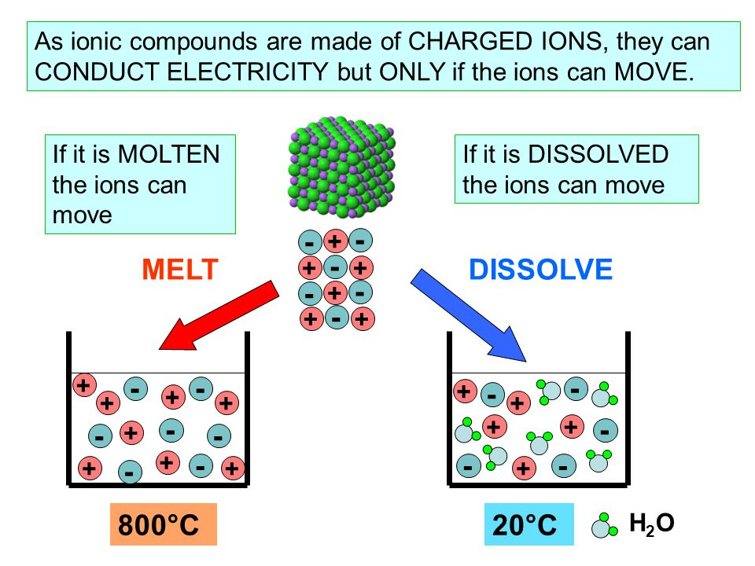

Slide 104
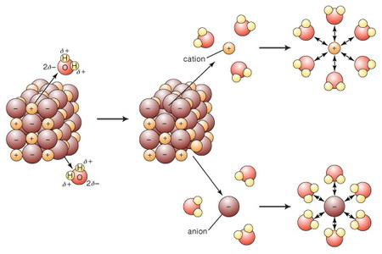
Solubility

Slide 105
Metallic Bonds
Sea of e-
Metals only
High mp and bp
Insoluble
Conduct always
All other metallic properties

Slide 106
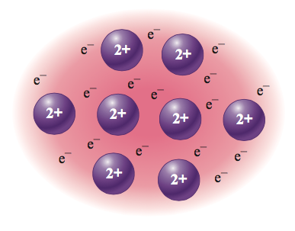
Metallic Bonds

Slide 107
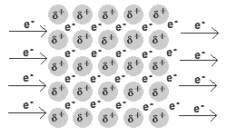
Metallic Bonds

Slide 108
Covalent Bonds (Molecular)
Share e-
Nonmetals only
Low mp and bp
Insoluble unless polar
Never conduct
Creates molecules

Slide 109
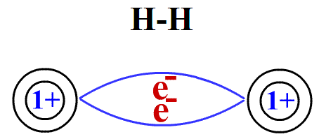
Covalent Bonding (Molecular Bonding)
If 2 atoms or more form a bond with the same electronegativity the bonds are nonpolar and they share e- equally.

Slide 110
Equal sharing

Slide 111
If there is an electronegativity difference between bonded atoms, the bonds are polar and e- are pulled toward the more electronegative atom.

Slide 112
If a molecule is polar, it will have a slightly negative and slightly positive side, like 2 poles of a magnet. This is called a dipole moment or a dipolar molecule.

Slide 113
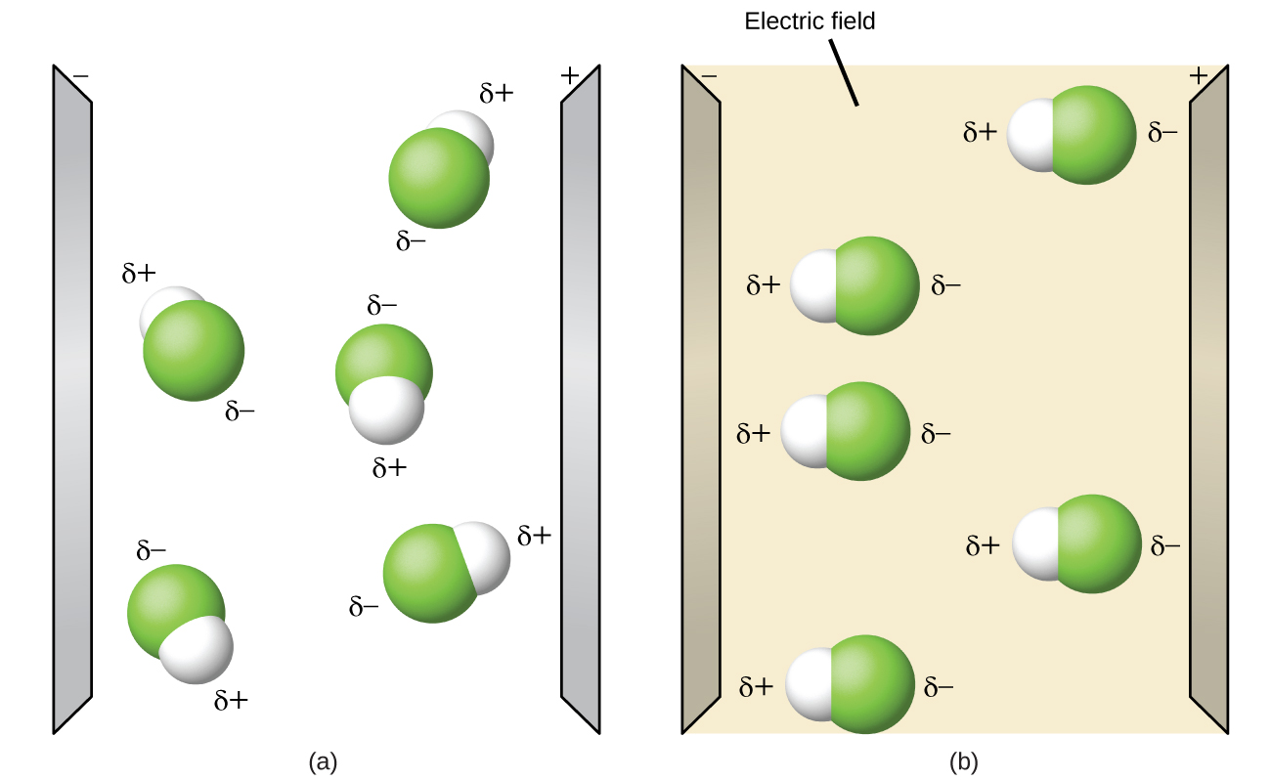
Dipolar Molecules
As you can see, normally polar molecules are unaligned.
When a electric source comes by, the molecules quickly align themselves.

Slide 114
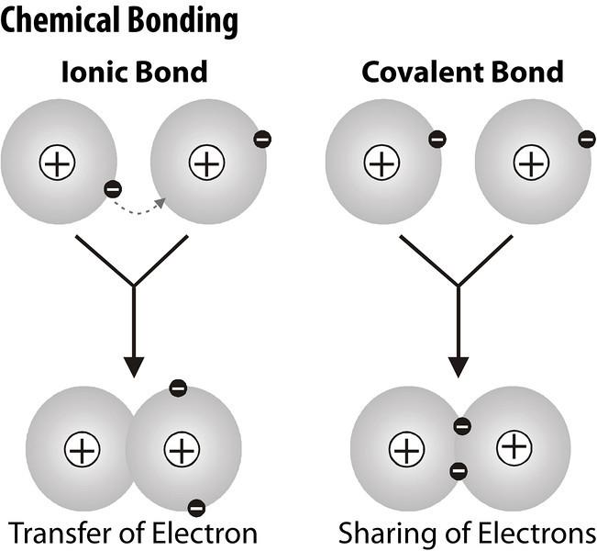
Something to think about…
What even is a bond? Is it a physical thing?

Slide 115
Lattice Energy
LiF is a compound that should form naturally, therefore the heat of it’s formation should be exothermic (stable and negative value).
When LiF forms, Li and F must become ions. Write out these equations:
It seems that if you sum these parts, the heat is still positive. Something else must play a part in the heat of formation…
IE: Li 🡪 Li⁺ + e⁻ 520kJ
EA: F +e⁻ 🡪 F⁻ -328kJ
EA is the Electron Affinity, or the opposite of IE, when an atom gains an electron

Slide 116
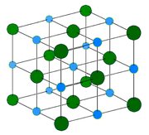
Lattice Energy
Lattice Energy is the change in energy that takes place when separate gaseous ions are packed together to form an ionic solid.
Lattice energy is generally exothermic and has a major affect on whether a compound can be made.

Slide 117
Lattice Energy
Coulomb’s Law can be used to calculate and compare the lattice energy of compounds: k = constant
Q = charge of ion
LE= k(Q₁Q₂/r) r = distance between ions

Slide 118
Lattice Energy
LE= k(Q₁Q₂/r)
Compounds with ions that have higher charges (+3 versus +1 or -3 versus -1) have larger lattice energies due to more electrons being transferred, creating a stronger ionic bond.
Compounds with ions that have smaller radii have larger lattice energies since the ions can get closer together, creating a stronger ionic bond.

Slide 119
Lattice Energy
1. What would happen to the lattice energy if the radii was tripled?
If the radii triples, the LE decreases.
2. If charges were doubled?
If the radii triples, the LE decreases.
3. If the radii was halved?
If the radii halves, the LE doubles.

Slide 120
Lattice Energy
Which compound has a more exothermic lattice energy?
NaCl or KCl
MgCl₂ or LiF
LiF or LiCl
Mg(OH)₂ or MgO
NaCl or Na₂O
Look for large charges and small radii!

Slide 121
Heat of Formation
IE, EA, and Lattice Energy are not the only factors that affect formation.
The lattice energy requires the ions be gaseous, therefore, sublimation may be necessary.
Also, some elements, like fluorine, are diatomic. Therefore, dissociation is necessary.
Generally the following steps must be taken:
Sublimation, Ionization, Dissociation, Electron Affinity, and Lattice Energy.

Slide 122
Find the Heat of Formation (∆H_{f}) of LiF: Li_{(s)} + ½ F_{2(g)} 🡪LiF_{(s)}
Sublimation: Li_{(s)} 🡪 Li_{(g)} 161 kJ/mol
Ionization: Li_{(g)} 🡪 Li⁺_{(g)} + e⁻ 520
Dissociation: ½ F_{2(g)} 🡪 F_{(g)} ½ (154)
Electron Affinity: F_{(g)} + e⁻ 🡪 F⁻_{(g)} -328
Lattice Energy: Li⁺_{(g)} + F⁻_{(g)} 🡪 LiF_{(s)} -1047
_____________________________________
These values are in your textbook appendix. Notice the overall sign is (-) and favorable. Also the dissociation had to be halved since we need ½ F₂.
Li_{(s)} + ½ F_{2(g)} 🡪LiF_{(s)} -617 kJ/mol

Slide 123
Lewis Structures Rules: CCl₄
Add up all valence e⁻
Draw a skeletal structure with bonds between elements.
Subtract 2e⁻ from total for each bond drawn.
Draw in remaining e⁻ to fill each atom’s octet.
Evaluate: each atom should have 8 e- only.
C: 4 + 4Cl: 7 = 32 valence e⁻
Cl
Cl—C—Cl
Cl
32-8=24

Slide 124
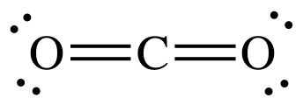
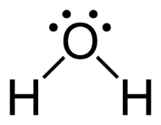
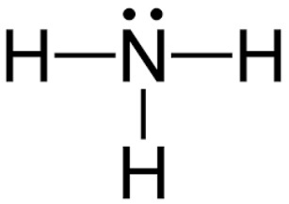
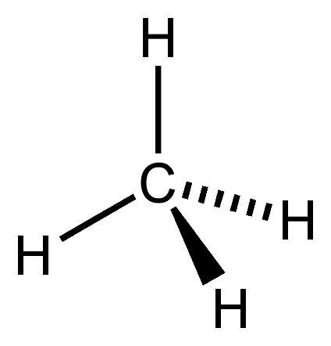
Geometry
Molecules have a specific geometry:
Linear: The molecule is on one plane (flat) such as CO₂ or H₂.
Bent: The molecule is bent at angle like H₂O due to unshared electrons and two bonding pairs on the central atom.
Pyramidal: The molecule has a triangular shape like NH₃ due to a lone pair and three bonding pairs on the central atom.
Tetrahedral: The molecule has four bonding pairs and no lone pairs on the central atom like CH₄.

Slide 125
Dipolar Molecules
Polar bonds can create polar or nonpolar molecules.
A polar molecule will have polar bonds and be asymmetrical.
A nonpolar molecule will either have nonpolar bonds or polar bonds with a symmetrical shape.
Water is polar, and like dissolves like, so only polar molecules are soluble in water. Polar (dipolar) molecules are also attracted to an electric field.

Slide 126
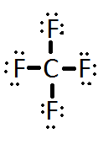
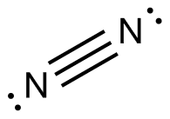
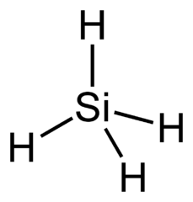
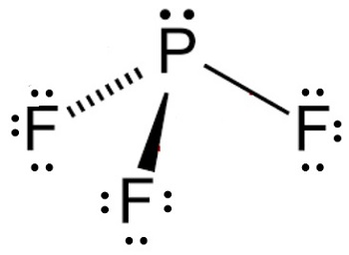
Draw the following. Identify the geometry and polarity:
O₂
CF₄
N₂
SF₂
PF₃
SiH₄
Notice, 4 elements is showing pyramidal, 5 elements is showing tetrahedral. Its not always that easy… stay tuned for more shapes! ☺

Slide 127
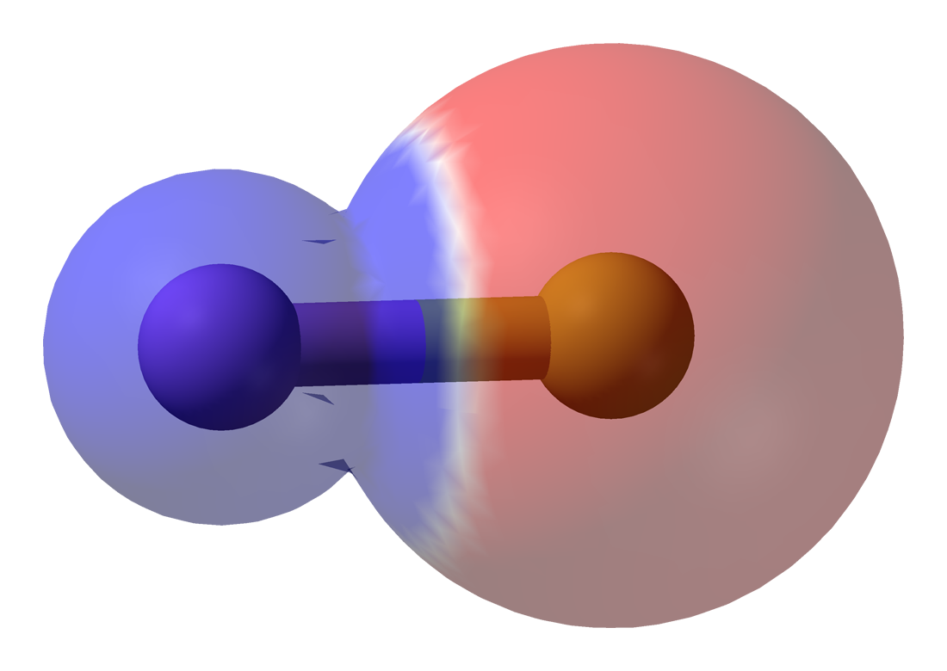
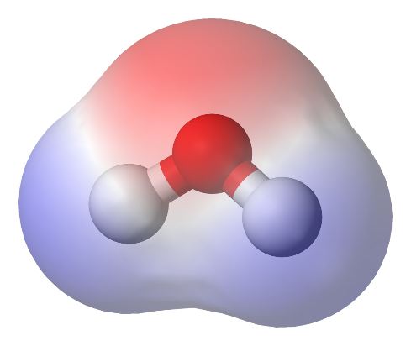
Examples
Draw the electric field lines through the molecule , head of the arrow toward the more negative side:
H
H---Cl H--C--H
H
Cl---Cl
S---H
H
nonpolar
nonpolar

Slide 128
Bond Energy
As you saw in the calculating the heat of formation of ionic compounds, an important step was breaking the covalent bond. Bond Energies are in the appendix of your textbook.
Forming bonds is exothermic and need to be negated.
Breaking bonds is endothermic and are positive.
Heat of formation of covalent reactions = the sum of all (-)bonds formed and (+) broken

Slide 129
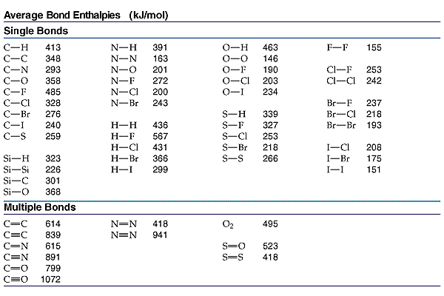
Bond Energy
What patterns emerge when we compare single versus double or triple bonds?
What patterns emerge when elements in the same group are compared?

Slide 130
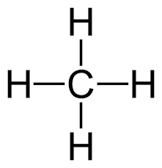
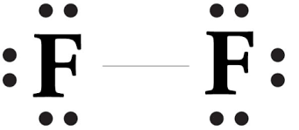
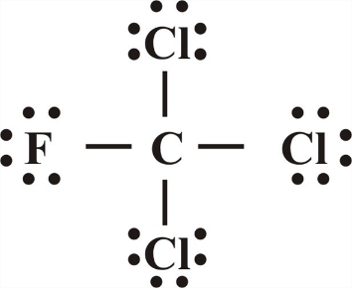
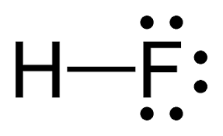
Bond Energy
Using bond energies in your textbook calculate the heat of formation. (It is recommended that you draw the compounds)
CH₄ + 2Cl₂+ 2F₂🡪 CF₂Cl₂ + 2HF + 2HCl (all gases)
[4(413) + 2(242) + 2(155)] – [2(485) + 2(328) + 2(567) + 2(431) =
-1176kJ

Slide 131
Exceptions to the Octet Rule ☹
1. Boron tends to form compounds with an incomplete octet. It can have 6e⁻. Al and Be can also do this but prefer not to.

Slide 132
Exceptions to the Octet Rule ☹
2. Some elements can exceed the octet when needed. Only elements that have an open d orbital can do this. That means only in periods 3-7!

Slide 133
General rules
An atom will bond as many times it needs to fill the octet (P had 5 valence electrons and needed 3 electrons to fill it’s octet.)
If there is an abundance of reactants under high pressure, the atom may bond as many times as it has valence electrons. (P had 5 valence electrons so it could bond up to 5 times.)

Slide 134
Examples
Draw the following molecules:
ClF₃
XeO₃
BCl₃
I₃⁻
ICl₄⁻

Slide 135
Polarity reminder:

Slide 137
No Dipole Moment if Symmetrical

Slide 138
Practice
Draw the Lewis structure for NO₃⁻.
Notice that the nitrate ion can be written 3 different ways. It appears that there are two single bonds and one double bond. However, when measured, the bonds are actually the same length. This is called resonance.

Slide 139
Resonance
When one or more valid structures (that obey octet) can be drawn for one molecule they are called resonance structures.
The electron placement changes but not the nucleus.
Arrows between structures mean they are all equal, not that the structure is changing.
Resonance is used to fix the localized electron model which we use (Lewis structures). In fact, electrons are delocalized, meaning all electrons are able to move about the molecule, not fixed in a position.

Slide 140
Resonance
34 e-
Draw all resonance forms of N₂O₄.

Slide 141
Resonance
Some molecules and ions exceed the octet rule and then have nonequivalent resonance structures (they have a different number of single double or triple bonds).
To determine the best structure formal charge is calculated:
Formal Charge = (Valence e⁻ of the atom) - (valence e⁻ assigned to the atom in the structure)

Slide 142
Resonance rules
Lone pairs around an atom only belong to that atom.
In shared pairs, one electron belongs to the 1st atom and the other electron belongs to the 2nd atom.
Compare the following structures of SO₄²⁻. Which is better and why?
0
-1
-1
0
+2
-1
-1
0
-1
-1

Slide 143
Structures that obey the octet are the best structure. After that, structures with lower formal charges are usually the better structure.

Slide 144
Practice
Draw resonance structures for the following and pick the best:
XeO₃
O₃

Slide 145
Bond Order
Bond Order refers to how many bonds are shared between the atoms in a bond.
Single bonds (1)
Double bonds (2)
Triple bonds (3)
The higher the bond order, the stronger the bond due to more electrons being shared.

Slide 146
Bond Order
What is the bond order of:
2
1
1.5
3

Slide 147
VSEPR
The structure of a molecule is determined by reducing electron repulsion between pairs. (Non bonded pairs should be as far apart as possible.) When determining the shape:
Double and triple bonds count as single bonds.
You may use any resonance structure.
If there is no central atom, it is not a classified shape.

Slide 148
Total bonds and lone pairs on central atom | electron shape
2 | Linear
3 | Trigonal Planar
4 | Tetrahedral
5 | Trigonal Bipyramidal
6 | Octahedral

Slide 151
Tetrahedral

Slide 152
Tetrahedral

Slide 153
Bipyramidal

Slide 154
Octahedral

Slide 155
What’s the Difference?

Slide 156
Hybridization
Carbon’s valence shell is 2s²2p². The one circular s orbitals hybridize with the three lobed p orbitals to make four sp³ orbitals which are all equal (degenerate).

Slide 158
Sp³ hybridization
Whenever a set of four similar bonds are needed sp³ hybridization occurs.

Slide 159
Sigma and Pi Bonds
Single bonds created between hybridized orbitals are referred to as sigma bonds and have the symbol σ. These bonds occur due to overlap of the orbitals.
Multiple bonds created between hybridized orbitals are referred to as pi bonds and have the symbol Π. These bonds occur because double and triple bonds do not touch but are parallel to each other above and below the bond.

Slide 160
Sigma and pi bonds

Slide 161
Hybridization
Draw ethene (C₂H₄).
The carbons in ethene (C₂H₄). have three effective pairs. This means 3 similar bonds are needed. Can it sp³ hybridize?
No! Each carbon will now combine the 2s with only two 2p orbitals to make sp² hybridization.
Whenever three similar bonds are needed the atom sp² hybridizes.

Slide 163
Ethene

Slide 164
Now draw CO₂
How many effective pairs does the carbon have?
How many similar bonds are needed?
Can you predict the hybridization?
The carbon will sp hybridize because it has 2 effective pairs needing 2 similar bonds.
How many effective pairs does each oxygen have in CO₂? What is each oxygen’s hybridization?
3 effective pairs means sp² hybridization.

Slide 167
Draw nitrogen and determine its hybridization.

Slide 168
In summary…
Effective pairs | Shape | Hybridization | angle
2 | Linear | sp | 180
3 | T. Planar | sp² | 120
4 | Tetrahedral | sp³ | 109.5

Slide 169
Unit 3: IMF

Slide 170
Intermolecular forces
Intermolecular forces of attraction are weaker than bonds, but are responsible for holding a substance together. Strength of IMF determines properties like mp, bp, hardness, solubility and phase.
Substances with strong IMF have _________ melting points, _________ boiling points, and are most likely in the __________ phase at room temperature. Liquids will have __________ surface tension and __________ viscosity.
high
high
solid
strong
high

Slide 171
London Dispersion Forces
Weakest attractions between covalent (mostly nonpolar) molecules. The electrons of one atom attract the nucleus of another. This causes a temporary shift of electrons making one side of the molecule positive and the other negative.
The more electrons there are, the stronger the force. (Example: CH₄ is a gas, C₈H₁₈ is liquid and C₅₀H₁₀₂ is a solid at room temperature).

Slide 172
LDF

Slide 173
Dipole-Dipole Attractions
Occur between polar molecules. (Note: Polar molecules also have LDF but dipole dipole is stronger in most cases.)
The greater the polarity of the molecules, the greater the force of attraction.
LDF and Dipole-Dipole forces are also known as Van der Waals Forces because they both involve covalent substances.

Slide 174
Hydrogen Bonds
A special IMF exists between H and F, O, N due to their high electronegativity values. (H bonds are FON!) These have very high melting point and boiling point!

Slide 175
Network solids
Another special case of IMF includes forces between C and SiO₂. These from network solids with more strength than normal VDW forces. They are actually covalently bonded.

Slide 176
Carbon’s allotropes

Slide 177
Common Network Solids

Slide 178
Ion-Dipole Attractions
The strongest attraction exists between ionic compounds and polar compounds.
Polar substances like water can ionize ionic substances due to strong attractions.
This is why polar substances and ionic substances are mostly miscible.

Slide 179
Summary of Strength
Strong
Weak
Ionic/Metallic Bonds
Covalent Bonds
Network Solids
Ion-Dipole Forces
Hydrogen Bonds
Dipole Dipole
Dipole induced Dipole
LDF

Slide 180
Always
identify all IMFs in the structures
explain which is stronger and WHY

Slide 181
Unit 3 Matter

Slide 182
Kinetic Molecular Theory of Ideal Gases
Have no attractive or repulsive forces.
Have a negligible volume (compared to the distance between atoms).
Molecules are in constant, rapid, random, straight-line motion.
The kinetic energy is proportional to the temperature. (Any two gases with the same T have the same KE)

Slide 183
Average Kinetic Energy
KE = ½ mv²
m = mass
v = velocity

Slide 184
When do real gases behave like ideal gases?
At low pressure and high temperatures…
…because then they are spread out with low forces and negligible volumes. Also, low masses help make them more ideal.

Slide 185
Under Pressure
Gases exert a pressure on the surface of a substance and can be measured in a variety of units:
Standard Pressure Units
Kilopascal (kPa) | 101.3
Atmospheres (atm) | 1.0
Torr (mmHg) | 760
You should set up dimensional analysis… BUT My trick? Just divide by the unit you have and multiply by the unit you want.

Slide 186
Boyle’s Law
Pressure and volume have an indirect relationship.
P₁V₁=P₂V₂

Slide 187
Q1: How do we breathe?

Slide 188
Charles’ Law
Volume and temperature have a direct relationship.
V₁/T₁ = V₂/T₂

Slide 189
Gay Lussac’s law
Pressure and temperature have a direct relationship.
P₁/T₁ = P₂/T₂

Slide 190
Avogadro’s Law
Equal volumes of gases at the same temperature and pressure have the same number of molecules.

Slide 191
Combined Gas law
Only use this equation when discussing initial and final conditions of a gas.
If a factor is held constant, cross it out of the equation.
Temperature must be in Kelvin!!!

Slide 192
Combined Gas Law
A bubble rises from the bottom of a lake at 8.0ºC with a pressure of 6.4 atm and a volume of 2.1 mL. Calculate the new volume of the bubble at STP.
(6.4)(2.1) = (1)(x)
(8+273) (273)
x = 13mL

Slide 193
Combined Gas Law
A gas evolved during the fermentation of glucose has a volume of 0.78 L at 20.1C and 1 atm. What is the volume of this gas if the temperature changes to 40.C and 1.2 atm?
(1)(0.78) = (1.2)(x)
(20.1+273) (40+273)
x = 0.69 L

Slide 194
Ideal Gas law
n= moles
R=0.0821 L atm mol⁻¹ K⁻¹
Used when one gas is calculated & doesn’t change values.
The units must be the same as the R units.

Slide 195
Ideal Gas Law
Calculate the pressure of 1.82 moles of SF₆ when it is at 69.5C, and 5.43L.
PV = nRT
(x)(5.43) = (1.82)(0.0821)(69.5+273)
x = 9.42atm

Slide 196
Ideal Gas Law
Calculate the temperature of a 2.56 moles of a gas at 1200mL and 680mmHg.
PV = nRT
(680/760)(1.2) = (2.56)(0.0821)(x)
x = 5.11 K

Slide 197
Graham’s Law of Diffusion
Gases move from high to low concentrations. Lighter gases diffuse faster.
V_{rms} = √(3RT)
M

Slide 198
Graham’s Law of Diffusion

Slide 199
Graham’s Law of Diffusion
Compare the speeds of Gases using:
KE = ½ mv²
Gases at the same temperature will have the same KE therefore the equation becomes
½ mv²=1/2 mv²
And the ½ drops and becomes
mv² = mv²

Slide 200
Graham’s Law of Diffusion
Compare the speeds of Hydrogen and water vapor.
mv² = mv²
(m₁/m₂)= (v₂/v₁)²
√(18/2) = 3
The hydrogen travels three times faster than water.

Slide 201
Dalton’s Law of Partial Pressure
The total pressure in a system of gases equals the pressure of each individual gas combined.

Slide 202
Dalton’s Law of Partial Pressure

Slide 204
Dalton’s Law of Partial Pressure
It’s just a ratio!

Slide 205
Dalton’s Law of Partial Pressure
A mixture of gases contain 4.46 moles Ne, .74 moles of Ar, and 2.15 moles of Xe. Calculate the partial pressure of each gas if the total pressure is 2 atm.
P_{Ne}= (4.46/7.35)(2) = 1.21 atm
P_{Ar}= (0.74/7.35)(2) = 0.201 atm

Slide 206
Partial Pressure Example
A 128mL sample of oxygen is generated by the decomposition of KClO₃ and is collected over water at 24C and 762 mmHg. Calculate the mass obtained if the pressure of water is 22.4 mmHg.
PV = nRT
(762-22.4)(.128) = x (.0821)(24+273)
760
x= .00511 mol
.00511 x 32g/mol =
0.163g O₂

Slide 207
Density and Molar Mass
Calculate the density of CO₂ at 760.mmHg and 27.0C.
Assume 1 mol… (760/760)(x)= (1)(.0821)(27.0+273)
x = 24.63L
Now solve for density: mass/volume
44.0g/24.63L=
Now Compare to water’s density of 1g/mL
Which is 1g/0.001L or 1000g/L…. Does CO₂ sink or float?
1.78g/L

Slide 208
Properties of Liquids
Surface Tension: elastic force on the liquid surface.
The higher the force, the higher the surface tension.

Slide 209
Properties of Liquids
Viscosity: measure of a liquid’s resistance to flow.
The greater its IMF, the greater the viscosity, the slower it flows.
If you increase the temperature, viscosity decreases.

Slide 210
Heats
Heat of vaporization: g 🡨🡪 l
Heat of fusion: s 🡨🡪 l
Heat of sublimation: s 🡨🡪 g
If the IMF is strong, the heats of vaporization, fusion, and sublimation is high.

Slide 211
Phase Change Diagrams
When temperature increases,
Kinetic Energy increases and Potential Energy is stable.
If Temperature is stable, Potential Energy increases and Kinetic Energy is stable.

Slide 212
Phase Change Diagrams
Explain phase changes.
Identify PE and KE changes.
Are bonds or forces changing?

Slide 213
Types of Solutions
Saturated
Solvent holds as much solute as is possible at that temperature.
Dissolved solute is in dynamic equilibrium with solid solute particles (some may dissolve and some may precipitate out at the same time).

Slide 214
Types of Solutions
Unsaturated
Less than the maximum amount of solute for that temperature is dissolved in the solvent.

Slide 215
Types of Solutions
Supersaturated
Solvent holds more solute than is normally possible at that temperature.
These solutions are unstable; crystallization can usually be stimulated by adding a “seed crystal” or scratching the side of the flask.

Slide 216
Factors Affecting Solubility
Polar substances tend to dissolve in polar solvents.
Nonpolar substances tend to dissolve in nonpolar solvents.
The more similar the intermolecular attractions, the more likely one substance is to be soluble in another.

Slide 217
Gases in Solution
The solubility of gases in water increases with increasing mass.
Larger molecules have stronger London dispersion forces.

Slide 218
Gases in Solution
The solubility of liquids and solids does not change appreciably with pressure.
The solubility of a gas in a liquid is directly proportional to its pressure.

Slide 219
Temperature
Generally, the solubility of solid solutes in liquid solvents increases with increasing temperature.

Slide 220
Temperature
The opposite is true of gases

Slide 222
Unit 4 :NIE

Slide 223
Conjugate Acids and Bases
Reactions between acids and bases always yield their conjugate bases and acids.

Slide 224
Acid and Base Strength
Strong acids are completely dissociated in water. Their conjugate bases are quite weak.
Weak acids only dissociate partially in water. Their conjugate bases are weak bases.

Slide 225
Strong Acids and Bases
Strong Acids
Strong Bases
HCl
HBr
HI
HNO₃
HClO₄
H₂SO₄
H₃PO₄
LiOH
NaOH
KOH
RbOH
CsOH
Ba(OH)₂
Ca(OH)₂

Slide 226
Find the conjugate acid:
NH₄⁺
NH₃
HS⁻
HSO₄⁻
H₂PO₄⁻
Bases gain H+ to become a conjugate acid!
H₂S
H₂SO₄
H₃PO₄

Slide 227
Find the conjugate base
HClO₄
HCl
H₂SO₄
H₃PO₄
Acids lose H+ to become a conjugate base!
ClO₄⁻
Cl⁻
HSO₄⁻
H₂PO₄⁻

Slide 228
Neutralization
Acid + Base 🡪 Salt + Water
HCl + NaOH 🡪 NaCl + H₂O
When the substances neutralize, they lose their properties and the pH will equal 7.
HBr + Ba(OH)₂ 🡪 H₂O + BaBr₂

Slide 229
Acids react with most metals
One hydrogen will be replaced by a more active metal. (Unreactive metals include Cu, Ag, and Au.)
2HCl + Mg 🡪 MgCl₂ + H₂(g)
2HCl + Zn 🡪 ZnCl₂ + H₂

Slide 230
Titration Definitions
A known concentration of base (or acid) is slowly added to a solution of an unknown acid (or base) to determine it’s concentration.
This is also known as standardization if a primary standard (solid, where the moles are constant) is used to determine the molarity of a substance.

Slide 231
Titration Methods
A pH meter or indicators are used to determine when the solution has reached the equivalence point, or neutralization point, at which the moles of acid equals that of base.
The endpoint is when the indicator actually changes color. You want the endpoint close to the equivalence point.

Slide 232
Equivalence during a Titration
Using the M=mol/L formula, MV = moles.
At this equivalence point ONLY,
the moles of acid = the moles of base.
Therefore, you can use M_{A}V_{A}=M_{B}V_{B}
to determine the molarity of the unknown
solution at the equivalence point only.

Slide 233
Example at Equivalence
An unknown concentration of NaOH was found in the stockroom. I measured 20.00mL of the 2.00M HCl into a flask and added a few drops of phenolphthalein. I filled a clean 50.00mL buret with unknown NaOH and began the titration, slowly adding NaOH drop wise until a faint pink color appeared. Initially the volume of base read 0.15mL but when the titration was complete, the volume read 35.45mL. What is the concentration of the base?
(2.00M)(0.02000L) = 0.0400 moles of HCl
0.0400 moles of HCl = moles of NaOH
0.0400moles of NaOH/(0.03545-0.00015) = 1.13M
Or (2.00M)(20.00mL) = (x)(35.45-0.15mL) = 1.13M

Slide 234
Titration of a Strong Acid with a Strong Base
From the start of the titration to near the equivalence point, the pH goes up slowly.
Just before and after the equivalence point, the pH increases rapidly.

Slide 235
Titration of a Strong Acid with a Strong Base
At the equivalence point, moles acid = moles base, and the solution contains only water and the neutral salt. The pH equals 7.

Slide 236
Electrochemical Reactions
In electrochemical reactions, electrons are transferred from one species to another.
In order to keep track of what loses electrons and what gains them, we assign oxidation numbers.

Slide 237
Oxidation Numbers general rules
Free elements are zero
group 1 ions are +1
group 2 ions are +2
fluorine is -1
oxygen is usually -2
but oxygen could also be +2 and -1
assign outer elements and then inner
Cu O₂ C
KI Na₂O Li₃PO₄
CaO MgCl₂ SrSO₄
KF CaF₂ AlF₃
MgO Li₂O CaSO₄
H₂O₂ OF₂
KMnO₄

Slide 239
Oxidation and Reduction
A species is oxidized when it loses electrons.
Here, zinc loses two electrons to go from neutral zinc metal to the Zn²⁺ ion.
A species is reduced when it gains electrons.
Here, each of the H⁺ gains an electron and they combine to form H₂.

Slide 240
Oxidation and Reduction
What is reduced is the oxidizing agent.
H⁺ oxidizes Zn by taking electrons from it.
What is oxidized is the reducing agent.
Zn reduces H⁺ by giving it electrons.

Slide 241
Solubility
The ability to dissolve in water depends on many factors such as polarity (defined later), chemical nature of ions, and attractive forces. There are varying degrees of solubility.
Substances that are characterized as “mostly soluble” will dissolve in water under most conditions- but will still have a limit to dissolving known as saturation.
Moderately soluble ions are soluble dependent on the other ion it is bonded to.
Insoluble substances may not actually be INSOLUBLE, per se. They are just not visibly soluble and may only dissolve a few molecules.

Slide 242
Memorize this list of soluble ions
Group 1 ions: Li⁺ Na⁺ K⁺ Rb⁺ Cs⁺
Ammonia NH₄⁺
Acetate C₂H₃O₂⁻
Nitrate NO₃-
Note: these are all +1 or -1 ions… If these are with ANY other ion, they are soluble. For the purposes of the AP Exam, all other substances are insoluble unless noted in the question.

Slide 243
Net Ionic Equations
Molecular Equations are frequently used to show what chemicals are mixed in a reaction, not which actually react. Net Ionic Equations are a simplified form of molecular equations that eliminate spectator ions and shows only those species that react.

Slide 244
Net Ionic Equations
Molecular Equation:
BaCl₂ + Na₂SO₄ 🡪 BaSO₄ + 2NaCl
Ionic Equation:
Ba⁺² + 2Cl⁻ + 2Na⁺ + SO₄²⁻ 🡪 BaSO₄ + 2Na⁺ + 2Cl⁻
Net Ionic Equation:
Ba⁺² + SO₄²⁻ 🡪 BaSO₄
Why did Na⁺ and Cl⁻ cancel???

Slide 245
Net Ionic Equations
Molecular Equation:
BaCl₂ + Na₂SO₄ 🡪 BaSO₄ + 2NaCl
Ionic Equation:
Ba⁺² + 2Cl⁻ + 2Na⁺ + SO₄²⁻ 🡪 BaSO₄ + 2Na⁺ + 2Cl⁻
Net Ionic Equation:
Ba⁺² + SO₄²⁻ 🡪 BaSO₄
Why did Na⁺ and Cl⁻ cancel???

Slide 246
Tips:
For practice, write out the ionic form, breaking down only soluble aqueous substances. Then cancel and re-write the net ionic.
Don’t worry about writing the phases, although it may help to write if a substance is a solid or gas, to remind you not to ionize it.
The AP will always give reactions that have a net ionic reaction, but your exercises may not. If every substance ionizes, then the reaction does not occur.

Slide 247
THINK
How will you know if a substance is solid, aqueous, liquid, or gas?
Substances are only aqueous if they are soluble and water is present.
All insoluble compounds that contain metals are solids. Also, if the compound has a metal but no water is present, it is a solid.
Most compounds that do not contain metals are not soluble and will not be broken down into ions.

Slide 248
Practice
3
+ NaNO₃
Al(OH)
3
₃
Al(NO₃)₃ + NaOH 🡪
Al⁺³ + 3NO₃⁻ + 3Na⁺ + 3OH⁻ 🡪 Al(OH)3 + 3Na⁺ + 3NO₃⁻
Al⁺³ + 3OH⁻ 🡪 Al(OH)₃
2K₃PO₄ + 3 Ca(NO₃)₂ 🡪
6K⁺ + 2PO₄⁻³ + 3Ca⁺² + 6NO₃⁻ 🡪 6K⁺ + 6NO₃⁻ + Ca₃(PO₄)₂
2PO₄⁻³ + 3Ca⁺² 🡪 Ca₃(PO₄)₂
₃ ₂
KNO₃
+ Ca (PO₄)
6

Slide 249
Recall: Strong Acids and Bases ionize completely. All other stay bonded.
Strong Acids
Strong Bases
HCl
HBr
HI
HNO₃
HClO₄
H₂SO₄
H₃PO₄
LiOH
NaOH
KOH
RbOH
CsOH
Ba(OH)₂
Ca(OH)₂

Slide 250
Acid Base Reactions
Strong Acid and Strong Base: HI + LiOH → HOH + LiI
Strong Acid and Weak Base: HCl + Sr(OH)₂ → SrCl₂ + HOH
H⁺ + I⁻ + Li⁺ + OH⁻ → HOH + Li⁺ +I⁻
H⁺ + OH⁻ → HOH
H⁺ + Cl⁻ + Sr(OH)₂ → SrCl₂ + HOH

Slide 251
Unit 5: Kinetics

Slide 252
How fast does a reaction proceed?
Collision Theory: When two chemicals react, their molecules have to collide with each other with proper energy and orientation.

Slide 253
What affects the rate of reactions?
The rate of reaction can increase (or speed up) by
Increasing the temperature of the system
Increasing the concentration of the reactants in solution
Increasing the pressure of gaseous reactants
Increasing the surface area of solid reactants
Introducing a catalyst
Agitating the solution (stirring to increase collisions)
The rate will decrease (will take longer) if you decrease T, M, P, SA, or if you introduce an inhibitor.
The reaction rate has nothing to do with how much of the reactants actually react. That is dependent on limiting reactants and equilibrium.

Slide 254
Rates of reactions can be determined by monitoring the change in concentration of either reactants or products as a function of time.

Slide 255
Reaction rate is the change in the concentration of a reactant or a product with time (M/s). This can be calculated using a rate expression in terms of reactants or products.
A B
Δ[A]
Δ[A] = change in concentration of A over
time period Δt
rate = -
Δt
Δ[B]
Δ[B] = change in concentration of B over
time period Δt
rate =
Δt
Because [A] decreases with time, Δ[A] is negative.

Slide 256
Δ[A]
rate = -
Δt
Δ[B]
rate =
Δt

Slide 257
C₄H₉Cl(aq) + H₂O(l) ⎯⎯→ C₄H₉OH(aq) + HCl(aq)
In this reaction, the concentration of chlorobutane, C₄H₉Cl, was measured at various times, t.

Slide 258
C₄H₉Cl(aq) + H₂O(l) ⎯⎯→ C₄H₉OH(aq) + HCl(aq)
The average rate of the reaction over each interval is the change in concentration divided by the change in time:

Slide 259
C₄H₉Cl(aq) + H₂O(l) ⎯⎯→ C₄H₉OH(aq) + HCl(aq)
Note that the average rate decreases as the reaction proceeds.
This is because as the reaction goes forward, there are fewer collisions between reactant molecules.

Slide 260
C₄H₉Cl(aq) + H₂O(l) ⎯⎯→ C₄H₉OH(aq) + HCl(aq)
A plot of concentration vs. time for this reaction yields a curve like this.
The slope of a line tangent to the curve at any point is the instantaneous rate at that time.

Slide 261
C₄H₉Cl(aq) + H₂O(l) ⎯⎯→ C₄H₉OH(aq) + HCl(aq)
In this reaction, the ratio of C₄H₉Cl to C₄H₉OH is 1:1.
Thus, the rate of disappearance of C₄H₉Cl is the same as the rate of appearance of C₄H₉OH.
-Δ[C₄H₉Cl]
Δt
Δ[C₄H₉OH]
Δt
Rate =
=

Slide 262
What if the ratio is not 1:1?
H₂(g) + I₂(g) ⎯⎯→ 2 HI(g)
HI forms at half the rate H₂ disappears.

Slide 263
aA + bB
cC + dD
Reactants (decrease)
Products (increase)

Slide 264
Example Questions
Write the rate expressions:
2H₂ + O₂ 🡪 2H₂O
3O₂ 🡪 2O₃
How is the rate of disappearance of O₂ related to the rate of appearance of O₃ if the O₃ rate equals 6.0x10⁵M/s?
-½ ΔH₂/Δt = -ΔO₂/Δt = ½ ΔH₂O/Δt
-1/3 ΔO₂/Δt = ½ ΔO₃/Δt
-1/3 ΔO₂/Δt = ½ ΔO₃/Δt
-1/3 x = ½ (6.0x10⁵)
6.0x10⁵M/s O₃ x 3O₂ = 9.0x10⁵M/s 1 2 O₃
9.0x10⁵M/s

Slide 265
Time (s) | [Br₂] | Rate (M/s)
0 | .0120 | 4.20x10⁻⁵
50 | .0101 | 3.52x10⁻⁵
100 | .00846 | 2.96x10⁻⁵
200 | .00710 | 2.49x10⁻⁵
ΔBr₂/ Δ t
The student obtained the following data for the change of concentration of Br₂:
Calculate the average rate for the interval from 0 to 50s.
Calculate the average rate for the interval from 50 to 100s.
Explain why the rate is not the same for each time and how it was obtained.
(.0120-.0101)/(50)
-3.80x10⁻⁵M/s
-3.28x10⁻⁵M/s

Slide 266
F₂ (g) + 2ClO₂ (g) 2FClO₂ (g)
rate = k [F₂]^{x}[ClO₂]^{y}
Find a trial where F₂ changes and ClO₂ remains the same.
F₂ doubles and the rate doubles, which is first order.

Slide 267
F₂ (g) + 2ClO₂ (g) 2FClO₂ (g)
Find a trial where ClO₂ changes and F₂ remains the same.
ClO₂ quadrupled and the rate quadrupled, which is 1st order.
rate = k [F₂][ClO₂]

Slide 268
Rules
If the concentration and the rate change the same way(1:1), it is first order.
If the concentration changes but the rate does not, it is zero order.
If the rate squares what the concentration does, it is second order.
The reaction order is the sum of all individual orders.
You may come across some questions with negative orders which means the rate changes the same magnitude the concentration does, just in the opposite direction.

Slide 269
Run # | Initial [A] ([A]₀) | Initial [B] ([B]₀) | Initial Rate (v₀)
1 | 1.00 M | 1.00 M | 1.25 x 10⁻² M/s
2 | 1.00 M | 2.00 M | 2.5 x 10⁻² M/s
3 | 2.00 M | 2.00 M | 2.5 x 10⁻² M/s
What is the order with respect to A?
What is the order with respect to B?
What is the overall order of the reaction?
0
1
1

Slide 270
[NO_{(g)}] (mol dm⁻³) | [Cl_{2(g)}] (mol dm⁻³) | Initial Rate (mol dm⁻³ s⁻¹)
0.250 | 0.250 | 1.43 x 10⁻⁶
0.250 | 0.500 | 2.86 x 10⁻⁶
0.500 | 0.500 | 1.14 x 10⁻⁵
2
What is the order with respect to NO?
What is the order with respect to Cl₂?
What is the overall order of the reaction?
1
3

Slide 271
Summary of Rate Laws
Rate laws are always determined experimentally.
Reaction order is always defined in terms of reactant (not product) concentrations.
The order of a reactant is not related to the stoichiometric coefficient of the reactant in the balanced chemical equation.
F₂ (g) + 2ClO₂ (g) 2FClO₂ (g)
1
rate = k [F₂][ClO₂]

Slide 272
Find the overall rate order and the rate constant:
[NO] | [H₂] | Rate (M/s)
.0050 | .0020 | .0013
.010 | .0020 | .0050
.010 | .0040 | .010
Rate =k[NO]²[H₂]
Overall order = 3
.0013 = k[.005]²[.002]
k = 26000/M²s

Slide 273
Find the overall rate order and the rate constant:
[S₂O₈⁻²] | [I⁻] | Rate (M/s)
.080 | .034 | .00022
.080 | .017 | .00011
.160 | .017 | .00022
Recall: Rate =k[S₂O₈⁻²][I⁻]
k = .081/Ms
A student is asked to run an additional trial using 2M S₂0₈⁻² and 4M I⁻. Calculate the rate of this trial.
Rate = 0.081(2)(4)
Rate = .648M/s

Slide 274
First-Order Reactions: the rate depends on the
concentration to the first power.
Δ[A]
rate = -
rate = k [A]
Δt
ln[A]_{t} - ln[A]₀ = - kt
[A]_{t} is the concentration of A at any time t
[A]₀ is the initial concentration of A (at time t=0)

Slide 275
The reaction 2A B is first order in A with a rate constant of 2.8 x 10⁻² s⁻¹ at 80⁰C. How long will it take for A to decrease from 0.88 M to 0.14 M
ln[A] - ln[A]₀ = - kt
[A]₀ = 0.88 M
[A] = 0.14 M
ln[0.14] – ln[.88]
= 66 s
-2.8x10⁻²

Slide 276
Cyclopropane changes to propene in a first order reaction with k=7.8x10⁻⁴ s⁻¹. If the initial concentration of cycloproane is 0.35M, calculate the final concentration after 9.8 min.
ln[A] - ln[A]₀ = - kt
ln[x] – ln [0.35] = -7.8x10⁻⁴(9.8*60)
0.22M
Now, find out how long it takes to decrease the concentration from 0.75M to 0.05M.
3500s

Slide 277
First-Order Reactions
The half-life, t_{½}, is the time required for the concentration of a reactant to decrease to half of its initial concentration.
What is the half-life of N₂O₅ if it decomposes with a rate constant of 5.7 x 10⁻⁴ s⁻¹?

Slide 278
First-Order Reactions
What is the half-life of N₂O₅ if it decomposes with a rate constant of 5.7 x 10⁻⁴ s⁻¹?
ln[1] – ln[2]
= 1200 s = 20. minutes
-5.7x10⁻⁴
0.693
= 1200 s = 20. minutes
-5.7x10⁻⁴
How do you know decomposition is first order?
units of k (s⁻¹)

Slide 279
Graphically:
ln[A] - ln[A]₀ = - kt
A plot of ln[A] vs t gives a straight line
y - b = mx

Slide 280
First-Order Processes
Consider the process in which methyl isonitrile is converted to acetonitrile.
CH₃NC
CH₃CN
How do we know this is a first order rxn?

Slide 281
First-Order Processes
When ln P is plotted against time, a straight line forms.
The process is first-order.
k is the negative slope: 5.1 × 10⁻⁵ s⁻¹.

Slide 282
Second-Order Reactions
Δ[A]
rate = k [A]²
rate = -
Δt
1
1
-
= kt
[A]
[A]₀
y - b = mx

Slide 283
A second order reaction with k = 7.0x10⁹/Ms at 23C. Find the final [I] after 22s if the initial equals 0.086M.
1
1
-
= kt
[A]
[A]₀
1/x -1/0.086 = (7.0x10⁹)(22)
6.5x10⁻¹²M
Now, calculate the time it takes for [I] to change from 0.60M to 0.42M.
1/.42 -1/0.60 = (7.0x10⁹)(x)
1.0x10⁻¹⁰s

Slide 284
Determining reaction order
NO₂ (g)
NO (g) + 1/2 O₂ (g)
Time (s) | [NO₂], M
0.0 | 0.01000
50.0 | 0.00787
100.0 | 0.00649
200.0 | 0.00481
300.0 | 0.00380
Graphing ln [NO₂] vs. t yields:
The plot is not a straight line, so the process is not first-order in [A].

Slide 285
A graph of 1/[NO₂] vs. t gives this plot.
This is a straight line. Therefore, the process is second order in [NO₂].
K=.543/Ms

Slide 286
Zero-Order Reactions: not dependent on concentration.
Δ[A]
rate = k [A]⁰ = k
rate = -
Δt

Slide 287
Since rate is dependant on T, so is k.

Slide 288
The overall progress of a chemical reaction can be represented at the molecular level by a series of simple elementary steps or elementary reactions.
The sequence of elementary steps that leads to product formation is the reaction mechanism.
2NO (g) + O₂ (g) 2NO₂ (g)
N₂O₂ is detected during the reaction!
Elementary step:
NO + NO N₂O₂
Elementary step:
N₂O₂ + O₂ 2NO₂
Overall reaction:
2NO + O₂ 2NO₂

Slide 289
Intermediates are species that appear in a reaction mechanism but not in the overall balanced equation.
An intermediate is always formed in an early elementary step and consumed in a later elementary step.
Elementary step:
NO + NO N₂O₂
+
Elementary step:
N₂O₂ + O₂ 2NO₂
Overall reaction:
2NO + O₂ 2NO₂

Slide 291
Catalysts
Catalysts speed up the reaction and are found in the reactants of the first elementary step and the products of the last step.
A + C 🡪 AC
AC + B 🡪 ABC
ABC 🡪 AB + C
A catalyst is homogeneous if it is in the same phase as the other reactants. If not, it is heterogeneous.

Slide 292
Reaction Progress with a catalyst

Slide 294
Rate Determining Step
The Rate Determining Step is always the slowest step.
It will have a similar Rate law as the overall reaction’s rate law.

Slide 295
NO₂ (g) + CO (g) ⎯⎯→ NO (g) + CO₂ (g)
The rate law for this reaction is found experimentally to be
Rate = k [NO₂]²
CO is necessary for this reaction to occur, but the rate of the reaction does not depend on its concentration.
This suggests the reaction occurs in two steps.

Slide 296
NO₂ (g) + CO (g) ⎯⎯→ NO (g) + CO₂ (g)
A proposed mechanism for this reaction is
Step 1: NO₂ + NO₂ ⎯⎯→ NO₃ + NO (slow)
Step 2: NO₃ + CO ⎯⎯→ NO₂ + CO₂ (fast)
The NO₃ intermediate is consumed in the second step.
As CO is not involved in the slow, rate-determining step, it does not appear in the rate law.

Slide 297
You should be able to create a rate law for each step in a mechanism.
Rate = k [HBr] [O₂]
Rate = k [HOOBr] [HBr]
Rate = k [HOBr] [HBr]
Rate = k [HOBr] [HBr]
Notice the overall rate law and the rate law of the slow step are identical.

Slide 298
Write the rate law for this reaction.
Rate = k [HBr] [O₂]
List all intermediates in this reaction.
HOOBr, HOBr
List all catalysts in this reaction.
None

Slide 299
Reaction Mechanisms
Given overall equation: H₂(g) + I₂(g) → 2HI(g)
Step 1: I₂ 🡨 🡪 2I (fast)
Step 2: H₂ + 2I 🡪 2HI (slow)
rate = k₂[H₂] [I]²
This rate expression is not acceptable because an intermediate is listed in the rate law but is not part of the overall reaction. I is an intermediate and should not appear in the rate expression.

Slide 300
Reaction Mechanisms
Consider the first equilibrium step: I₂ 🡨 🡪 2I (fast)
The forward rate is equal to the reverse rate: k_{f}[I₂] = k_{r} [I]²
k_{f}/k_{r} [I₂] = [I]²
If we substitute the previous rate law rate = k₂[H₂] [I]² for [I]² , the rate law becomes
rate = k[H₂] [I₂]
This now matches the overall balanced equation! H₂(g) + I₂(g) → 2HI(g)

Slide 301
Example 1
The overall reaction 2NO₂(g) + F₂(g) →2NO₂F(g) has an experimental rate law Rate = k[NO₂][F₂].
The accepted mechanism is
NO₂(g) + F₂(g) → NO₂F(g) + F(g) [slow; rate determining]
NO₂(g) + F(g) → NO₂F(g) [fast]
2NO₂(g) + F₂(g) →2NO₂F(g)
The elementary steps sum to the overall balanced equation:
Both steps are bimolecular and are therefore reasonable.
The elementary rate law has the same species as the overall reaction rate law.
The mechanism is therefore reasonable.

Slide 302
Example 2
The overall reaction 2NO (g) + O₂(g) →2NO₂(g) has an experimental rate law Rate = k[NO]²[O₂].
A proposed mechanism is
NO(g) + O₂(g) ⮀ NO₃(g) [fast]
NO₃(g) + NO(g) → 2NO₂(g) [slow; rate determining]
2NO (g) + O₂(g) →2NO₂(g)
The elementary steps sum to the overall balanced equation:
Both steps are bimolecular and are therefore reasonable.
The elementary rate law DOES NOT HAVE the same species
as the overall reaction rate law.

Slide 303
NO(g) + O₂(g) ⮀ NO₃(g)
NO₃(g) + NO(g) → 2NO₂(g)
rate_{1(f)} = k₁[NO][O₂] rate_{1(r)} = k_{r}[NO₃]
rate₂ = k₂[NO₃][NO]
2NO (g) + O₂(g) →2NO₂(g)
When equilibrium (1) has been established rate_{1(f)} = rate_{1(r)}
k_{f}[NO][O₂] = k_{r}[NO₃]
k_{f}
k_{r}
[NO₃] =
[NO][O₂]
k_{f}
k_{r}
rate₂ = k₂[NO₃][NO] = k₂
[NO][O₂]
[NO]
rate₂ = k[NO]²[O₂] which is consistent with the observed rate law of the overall reaction.

Slide 304
Reaction Mechanisms Summary
The elementary steps must add up to the overall balanced equation.
The rate determining (slow) step determines the overall rate law.
Overall rate laws’ order is found through experimentation, NOT by the coefficient in the balanced equation.
Elementary steps in a reaction mechanism have rate laws that ARE determined by their molecularity/coefficients.
Any reversible reactions will have a forward rate equal to its reverse rate, therefore, a forward rate law equal to its reverse rate law. This can be used to substitute intermediates in the rate deterring step’s rate law.
A mechanism is a hypothesis –we cannot prove it is correct, but if it is consistent with the data, and can be used to predict results accurately, it is a useful model for the reaction.

Slide 305
Unit 6 Heat

Slide 306
System and Surroundings
The system includes the molecules we want to study (here, the hydrogen and oxygen molecules).
The surroundings are everything else (here, the cylinder and piston).

Slide 307
Systems
An open system allows for energy and mass to change, like an open cup of coffee or beaker.
A closed system allows for changes in energy only, like a closed coffee cup or beaker.

Slide 308
Systems
An isolated system doesn’t allow any change in temperature or heat to occur, like a perfect calorimeter.

Slide 309
Changes in Internal Energy
When energy is exchanged between the system and the surroundings, it is exchanged as either heat (q) or work (w).
ΔE = q + w

Slide 310
Energy
The ability of the system to do work or transfer heat.
First Law of Thermodynamics Energy may be transferred, but not created or destroyed (Conservation of Energy)

Slide 311
Energy
The ability of the system to do work or transfer heat.
First Law of Thermodynamics Energy may be transferred, but not created or destroyed (Conservation of Energy)

Slide 312
Heat (q)
Endothermic: Energy goes into the system, the reaction is probably not spontaneous (low stability), positive value.
Exothermic: Energy comes out of the system, the reaction is probably spontaneous (high stability), negative value.

Slide 313
Energy
Heat energy is used to cause the temperature of an object to rise. Heat transfers from warm to cold.
Kinetic Energy refers to the energy of motion. It is proportional to temperature.
Potential energy refers to stored energy.
1
KE = ⎯ mv²
2

Slide 314
Units of Energy
The SI unit of energy is the joule (J).
An older, non-SI unit is still in widespread use: The calorie (cal).
1 cal = 4.184 J
kg m²
1 J = 1 ⎯⎯
s²

Slide 315
Calorimetry
Since we cannot measure the exact enthalpy of the reactants or products, we measure ΔH through calorimetry, the measurement of heat flow.

Slide 316
Specific Heat
We define specific heat capacity (or simply specific heat, c) as the amount of energy required to raise the temperature of 1 g of a substance by 1 K (or 1°C) .

Slide 317
Heat Capacity
The amount of energy required to raise the temperature of a substance with a fixed mass (such as the calorimeter) by 1 K is its heat capacity, C.
C = mc

Slide 318
Constant Pressure Calorimetry
By carrying out a reaction in a calorimeter, you can measure the heat change for the system by measuring the heat change for the surroundings (the calorimeter and water).
The specific heat for water is 4.184 J/gK. We measure ΔH for the reaction with the equation: q = m × c × ΔT

Slide 319
Calorimetry Examples
A 466g sample of water is heated from 8.5 to 74.6C. Calculate the heat change.
A 869g sample of Fe (with c=0.46J/g C) cools from 84 to 5C. Calculate the heat change.
q = mcT = (466)(4.18)(66.1) = 130000J
q = mcT = (869)(0.46)(-79) = -32000J

Slide 320
Calorimetry Example
7.85g of Cu is heated to 70.0C and placed in a calorimeter with 5.00g of water at 10.0C. At equilibrium, the temperature equals 20.0C. Calculate the specific heat of the Cu.
Q_{H2O} = (5.00)(4.184)(10.0) = 209.2
Q_{Cu}= -Q_{H2O} = -209.2 = (7.85)(x)(-50.0)
x =0.533 J/gC

Slide 321
Heat of vaporization
q=mH_{v}
Used when no temperature change has taken place, but the substance turns from gas to liquid or liquid to gas.
H_{v} is specific to the substance like specific heat (c). The stronger the IMF, the ______ the H_{v}.
Calculate the heat absorbed when 5 grams of water vaporizes (H_{v}=2260 J/g).
11300J

Slide 322
Heat of Fusion
q=mH_{f}
Used when no temperature change has taken place, but the substance turns from solid to liquid or liquid to solid.
H_{f} is specific to the substance like specific heat (c). The stronger the IMF, the ______ the H_{f}.
Calculate the heat absorbed when 5 grams of ice melts (H_{f}=334 J/g).
1670J
🡪Which took more energy, to fuse or to vaporize the 5 g?

Slide 323
Heat
q=mcΔT q=mH_{v} q=mH_{f}
Notice it takes longer for water to evaporate than melt which is why the Hv is higher than it’s Hf.
Which q formula will you use for each part of this graph?

Slide 324
Examples
1.435g of decyne is burned in a calorimeter and the temperature rose from 20.17 to 25.84C. The mass of the water equals 2000g and the heat capacity of the calorimeter equals 1.80KJ/C. Calculate the molar heat of combustion.
(2000)(4.18)(5.67)+(1800)(5.67) = 57607.2J
1.435g/138g = 0.0104 moles
57607.2J/0.0104 = 5550000J/mol = 5550KJ/mol

Slide 325
Enthalpy
Enthalpy is an extensive property, meaning it depends on the amount of sample you have.
ΔH for a reaction in the forward direction is equal in size, but opposite in sign, to ΔH for the reverse reaction.
If a reaction is multiplied by any number, the Δ H should also be multiplied by that number.

Slide 326
Examples
H₂ + I₂ → 2HI ΔH=53.0 kJ/mol
Calculate the heat that can be absorbed when 4 moles of HI are formed.
Calculate the number of moles of H₂ and I₂ that must react to absorb 106kJ/mol.
4HI x 53kJ = 106kJ
1 2HI
106kJ x 1H₂ = 2 mole H₂ and 2 moles I₂
1 53kJ

Slide 327
Enthalpies of Formation
A standard enthalpy of formation, ΔH_{f}°, is defined as the enthalpy change for the reaction in which one mole of a compound is made from its elements in their elemental forms at 1 atm and 25C. Elements are zero if the element is at it’s standard state.
Δ H_{rxn}° is the standard heat of a reaction at 1atm and 25C. This is obtained by Δ H_{f}°(P-R)

Slide 329
Enthalpy of Formation Example
Given the values below, calculate the ΔH_{rxn}° of:
C₃H_{8(g)} + 5O_{2(g)} 🡪 3CO_{2(g)} + 4H₂O(l)
C₃H₈ ΔHf° = -103.85kJ/mol
CO₂ ΔHf° = -393.5kJ/mol
H₂O ΔHf° = -285.8 kJ/mol
[3(-393.5) + 4(-285.8)] - [-103.85 + 5(0)] = -2220.0 kJ/mol
Notice all elements are zero and units are in kJ/mol
This tells us only that the reaction is exothermic and may be favorable.

Slide 331
Bond Energy

Slide 332
BARF
4(413) + 4(154) - 4(485) – 4(565)
-1932KJ/mol

Slide 333
Hess’s Law
ΔH° is well known for many reactions, and it is inconvenient to measure ΔH° for every reaction in which we are interested.
However, we can estimate ΔH° using other ΔH° values that are published.
Hess’s law states that “If a reaction is carried out in a series of steps, ΔH° for the overall reaction will be equal to the sum of the enthalpy changes for the individual steps.”

Slide 334
Enthalpy
Enthalpy is an extensive property, meaning it depends on the amount of sample you have.
ΔH for a reaction in the forward direction is equal in size, but opposite in sign, to ΔH for the reverse reaction.
If a reaction is multiplied by any number, the Δ H should also be multiplied by that number.

Slide 335
Example
Given: H₂O_{(s)} 🡪 H₂O_{(l)} ΔΗ°=6.01KJ
CH_{4(g)}+2O_{2(g)}🡪CO_{2(g)}+2H₂O_{(l)} ΔH°=-890.4KJ
Calculate the heat of reaction of:
2CH_{4(g)}+4O_{2(g)}🡪2CO_{2(g)}+ 4H₂O_{(s)}
Multiply equation 2 by 2: 2CH_{4(g)}+ 4O_{2(g)}🡪2CO_{2(g)}+4H₂O_{(l)} ΔH=2(-890.4KJ)
Reverse quadruple equation 1: 4H₂O_{(l)} 🡪 4H₂O_{(s)} ΔΗ=-4(6.01KJ)
Combine new equations : 2(-890.4)+-4(6.01) = -1804.84kJ

Slide 336
Another Example
Overall Reaction: CS₂(l) + 3O₂(g) → CO₂(g) + 2SO₂(g)
C(s) + O₂(g) → CO₂(g) ∆H= -395 kJ/mol S(s) + O₂(g) → SO₂(g) ∆H= -295 kJ/mol C(s) + 2S(s) → CS₂(l) ∆H= +90 kJ/mol
2S(s) + 2O₂(g) → 2SO₂(g) ∆H= -295 kJ/mol x 2
CS₂(l) → C(s) + 2S(s) ∆H= -90 kJ/mol
-395 + 2(-295) - 90 = -1075kJ/mol

Slide 337
Unit 7 Equilibrium

Slide 338
The Concept of Equilibrium
As a system approaches equilibrium, both the forward and reverse reactions are occurring at different rates.
At equilibrium, the forward and reverse reactions are proceeding at the same rate.

Slide 339
Equilibrium
Like this picture, the amount remains CONSTANT and the rates are EQUAL.

Slide 340
A System at Equilibrium
Once equilibrium is achieved, the amount of each reactant and product remains constant.

Slide 341
Depicting Equilibrium
N₂O_{4 (g)}
2 NO_{2 (g)}
In a system at equilibrium, both the forward and reverse reactions are being carried out. We write its equation with a double arrow.

Slide 342
The Equilibrium Constant
Forward reaction:
N₂O_{4 (g)} → 2 NO_{2 (g)}
Rate law:
Rate = k_{f} [N₂O₄]
Reverse reaction:
2 NO_{2 (g)} → N₂O_{4 (g)}
Rate law:
Rate = k_{r} [NO₂]²

Slide 343
The Equilibrium Constant
Therefore, at equilibrium
Rate_{f} = Rate_{r}
k_{f} [N₂O₄] = k_{r} [NO₂]²
This is called the Mass Action expression
k_{f}
k_{r}
[NO₂]²
[N₂O₄]
=

Slide 344
The Equilibrium Constant
To generalize this expression, consider the reaction
aA + bB
cC + dD
The equilibrium expression for this reaction would be
[C]^{c}[D]^{d}
[A]ª[B]^{b}
K_{c} =
Pure solids and liquids should be omitted.

Slide 345
The Equilibrium Constant
Because pressure is proportional to concentration for gases in a closed system, the equilibrium expression can also be written
(P_{C})^{c} (P_{D})^{d}
(P_{A})ª (P_{B})^{b}
K_{p} =
Only gases should be in the Pressure mass action expression.

Slide 346
What Are the Equilibrium Expressions for These Equilibria?
Kp = P(CO₂)²/(P(CO)²
Kp = P(CO₂)
Kc = [Zn²⁺]/[Cu²⁺]

Slide 347
Mass Action Expressions
MAE can be used to calculate the concentrations or pressures of species in an equilibrium expression. Just plug and chug…

Slide 348
Example 1
At 230°C, the concentration of NO is 0.0542M, the concentration of oxygen is 0.127M, and the concentration on NO₂ is 15.5M. Calculate K.
2NO_{(g)} + O_{2(g)} ↔ 2NO_{2(g)}
Kc= [NO₂]²/[NO]²[O₂]
Kc= (15.5)²/(0.0542)²(0.127)
644000
Large K values such as this shows the reaction goes almost to completion

Slide 349
Example 2
The Kp of the following reaction equals 1.05 at 250°C. Find the pressure of Cl₂ if PCl₅ equals 0.875 atm and PCl₃ equals 0.463 atm at equilibrium.
PCl_{5(g)} ↔ PCl_{3(g)} + Cl_{2(g)}
Kp= P(Cl₂)P(PCl₃)/P(PCl₅)
1.05 = (x)(0.463)/(0.875)
1.98atm

Slide 350
Equilibrium Can Be Reached from Either Direction
It does not matter whether we start with N₂ and H₂ or whether we start with NH₃. We will have the same proportions of all three substances at equilibrium.

Slide 351
What Does the Value of K Mean?
If K >> 1, the reaction is product-favored; product predominates at equilibrium (products are on the numerator).
Extremely large K values may show the reaction goes nearly to completion
If K << 1, the reaction is reactant-favored; reactant predominates at equilibrium.
Extremely small values of K show the reaction may not proceed at all.

Slide 352
Manipulating Equilibrium Constants
If you reverse an equation, you must take the reciprocal of the equilibrium constant.
2 NO₂(g)
[NO₂]²
[N₂O₄]
N₂O₄ (g)
K_{c} = = 0.212 at 100°C
N₂O₄(g)
[N₂O₄]
[NO₂]²
1
0.212
2 NO₂ (g)
=
K_{c} = 4.72 at 100°C

Slide 353
Manipulating Equilibrium Constants
If you multiply the reaction by any number, you must raise the equilibrium constant to that number.
[NO₂]²
[N₂O₄]
N₂O₄ (g)
2 NO₂ (g)
K_{c} = = 0.212 at 100°C
[NO₂]⁴
[N₂O₄]²
2 N₂O₄ (g)
4 NO₂ (g)
K_{c} = = (0.212)² at 100°C

Slide 354
Manipulating Equilibrium Constants
If two equations are combined, you must multiply their Keq.
H⁺ + F⁻ ↔ HF K₁=2
HF + Na⁺ ↔ NaF + H⁺ K₂=3
_________________ _______
K₁ = [HF] K₂ = [NaF][H⁺]
[H⁺][F⁻] [HF][Na⁺]
x
F⁻ + Na⁺ ↔ NaF K=6

Slide 355
The Reaction Quotient (Q)
To calculate Q, substitute the initial concentrations of reactants and products into the equilibrium expression.
Q gives the same ratio the equilibrium expression gives, but for a system that is not at equilibrium.

Slide 356
K or Q = P/R
If Q=K At equilibrium
If Q>K Too many products, shifts left (reverse) to make reactants.
If Q<K Too many reactants, shifts right (forward) to make products.

Slide 357
Example
The Kc of the following equation equals 54.3 at 430C. Initially, 0.243moles of hydrogen, 0.0146moles of iodine and 1.98 moles of hydrogen iodide are placed in a sealed 1.00L container. Which way will the reaction shift to achieve equilibrium?
H₂ + I₂ ↔ 2HI
Q = (1.98)²/[(0.0146)(0.243)]
Q = 1110, shifts left to make reactants

Slide 358
ICE BOX
Only use an ice box if you are given initial conditions and need to change to equilibrium conditions.
Question 1 on Part 2 of every AP Exam will need an ice box!!!
The initial concentration of A is 0.850M. Calculate the final concentration of A and B.
A ↔ B Kc=24 at STP

Slide 359
Kc = [B]/[A]
24 = [x]/[0.850-x]
X=0.816
[A] = 0.850 - .816 = 0.034M
[B] = 0.816M
STEPS:
Write the Kc
Construct an ice box
Fill in initial []
Fill in the changes based on the number of moles and equation
Combine I and C to get E
Plug E into the Kc
Solve for x
Calculate the Final [] from E and x.
 | [A] | [B]
I | 0.850 | 0
C | -X | +x
E | 0.850-x | x

Slide 360
A mixture of 0.50mole of H₂ and 0.50mol of I₂ is placed in a 1L flask at 430C. If the Kc equals 54.3 for H₂ + I₂ 🡪 2HI, calculate the concentrations at equilibrium.
 | H₂ | I₂ | HI
I | 0.50 | 0.50 | 0
C | -x | -x | +2X
E | 0.50-X | 0.50-X | 2X
Kc= [HI]²/[H₂][I₂] = 54.3 = [2x]²/[0.50-x]²
√54.3 = 2x/[.5-x]
x= 0.393M
[HI] = 0.786M [H₂] = [I₂] = 0.107M

Slide 361
Le Châtelier’s Principle
If a change is imposed on a system at equilibrium, the position of the equilibrium will shift in a direction that tends to reduce that change.

Slide 362
The Haber Process
The transformation of nitrogen and hydrogen into ammonia (NH₃) is of tremendous significance in agriculture, where ammonia-based fertilizers are very important.

Slide 363
The Haber Process
If H₂ is added to the system, N₂ will be consumed and the two reagents will form more NH₃.

Slide 364
The Effects of Changes in Concentration
If a species is added, the reaction will shift away from that species to restore equilibrium.
If a species is removed, the reaction will shift toward that species to restore equilibrium.

Slide 365
The Effects of Changes in Volume
A decrease in volume increases the pressure and causes a shift that favors less moles of gas
An increase in volume decreases the pressure and causes a shift that favors more moles of gas
N₂O_{4(g)} 🡨 🡪 2NO_{2(g)} Volume shifts right
Volume shifts left

Slide 366
2Red 1Gray

Slide 367
The Effect of Changes in Temperature
Endothermic Reactants + Heat ↔ Products
Exothermic Reactants ↔ Heat + Products
Heat is considered a reactant and product

Slide 368
Catalysts
Catalysts increase the rate of both the forward and reverse reactions.
Equilibrium is achieved faster, but the reactants and products do not change.

Slide 369
Common Ion Effect
If a common ion is added, shift away from that ion:
In the reaction:
Na⁺_{(aq)} + F⁻_{(aq)} ↔ NaF_{(aq)}
If NaCl is added, how the reaction affected?
NaCl contains Na⁺ ions which will shift the reaction towards the products.

Slide 370
Reactions to Remove Ions
If a substance is added that is known to react with a species in the reaction, treat the reaction as if that species is decreasing.
In the reaction:
Na⁺_{(aq)} + F⁻_{(aq)} ↔ NaF_{(aq)}
If H⁺ is added, how the reaction affected?
H⁺ will react with F⁻ to decrease the F⁻ and shift the reaction towards the reactants.

Slide 371
LeChatelier Problems
Consider the following equation:
N_{2(g)} + 3H_{2(g)} ↔ 2NH_{3(g)} + 92KJ
Predict how the H₂ will be affected by:
Ammonia being added
Nitrogen being added
Heat being added
Pressure decreasing
Ammonia being removed
Nitrogen being removed
Decreasing the volume
H₂ increases
H₂ decreases
H₂ increases
H₂ increases
H₂ decreases
H₂ increases
H₂ decreases

Slide 372
LeChatelier Answers Wording
Catalysts/Increasing Surface Area of a solid: “Has no effect on equilibrium.”
Solids: “Has no effect on equilibrium”. HOWEVER, equilibrium can produce more solid (Think saturation)
Addition of a species X: “Additional X will react with Y (or decompose) to shift the reaction away from that side (towards the other side, forming __, removing __, etc).”
Removing a species X:“Removing X will force the reaction to shift towards X to restore it, thus increasing ____ (decreasing ____, etc.)”
Increasing Pressure/Decreasing Volume: “A reaction with lower volume will favor the side with less moles of gas, thus increasing ___ (decreasing ___, shifting ___, etc.)”
Increasing Temperature: “Increasing the temperature favors endothermic reaction, thus favoring the ___ reaction (decreasing ___, increasing ___, shifting ___, etc.)”

Slide 373
YOU MUST BE ABLE TO
Use reaction quotients to determine if a system is at equilibrium.
Use ICE Box to calculate species that are not at equilibrium.

Slide 374
Solubility Products
Solubility is generally expressed as the mass of solute dissolved in 1 L of solution (g/L)
Molar solubility is in mol/L (M).
Ksp must be in Molarity units.

Slide 375
Solubility versus Molar Solubility
The solubility of CaSO₄ is 0.67g/L. Calculate the molar solubility.
The molar solubility of Cu(OH)₂ is 1.8x10⁻⁷ . Calculate the solubility in g/L.
0.67g x 1 mole =
1L 136.14g
4.9x10⁻³M
1.8x10⁻⁷ mole x 97.55g =
1L 1 mole
1.8x10⁻⁵g/L

Slide 376
Solubility Products
Consider the equilibrium that exists in a saturated solution of BaSO₄ in water:
BaSO₄(s)
H₂O
Ba²⁺(aq) + SO₄²⁻(aq)
K_{sp} = [Ba²⁺] [SO₄²⁻]
where the equilibrium constant, K_{sp}, is called the solubility product.
Notice: no water or Barium sulfate because they are pure liquids and solids!

Slide 377
Write the solubility product expression (Ksp).
MgF₂
Ag₂CO₃
Ca₃(PO₄)₂
Ksp= [Mg⁺²][2F⁻]²
Ksp=[2Ag⁺]²[CO₃⁻²]
Ksp=[3Ca⁺²]³[2PO₄⁻³]²
Ksp = [X product]^{X}
[Y reactant]^{Y}

Slide 378
Calculate the Ksp of Cu(OH)_{2.} The molar solubility is 1.8x10⁻⁵
Ksp=[Cu⁺²][2OH⁻]²
Ksp = 4x³
Ksp=4(1.8x10⁻⁵)³
Ksp=2.3x10⁻²⁰
Cu(OH)₂ 🡪 Cu⁺² + 2OH⁻
I unknown 0 0
C -x +x +2x
E unknown-x x 2x

Slide 379
Calculate the Ksp of CaSO₄. Molar solubility is 4.9x10⁻³
CaSO₄ 🡨 🡪 Ca⁺² + SO₄⁻²
amount 0 0
-x +x +x
A-x x x
Ksp=[Ca⁺²][SO₄⁻²]
Ksp = x²
Ksp=(4.9x10⁻³)²
Ksp=2.4x10⁻⁵

Slide 380
Calculate the molar solubility of compound XY₃ if the Ksp equals 1.5x10⁻²
XY₃ 🡨 🡪 X⁺³ + 3Y⁻¹
Unknown 0 0
-x +x +3x
U-x x 3x
Ksp=[x][3x]³
Ksp = 27x⁴
1.5x10⁻²=27x⁴
x=0.15M

Slide 381
Calculating Q
If Q is less than Ksp, it is unsaturated and more solute can dissolve.
If Q is equal to Ksp, it is saturated. No more will dissolve and no solute will precipitate.
If Q is more than Ksp, it is supersaturated and the extra solute will precipitate out.
Qsp = [X product]^{X}
[Y reactant]^{Y}

Slide 382
XY₂ has a Ksp equal to 1.0x10⁻⁶. If 0.010M X⁺² reacts with 0.020M Y⁻, is the solution saturated? Will it precipitate out or dissolve more?
XY₂ 🡨 🡪 X⁺² + 2Y⁻
unknown 0 0
-x +x +2x
U-x x 2x
Q=[X⁺²][2Y⁻]²
Q=[0.010][0.020]²
Q=4x10⁻⁶
Ksp<Q so SS and some will precipitate.

Slide 383
200.0mL of 0.0040M BaCl₂ is added to 600.0mL of 0.0080M K₂SO₄. Will a precipitate form? (Ksp=1.1x10⁻¹⁰)
BaCl₂ + K₂SO₄ 🡪 2KCl_{(aq)} + BaSO_{4(s)}
BaSO₄ 🡨 🡪 Ba⁺² + SO₄⁻²
U 0 0
-x +x +x
U-x x x
(200)(.0040)=(800)(x) x=1.0x10⁻³ Ba⁺²
(600)(0.0080)=(800)(x) x= 6.0x10⁻³ SO₄⁻²
Q=[Ba⁺²][SO₄⁻²] = (1.0x10⁻³)(6.0x10⁻³)
Q= 6x10⁻⁶ Q>K so SS and
precipitate forms.

Slide 384
The Ksp of AgCl is 1.6x10⁻¹⁰. How many grams of AgCl must be added to a 20.00L sample of water in order for precipitation to occur?
AgCl 🡨 🡪 Ag+ + Cl-
U 0 0
-x +x +x
U-x x x
Ksp=[Ag⁺][Cl⁻]
1.6x10⁻¹⁰=x²
x=1.26x10⁻⁵M (20.00L)(143.32g/mol)
0.036 grams very insoluble!

Slide 385
The Ksp of Lead (II) fluoride is 4.1x10⁻⁸. 4.50 grams of lithium fluoride is added to 4000.mL of water and it dissolves completely. After the addition of how many grams of Lead (II) nitrate does the lead(II)fluoride precipitate?
PbF₂ 🡨 🡪 Pb⁺² + 2F-
U 0 0
-x +x +2x
U-x x 2x
Ksp=[Pb⁺²][2F⁻]²
4.5g/25.94g/mol/4.0L=0.043M
4.1x10⁻⁸=[x][0.043]²
x=2.22x10⁻⁵M (4.0L)(331.22g/mol)
0.029 grams

Slide 386
The addition of a common ion will decrease solubility of a salt.
When CaF₂ is the only substance in the water Ksp = 3.9x10⁻¹¹. calculate the concentration of Ca⁺².
If 0.50M NaF is also present, recalculate the [Ca⁺²].
Ksp = [Ca⁺²][2F⁻]² = x(2x)² = 4x³ = 3.9x10⁻¹¹
x = 2.14x10⁻⁴M
Ksp = [Ca⁺²][2F⁻]²
3.9x10⁻¹¹ = x(0.50)²
x = 1.56x10⁻¹⁰M

Slide 387
The addition of an acid or base can affect solution pH and salt solubility.
Recall that bases have pH values higher than 7 and acids have pH values lower than 7.
Mg(OH)₂(s) → Mg⁺²(aq) + 2OH⁻(aq)
If any base containing OH⁻ is added, the pH increases and the additional OH⁻ can shift the reaction in the reverse direction, Mg(OH)₂ decreasing the amount of that dissolves.
If any acid containing H₃O⁺ is added, the pH decreases and the additional H₃O⁺ reacts with OH⁻ can shift the reaction in the forward direction, Mg(OH)₂ increasing the amount of that dissolves.

Slide 388
Enthalpy
The change in enthalpy (ΔH) represents the change in energy, usually in the form of heat, that is associated with a physical or chemical change.
If ΔH is positive, energy is absorbed by the system. endothermic
If ΔH is negative, energy is released by the system. exothermic
Recall that Enthalpy can be the net heat change of multiple steps (Hess’ law).
When NaCl dissolves in water it must break
lattice energy (endo) and hydrate with water (exo).
Thus some substance have a net exo (hot) reaction
and others have a net endo (cold) dissolving process.

Slide 389
Entropy
The change in entropy (ΔS) is related to changes associated with the dispersal of matter and/or energy. Entropy increases when:
matter becomes more dispersed and the particles have more freedom to move around.
the number of possible arrangements of the particles increases.
energy is dispersed (e.g., the temperature of a sample of matter increases, resulting in a broader distribution of the kinetic energies of the particles).

Slide 390
Entropy
If ΔS is positive, the particles of matter are more dispersed and more disordered. There is a greater number of possible arrangements of the particles.
If ΔS is negative, the particles of matter are less dispersed and more ordered. There is a smaller number of possible arrangements of the particles.

Slide 391
Gibbs Free Energy
Gibbs Free energy can be calculated to determine if a reaction actually takes place. It takes into account both the Enthalpy and Entropy of the reaction as well as the temperature.
For example, more salts dissolve better at higher temperatures.

Slide 392
Gibbs
NaOH
NH₄Cl
ΔH = - hot/exo/favorable
ΔS = - decrease in entropy due to
order with water/unfavorable
ΔG= - spontaneous (observed
dissolving) at room and other temperatures so enthalpy value must be larger than entropy value.
ΔH = + cold/endo/unfavorable
ΔS = + increase in entropy due to
disorder with water /favorable
ΔG= - spontaneous (observed
dissolving) at room and other temperatures so entropy value must be larger than enthalpy value.

Slide 393
Acids and Bases

Slide 394
Strong Acids
You will recall that the seven strong acids are HCl, HBr, HI, HNO₃, H₂SO₄, H₃PO₄, and HClO₄.
These are, by definition, strong electrolytes and exist totally as ions in aqueous solution.
For the monoprotic strong acids, [H₃O⁺] = [acid].
To calculate the pH for strong acids use pH = -log [H₃O⁺]

Slide 395
pH of Strong Acids
If the concentration of HA is 2.5x10⁻³M calculate the pH.
-log(2.5x10⁻³) = 2.60
If the concentration of HA is 3.5x10⁻⁸M calculate the pH.
-log (3.5x10⁻⁸) = 7.46

Slide 396
Strong Bases
Strong bases are the soluble hydroxides, which are the alkali metal and heavier alkaline earth metal hydroxides (Ca⁺² and Ba²⁺).
Again, these substances dissociate completely in aqueous solution. And [Base] = [OH⁻]
pH = 14-(-log[OH⁻])

Slide 397
pH of Strong Bases
If the concentration of MOH is 1.5x10⁻⁴M calculate the pH.
14-[-log(1.5x10⁻⁴)] = 10.18
If the concentration of MOH is 2.2x10⁻¹³ M calculate the pH.
14-[-log (2.2x10⁻¹³)] = 1.34

Slide 398
Think
What’s another way to calculate the pH of 2.2x10⁻¹³ M MOH?
1.0x10⁻¹⁴/2.2x10⁻³ = 0.045
-log(0.045) = 1.34

Slide 399
pH square

Slide 400
Dissociation Constants
For a generalized acid dissociation,
the equilibrium expression would be
This equilibrium constant is called the acid-dissociation constant, K_{a}.
HA(aq) + H₂O(l)
A⁻(aq) + H₃O⁺(aq)
[H₃O⁺] [A⁻]
[HA]
K_{c} =

Slide 401
Dissociation Constants
The greater the value of K_{a}, the stronger the acid. The strongest acids don’t report Ka values.

Slide 402
Calculating pH from K_{a}
Calculate the pH of a 0.30 M solution of acetic acid, HC₂H₃O₂, at 25°C.
HC₂H₃O₂(aq) + H₂O(l) H₃O⁺(aq) + C₂H₃O₂⁻(aq)
K_{a} for acetic acid at 25°C is 1.8 × 10⁻⁵.

Slide 403
Calculating pH from K_{a}
[H₃O⁺] [C₂H₃O₂⁻]
[HC₂H₃O₂]
K_{a} =
 | [HC₂H₃O₂], M | [H₃O⁺], M | [C₂H₃O₂⁻], M
Initially | 0.30 | 0 | 0
Change | −x | +x | +x
Equilibrium | 0.30 − x | x | x

Slide 404
Calculating pH from K_{a}
(x)²
(0.30-x)
1.8 × 10⁻⁵ =
We are assuming that x will be very small compared to 0.30 and can be ignored.
(1.8 × 10⁻⁵) (0.30) = x²
2.3 × 10⁻³ = x
pH = −log [H₃O⁺] = −log (2.3 × 10⁻³) = 2.64

Slide 405
Predict the favored direction of:
HNO₂ + F⁻ 🡨 🡪 NO₂⁻ + HF
HF (Ka=6.8x10⁻⁴)
HNO₂ (Ka=4.5x10⁻⁴)

Slide 406
Calculating Percent Ionization
[H₃O⁺]_{eq}
[HA]_{initial}
Percent Ionization = × 100
In a previous example 0.36M HNO₃ had 1.3x10⁻²M H⁺ ions.
1.3x10⁻² x 100 = 3.6% ionized
0.36
Weak acids tend to ionize less than 5% of the time

Slide 407
Weak Bases
Bases react with water to produce hydroxide ion.
[HB] [OH⁻]
[B⁻]
K_{b} =

Slide 408
Weak Bases
K_{b} can be used to find [OH⁻] and, through it, pH of weak bases.

Slide 409
What is the pH of a 0.15 M solution of NH₃?
NH₄⁺(aq) +OH⁻(aq)
K_{b}=
[NH₄⁺] [OH⁻]
[NH₃]
= 1.8 × 10⁻⁵
NH₃(aq) + H₂O(l)
 | [NH₃], M | [NH₄⁺], M | [OH⁻], M
Initially | 0.15 | 0 | 0
Change | -x | +x | +x
Equilibrium | 0.15 - x ≈ 0.15 | x | x
(x)²
(0.15)
1.8 × 10⁻⁵ =
(1.8 × 10⁻⁵) (0.15) = x²
2.7 × 10⁻⁶ = x²
1.6 × 10⁻³ = x
[OH⁻] = 1.6 × 10⁻³ M
pOH = −log (1.6 × 10⁻³)= 2.80
pH = 14.00 − 2.80 = 11.20

Slide 410
K_{a} and K_{b}
K_{a} × K_{b} = K_{w} = 1.0x10⁻¹⁴

Slide 411
Polyprotic Acids
If the difference between the K_{a} for the first dissociation and subsequent K_{a} values is 10³ or more, the pH generally depends only on the first dissociation.

Slide 412
Calculate the pH of 0.10M H₂SO₄ assuming it ionizes only once.
H₂SO₄ 🡪 H⁺ + HSO₄⁻
pH = -log(0.10) = 1.0

Slide 413
Calculate the pH of 0.10M H₂SO₄ assuming it fully ionizes.
H₂SO₄ 🡪 2H⁺ + SO₄⁻²
pH = -log(0.20) = 0.70

Slide 414
Calculate the actual pH of 0.10M H₂SO₄ (Ka₂= 1.2x10⁻²)
H₂SO₄ 🡪 H⁺ + HSO₄⁻ Strong acid fully ionizes
0.10 0.10 0.10
HSO₄⁻ 🡪 H⁺ + SO₄⁻² Weak acid ice box
0.10 0.10 0
-x +x +x
0.10-x 0.10+x x
[x(0.10+x)]/(0.10-x) = 1.2x10⁻²
0.10x/0.10 = 1.2x10⁻²
X = 1.2x10⁻²
[H⁺] = 0.10 +1.2x10⁻² = 0.112
pH = -log(0.112) = .95

Slide 415
Factors Affecting Acid Strength
The more polar the bond between H and it’s neighboring element (or the weaker the H-X bond/IMF) the more acidic the compound (it will lose H⁺ better because the other bond is more attracted).

Slide 416
Factors Affecting Acid Strength
In oxyacids, in which an OH is bonded to another atom, Y, the more electronegative Y is, the more acidic the acid.

Slide 417
Factors Affecting Acid Strength
For a series of oxyacids, acidity increases with the number of oxygens atoms. The increased polarity and strength of the O-X bonds makes the O-H bonds will be weaker and lose H⁺ easier.

Slide 418
pH of salts
The cation of a salt comes from the base in a reaction. The anion of the salt comes from the acid.
NaOH + HCl 🡪 NaCl + H₂O
SA + SB 🡪 Neutral Salt
WA + SB 🡪 Basic Salt
SA+WB🡪 Acidic Salt
WA + WB🡪 depends on Ka and Kb values.
Any weak particles will react with the water (hydrolysis)

Slide 419
pH of salts
Are these salts acidic, basic, or neutral?
NaBr
Li₂CO₃
KF
Mg(NO₃)₂
CaCl₂
NaOH and HBr SB/SA Neutral
LiOH and H₂CO₃ SB/WA Basic
KOH and HF SB/WA Basic
Mg(OH)₂ and HNO₃ WB/SA Acidic
Ca(OH)₂ and HCl SA/SB Neutral

Slide 420
Titration Definitions
A known concentration of base (or acid) is slowly added to a solution of an unknown acid (or base) to determine it’s concentration.
This is also known as standardization if a primary standard (solid, where the moles are constant) is used to determine the molarity of a substance.

Slide 421
Titration Methods
A pH meter or indicators are used to determine when the solution has reached the equivalence point, or neutralization point, at which the moles of acid equals that of base.
The endpoint is when the indicator actually changes color. You want the endpoint close to the equivalence point.

Slide 422
Equivalence during a Titration
Using the M=mol/L formula, MV = moles.
At this equivalence point ONLY,
the moles of acid = the moles of base.
Therefore, you can use M_{A}V_{A}=M_{B}V_{B}
to determine the molarity of the unknown
solution at the equivalence point only.

Slide 423
Example at Equivalence
An unknown concentration of NaOH was found in the stockroom. I measured 20.00mL of the 2.00M HCl into a flask and added a few drops of phenolphthalein. I filled a clean 50.00mL buret with unknown NaOH and began the titration, slowly adding NaOH drop wise until a faint pink color appeared. Initially the volume of base read 0.15mL but when the titration was complete, the volume read 35.45mL. What is the concentration of the base?
(2.00M)(0.02000L) = 0.0400 moles of HCl
0.0400 moles of HCl = moles of NaOH
0.0400moles of NaOH/(0.03545-0.00015) = 1.13M
Or (2.00M)(20.00mL) = (x)(35.45-0.15mL) = 1.13M

Slide 424
Titration of a Strong Acid with a Strong Base
From the start of the titration to near the equivalence point, the pH goes up slowly.
Just before and after the equivalence point, the pH increases rapidly.

Slide 425
Titration of a Strong Acid with a Strong Base
At the equivalence point, moles acid = moles base, and the solution contains only water and the neutral salt. The pH equals 7.

Slide 426
Strong Acid Base Titration
Once the concentrations are known, the pH can be calculated at any point during the titration.
Write the reaction. Single arrow if both species are strong.
Start an ICE box, with initial values in moles.
Determine changes in mole ratios: the x value will be equal to the lowest initial value.
Determine equilibrium values by subtraction and addition.
If a strong acid or strong base is left over, divide the left over by the TOTAL VOLUME used because they are in the same container, diluted by one another.
Calculate the pH. (-log[H₃O⁺])

Slide 427
Strong Species before Neutralization
.025L x 0.10M = .0025 mol
Calculate the pH when 25.0mL of 0.10M HCl is titrated with 10.0mL of 0.10M NaOH.
HCl + NaOH 🡪 NaCl + H₂O
I .0025 .001 0 0
C -.001 -.001 +.001 +.001
E .0015 0 .001 .001
-log (.0015/(.025+.01)) = 1.37
.010L x 0.10M = .001 mol

Slide 428
Strong Species at Neutralization
Calculate the pH when 25.0mL of 0.10M HCl is titrated with 25.0mL of 0.10M NaOH.
HCl + NaOH 🡪 NaCl + H₂O
I .0025 .0025 0 0
C -.0025 -.0025 +.0025 +.0025
E 0 0 .00125 .0025
Only salt and water left pH = 7
.025L x 0.10M = .0025 mol

Slide 429
Strong Species near the end of a Titration
.025L x 0.10M = .0025 mol
Calculate the pH when 25.0mL of 0.10M HCl is titrated with 35.0mL of 0.10M NaOH.
HCl + NaOH 🡪 NaCl + H₂O
I .0025 .0035 0 0
C -.0025 -.0025 +.0025 +.0025
E 0 .001 .0025 .0025
14-[-log (.001/(.025+.035))] = 12.22
.035L x 0.10M = .0035 mol

Slide 430
The Common-Ion Effect
HC₂H₃O₂ + H₂O(l)
H₃O⁺ + C₂H₃O₂⁻
If acetate ion is added to the solution, LeChâtelier says the equilibrium will shift to the _______.
A weak acid ionizes______when a common ion is added to the solution.
Left
Less

Slide 431
Buffers
Buffers are solutions of a weak conjugate acid-base pair.
They are resistant to pH changes, even when strong acid or base is added.
Buffers are used to maintain pH balances .
Effectiveness depends on volume used.

Slide 432
Buffer pH may change slightly with the addition of chemicals but not drastically.

Slide 433
Buffers
If a small amount of hydroxide is added to an equimolar solution of HF in NaF, for example, the HF reacts with the OH⁻ to make F⁻ and water.

Slide 434
Buffers
If acid is added, the F⁻ reacts to form HF and water.

Slide 435
Which are buffer systems?
No, strong acid present
Yes, acidic buffer
Yes, acidic buffer
Yes, basic buffer
No, strong base present
KH₂PO₄/H₃PO₄
NaClO₃/HClO₃
CH₃COOH/CH₃COONa
NH₃/NH₄⁺
NaOH/NaCl
Buffers must contain weak acids or bases and their conjugates.

Slide 436
Calculate the pH of a buffer using 0.20M HF and 0.10M NaF. Ka = 6.8x10⁻⁴
 | HF | H⁺ | F⁻
I | 0.2 | 0 | 0.1
C | -x | +x | +x
E | 0.2-x | x | 0.1+x
Ka = (.1+x)(x) = 6.8x10⁻⁴
(.2-x)
Ka = (.1)(x) = 6.8x10⁻⁴
(.2)
x = 1.36x10⁻³
pH = 2.87

Slide 437
Calculate the pH of a buffer using 0.250M CH₃COOH and 0.150M CH₃COONa. Ka = 1.8x10⁻⁵
 | CH₃COOH | H⁺ | CH₃COO⁻
I | 0.250 | 0 | 0.150
C | -x | +x | +x
E | 0.25-x | x | 0.150+x
Ka = (.15+x)(x) = 1.8x10⁻⁵
(.25-x)
Ka = (.15)(x) = 1.8x10⁻⁵
(.25)
x = 3x10⁻⁵
pH = 4.52

Slide 438
Buffer Calculations
Rearranging your calculations you can use the Henderson-Hasselbalch equation found on your reference table:
[base]
[acid]
pH = pK_{a} + log
[acid]
[base]
pOH = pK_{b} + log

Slide 439
Henderson–Hasselbalch Equation
What is the pH of a buffer that is 0.12 M in lactic acid, HC₃H₅O₃, and 0.10 M in sodium lactate? K_{a} for lactic acid is1.4 × 10⁻⁴.
[base]
[acid]
pH = pK_{a} + log
(0.10)
(0.12)
pH = −log (1.4×10⁻⁴) + log
pH = 3.85 + (−0.08)
pH = 3.77

Slide 440
pH Range
The pH range is the range of pH values over which a buffer system works effectively.
It is best to choose an acid with a pK_{a} close to the desired pH. This means the [H⁺] equals Ka. Why?
Because the amounts of the acid and base will be equal so they can both sufficiently counterbalance additions of solutions.
[base]
[acid]
pH = pK_{a} + log

Slide 441
Review Buffers
Consider the reaction: CH₃COOH 🡪 CH₃COO⁻ + H⁺
CH₃COONa is a ______ salt. It ionizes into _______ and ________.
Adding sodium acetate to the reaction above will shift the reaction to the _______, and will __________ the ionization of the acid.
basic
Na+
CH₃COO-
left
decrease

Slide 442
Review Buffers
A buffer resists changes in pH since it contains both acidic and basic species.
If OH- is added, it reacts with the _____ part of the buffer.
If H+ is added, it reacts with the _____ part of the buffer.
The acidic and basic species in the buffer cannot consume each other in a _________ reaction, or it won’t work.
This is why the buffer must have ___ acids and ___ bases.
acidic
basic
neutralization
weak
weak

Slide 443
Titration of a Weak Acid with a Strong Base
Now, the conjugate base of the acid affects the pH when it is formed. It creates a buffer!
The pH at the equivalence point will be >7.
The weak acid’s titration curve starts at a higher pH and has a slight bump.

Slide 444
Titration of a Weak Base with a Strong Acid
Again, the conjugate acid affects the pH at the beginning of the reaction due to the formation of a buffer.
The pH at the equivalence point in these titrations is < 7.
The pH starts very high with a base and should have a slight bump.

Slide 445
Titrations of Polyprotic Acids
In these cases there is an equivalence point for each dissociation.

Slide 446
Weak Acid or Base Titration
Steps:
Write the reaction. Double arrow if one species is weak.
Start and ICE, with initial values in moles.
Determine changes in mole ratios: the x value will be equal to the lowest initial value.
Determine equilibrium values by subtraction and addition.
If a strong acid or strong base is left over, divide the left over by the TOTAL VOLUME used.
Calculate pH. (-log[H⁺])
If a weak acid or base is left over, calculate the pH using Ka or Hasselbach.

Slide 447
Weak Acid with Strong Base before Equivalence
Calculate the pH when 25.0mL of 0.10M acetic acid (Ka=1.8x10⁻⁵) is titrated with 10.0mL of 0.10M NaOH.
HC₂H₃O₂ + NaOH 🡪 NaC₂H₃O₂ + H₂O
I .0025 .001 0 0
C -.001 -.001 +.001 +.001
E .0015 0 .001 .001
Weak acid and non-neutral salt left over
You can solve the acid’s Ka expression using ice box:

Slide 448
HC₂H₃O₂ + NaOH 🡪 NaC₂H₃O₂ + H₂O
I .0025 .001 0 0
C -.001 -.001 +.001 +.001
E .0015 0 .001 .001
Ka=[H⁺][C₂H₃O₂⁻]/[HC₂H₃O₂]
1.8x10⁻⁵ = [x][.001]/[.0015]
X= H⁺ = 2.7x10⁻⁵
pH = -log(2.7x10⁻⁵) = 4.57 (higher than SA/SB titration)
*Or hasselbach: pH = pKa + Log (S/A)
pH = -log(1.8x10⁻⁵) + log(.001/.0015)
pH = 4.57

Slide 449
Weak Acid with Strong Base after Equivalence
Calculate the pH when 25.0mL of 0.10M acetic acid (Ka=1.8x10⁻⁵) is titrated with 35.0mL of 0.10M NaOH.
HC₂H₃O₂ + NaOH 🡪 NaC₂H₃O₂ + H₂O
I .0025 .0035 0 0
C -.0025 -.0025 +.0025 +.0025
E 0 .001 .0025 .0025
Strong base left over
14-[-log(.001/.060)] = 12.22
(same as SA SB titration)

Slide 450
Strong Acid with Weak Base before Equivalence
Calculate the pH when 25.0mL of 0.10M HCl is titrated with (Kb=1.8x10⁻⁵)10.0mL of 0.10M NH_{3.}
HCl + NH₃ 🡪 NH₄Cl + H₂O
I .0025 .001 0 0
C -.001 -.001 +.001 +.001
E .0015 0 .001 .001
Strong Acid left over
-log(.0015/.035) = 1.37 (same as SA/SB titration)

Slide 451
Strong Acid with Weak Base after Equivalence
Calculate the pH when 25.0mL of 0.10M HCl is titrated with: (Kb=1.8x10⁻⁵) 35.0mL of 0.10M NH_{3.}
HCl + NH₃ 🡪 NH₄Cl + H₂O
I .0025 .0035 0 0
C -.0025 -.0025 +.0025 +.0025
E 0 .001 .0025 .0025
Weak base left over
You can solve Kb for the base using ice box:

Slide 452
HCl + NH₃ 🡪 NH₄Cl + H₂O
I .0025 .0035 0 0
C -.0025 -.0025 +.0025 +.0025
E 0 .001 .0025 .0025
Kb=[OH⁻][NH₄⁺]/[NH₃]
1.8x10⁻⁵ = [x][.0025]/[.001]
X= OH⁺ = 7.2x10⁻⁶
pH = 14-[-log(7.2x10⁻⁶)] = 8.86 (lower than SA/SB)
*Or hasselbach: pOH = pKb + Log (S/B)
pOH = -log(1.8x10⁻⁵) + log(.0025/.001)
pH = 8.86

Slide 453
The Half Titration Point
The half titration point of a weak acid can be found by halving the volume of NaOH needed to obtain neutralization. At this point the amount of origional acid equals the amount of conjugate base.

Slide 454
The Half Titration Point
HA H⁺ + A⁻
I M 0 0
C -½M +½M +½M
E ½M ½M ½M
Ka=[H⁺][A⁻]/[HA]
Ka=[½M][½M]/[½M]
Ka=[½M]
Ka=[H⁺]

Slide 455
The Half Titration Point
The Ka equals the concentration of H⁺!
You can use a titration curve to determine the Ka of a weak acid (or weak base).
The ka can be used to ID the acid.
The acid shown has a pH of 5.00 at the half point. The Ka equals
1.00x10⁻⁵

Slide 456
The Half Titration Point
Just remember, at half titration:
pH=pKa
Derived also from Hasselback:
pH=pKa + log (S/A) where S=A

Slide 457
Salt Hydrolysis
When the equivalence point is reached in a titration the moles of acid equal moles of base. This can happen in three scenarios:
SA/SB: the equivalence point is 7.00 because the salt formed is neutral.
WA/SB: the equivalence point is above 7.00 because the salt formed is basic.
WB/SA: the equivalence point is under 7.00 because the salt formed is acidic.
If a basic or acidic salt is formed you must ICE BOX the salt as if it were a weak acid or weak base.

Slide 458
Salt Hydrolysis
The reason salts can create acidic or basic solutions is because the weaker ion re-react with water to create either H⁺ or OH⁻ ion in a reaction known as hydrolysis.
Remember pH is determines by the amount of H⁺ ions! Let’s track the ions that affect pH like H⁺ and OH⁻ in each salt combination.
Strong Acid and Strong Base make Neutral salts:
Molecular Equation: HCl(aq) + NaOH (aq)🡪 NaCl(aq) + H₂O(l)
Ionic Equation: H⁺ + Cl⁻ + Na⁺ + OH⁻ 🡪 Na⁺ + Cl⁻ + H₂O(l)
Net Ionic Equation: H⁺ + OH⁻ 🡪 H₂O(l)
No salt to hydrolyze! pH remains neutral.

Slide 459
Acidic Salt Hydrolysis
Strong Acid and Weak Base make Acidic salts:
Molecular Equation: HCl(aq) + NH₃(aq)🡪 NH₄⁺ +Cl⁻(aq) + H₂O(l)
Ionic Equation: H⁺ + Cl⁻ + NH₃(aq) 🡪 NH₄⁺ + Cl⁻ + H₂O(l)
Net Ionic Equation: H⁺ + NH₃(aq)🡪 NH₄⁺ + H₂O(l)
Hydrolysis: NH₄⁺ + H₂O 🡪 NH₃ + H⁺
(consider this: NH₄⁺ + H⁺OH⁻ 🡪 NH₃ + H⁺)

Slide 460
Basic Salt Hydrolysis
Weak Acid and Strong Base make Basic salts:
Molecular Equation: HF(aq) + NaOH (aq)🡪 NaF(aq) + H₂O(l)
Ionic Equation: HF + Na⁺ + OH⁻ 🡪 Na⁺ + F⁻ + H₂O(l)
Net Ionic Equation: HF + OH⁻ 🡪 F⁻ + H₂O(l)
Hydrolysis: F⁻ + H₂O 🡪 HF + OH⁻
(consider this: F⁻ + H⁺OH⁻ 🡪 HF + OH⁻ )

Slide 461
Salt Hydrolysis Example 1: SA SB
Calculate the pH when 25.0mL of 0.10M HCl is titrated with 25.0mL of 0.10M NaOH.
No Acid or Base is left over but 0.0025 mole of a strong Acid and 0.0025 moles of a strong Base were used which form 0.0025 moles of a salt in a total of 0.050L of solution (25 mL of acid and 25mL of base).
The salt is neutral so the pH = 7!
(0.025L)(0.10M) = 0.0025mol
(0.025L)(0.10M) = 0.0025mol

Slide 462
Salt Hydrolysis Example 2: SA WB
(0.025L)(0.10M) = 0.0025mol
(0.025L)(0.10M) = 0.0025mol
Calculate the pH when 25.0mL of 0.10M HCl is titrated with: 25.0mL of 0.10M NH₃. (Kb=1.8x10⁻⁵)
No Acid or Base is left over but again, 0.0025 mole of a salt were formed in 0.050L of solution (25 mL acid and 25 mL of base). ICE BOX!
_ X² = 1.0x10⁻¹⁴ (use Ka because the salt is acidic!!!)
(0.0025mol/0.050L) 1.8x10⁻⁵
x = 5.27x10⁻⁶
pH = -log(5.27x10⁻⁶) = 5.27

Slide 463
Salt Hydrolysis Example 3: WA SB
Calculate the pH when 25.0mL of 0.10M acetic acid (Ka=1.8x10⁻⁵) is titrated with 25.0mL of 0.10M NaOH.
No Acid or Base is left over but again, 0.0025 mole of a salt were formed in 0.050L of solution (25 mL acid and 25 mL of base). ICE BOX!
_ X² = 1.0x10⁻¹⁴ (use Kb because the salt is basic!!!)
(0.0025mol/0.050L) 1.8x10⁻⁵
X = 5.27x10⁻⁶
pOH = -log(5.27x10⁻⁶) = 5.27
PH = 14-5.27 = 8.73

Slide 464
Let’s review what happens when a solute is added to water…
Anion and Cation are both strong:
NaCl + H₂O 🡪 Na⁺ + Cl⁻
HBr + H₂O 🡪 H₃O⁺ + Br⁻
LiOH + H₂O 🡪 Li⁺ + OH⁻
In all these reactions all ions stay in solution and conduct electricity. These are good electrolytes.

Slide 465
Let’s review what happens when a solute is added to water…
Only ion is weak:
KNO₂ + H₂O 🡪 K⁺ + NO₂⁻
NO₂⁻ + H₂O 🡪 HNO₂ + OH⁻
b. MgCl₂ + H₂O 🡪 Mg⁺² + 2Cl-
Mg⁺² + H₂O 🡪 Mg(OH)₂ + H₃O⁺
K⁺ is strong and stays in solution. Nitrite is weak and re-reacts with water to hydrolyze. The OH⁻ confirms our thoughts that this salt was basic.
Chloride is strong and stays in solution. Magnesium is weak and re-reacts with water. The presence of the hydronium ion confirms this salt was acidic. Re-reacting with water is also known as hydrolyzing.

Slide 466
But what happens when both ions are weak?
CuF 🡪 Cu⁺ + F⁻ Do they both hydrolyze?
No. They barely dissolve. Neither ion wants to dissolve. There is no “driving force” to make this solute dissolve. Nevertheless, some might.
Time for our second to last K! ☺

Slide 467
Unit 9 Thermodynamics

Slide 468
Spontaneous Processes
Spontaneity depends on two important issues:
Entropy can be thought of as a measure of the randomness of a system.
Enthalpy is the heat change of a reaction.

Slide 469
Second Law of Thermodynamics
The second law of thermodynamics states that the entropy of the universe increases for spontaneous processes.

Slide 470
Entropy is dependant on:
Temperature (phase changes) S(g) > S(l) > S(s)
The number of independently moving molecules
Ssolute < Ssolution
The change in phase usually has a larger affect than the number of molecules.
Polarity provides order to the particles because they align themselves like poles of magnets. Entropy decreases when polar molecules form.

Slide 471
Third Law of Thermodynamics
The entropy of a pure crystalline substance at absolute zero is 0.

Slide 472
Standard Entropy
These are molar entropy values of substances in their standard states.
Standard entropies tend to increase with increasing molar mass.

Slide 473
Standard Entropies
Larger and more complex molecules have greater entropies.

Slide 474
Examples
Which has a greater entropy?
NaCl_{(s)} or NaCl_{(aq)}
CO_{2(s)} or CO_{2(g)}
KI_{(aq)} at 45C or 100C
Is the entropy positive (increasing) or negative?
2H_{2(g)} + O_{2(g)} 🡪 2H₂O_{(l)}
NH₄Cl_{(s)} 🡪 NH_{3(g)} + HCl_{(g)}

Slide 475
Entropy
Like total energy and enthalpy, entropy is a state function (dependant on only final and initial conditions, not the changes it takes in between).
Entropy changes for a reaction can be estimated in the same manner by which ΔH is estimated:
ΔS_{rxn}° = ΣS_{f}°(products) - ΣS_{f}°(reactants)

Slide 476
Entropy of Formation Example
Given the values below, calculate the ΔS°_{rxn} of:
C₃H_{8(g)} + 5O_{2(g)} 🡪 3CO_{2(g)} + 4H₂O(l)
C₃H₈ S° = 269.9 J/mol K
CO₂ S° = 213.6 J/mol K
H₂O S° = 69.91 J/mol K
O₂ S° = 205.0 J/mol K
[3(213.6) + 4(69.91)] - [ 269.9 + 5(205.0)] = -374.5 J/mol K
Notice all numbers are nonzero and the units are J/mol K
This only tells us that this reaction decreases in entropy or disorder which may be unfavorable.

Slide 477
Standard Free Energy Changes
Just like the standard enthalpies and entropies of formation, the standard Gibbs free-energy:
ΔG° = ΣΔG°(products) − ΣΔG°(reactants)
_{r}
_{f}
_{f}
This number can tell you if a reaction is spontaneous or not at a given temperature.
if ΔG°_{rxn} is negative it is spontaneous.
if ΔG°_{rxn} is positive it is not spontaneous.

Slide 478
Gibbs Free Energy of Formation Example
C₃H₈ ΔGf° = -23.47 kJ/mol
CO₂ ΔGf° = -394.4 kJ/mol
H₂O ΔGf° = -237.13 kJ/mol
Given the values below, calculate the ΔG°_{rxn} of:
C₃H_{8(g)} + 5O_{2(g)} 🡪 3CO_{2(g)} + 4H₂O(l)
[3(-394.4) + 4(-237.13)] - [ -23.47 + 5(0)] = -2108.3 kJ/mol
Notice all elements are zero and the units are kJ/mol
This only tells us that this reaction is favorable and spontaneous at THIS temperature. But there is another way…

Slide 479
Gibbs in action Example
Recall from previous lessons:
C₃H_{8(g)} + 5O_{2(g)} 🡪 3CO_{2(g)} + 4H₂O(l)
ΔH°_{rxn} = -2220.0 KJ/mol
Δ S°_{rxn} = -374.5 J/mol
ΔG°_{rxn} = -2108.3 kJ/mol
You can also calculate G using the equation ΔG= ΔH-TΔS
ΔG = -2220.0 – 298(-.3745) = -2108.4kJ/mol
Notice the ΔS had to be modified for units.

Slide 480
Gibbs changes with Temperature ΔG= ΔH −TΔS

Slide 481
Free Energy and Equilibrium
Under any conditions, standard (298K and 1atm) or nonstandard, the free energy change can be found this way:
ΔG = ΔG° + RT lnQ

Slide 482
Gibbs and Q Example
Calculate the Gibbs Free Energy of the Haber process at 273K, when [H₂]=1.0M. [N₂]=0.050M and [NH₃]=1.50M. ΔG_{f}° of NH₃ = -33kJ/mol
ΔG = ΔG° + RT lnQ
X = -33000+(8.314)(273) ln (1.50)²
(0.05)(1.0)³
X=-24360J/mol = -24.360kJ/mol
Notice the Units had to match R (8.314J/Kmol).

Slide 483
Free Energy and Equilibrium
ΔG = ΔG° + RT lnQ
At equilibrium, Q = K, and ΔG = 0.
The equation becomes
0 = ΔG° + RT lnK
Rearranging, this becomes
ΔG° = −RT lnK

Slide 484
G and K
Recall that if K>1 the products are favored.. If K<1 the reactants are favored.
If G<1 (or negative) the reaction is spontaneous in the forward direction. If G>1 (or positive) the reaction is spontaneous in the reverse direction.
So, G and K are related. When G is negative, K is over 1. When G is positive, K is less than 1.
If K is 1, what is G and what does that mean?

Slide 485
Gibbs Final Example
The value of equilibrium constant for a reaction equals 45 at 298K. At the same temperature, the reaction not at equilibrium has Q=35. Determine the Gibbs value at 298K and show that the value of G indicates the same direction as Q states.
Q<K which predicts the reaction will proceed forward.
ΔG° = −RT lnK = -8.314(298)ln(45) = -9.43KJ/mol
G is negative, which is spontaneous and favors the forward direction.
ΔG = ΔG° + RT lnQ
= -9430 + 8.314(298)ln(35)
= -620KJ/mol

Slide 486
One last thing…
Both Gibbs Free Energy and Entropy can be calculated using Hess’s law like Enthalpy.

Slide 487
Unit 9 Redox Reactions

Slide 488
Voltaic Cells
We can use that energy to do work if we make the electrons flow through an external device.
We call such a setup a voltaic cell.

Slide 489
Voltaic Cells
The oxidation occurs at the anode which is negative.
The reduction occurs at the cathode which is positive.
Electrons move from the anode to the cathode.

Slide 490
Voltaic Cells
Once one e- flows from the anode to the cathode, the charges in each beaker would not be balanced and the flow of electrons would stop. Therefore, we use a salt bridge to keep the charges balanced.
Cations move toward the cathode.
Anions move toward the anode.

Slide 491
Voltaic Cells
As the electrons reach the cathode, cations in the cathode are attracted to the now negative cathode.
The electrons are taken by the cation, and the neutral metal is deposited on the cathode. (The cathode gains mass)

Slide 492
Electromotive Force (emf)
A voltmeter may be placed on the wire connecting the anode and cathode in order to determine the cell’s voltage.
The potential difference between the anode and cathode in a cell is called the electromotive force (emf).
It is also called the cell potential, and is designated E_{cell}.

Slide 493
Cell Potential
J
C
1 V = 1
Cell potential is measured in volts (V).

Slide 495
Standard Hydrogen Electrode
The values are referenced to a standard hydrogen electrode (SHE).
By definition, the reduction potential for hydrogen is 0 V:
2 H⁺ + 2 e⁻ ⎯⎯→ H₂
_{* At 1atm and 1M solution}

Slide 496
Standard Reduction Potentials
Reduction potentials for many electrodes have been measured and tabulated.

Slide 497
Standard Cell Potentials
The cell potential at standard conditions can be found through this equation:
We do not multiply any voltages (unlike enthalpies). This is because voltage is dependant on radius of the atoms, not the amount of atoms (intensive or extensive???) However, the length of time the battery works IS dependant on amount of atoms. (This is why car batteries range in price thought they are all made out of the same metals!)
E_{cell}
= E_{red} (cathode) − E_{red} (anode)
°
°
°

Slide 498
Cell Potentials
For the oxidation in this cell,
For the reduction,
°
E_{red} = −0.76 V
°
E_{red} = +0.34 V
E_{cell}
=
E_{red}
c − a
°
°
= +0.34 V − (−0.76 V)
= +1.10 V

Slide 499
Examples
Find the voltage: Cathode-Anode
Zn Zn⁺² H⁺ H₂
H₂ H⁺ Cu⁺² Cu
Zn Zn⁺² Cu⁺² Cu
Can Sn reduce Zn⁺² spontaneously?
Calculate the electromotor force of a cell with an Mg electrode in Mg(NO₃)₂ and Ag in AgNO₃.
0- -.76 = .76V
.34-0 = .34V
.34- -.76 = 1.10V
No. Sn is better at reducing ( a higher reduction voltage) so zinc would oxidize spontaneously, not reduce.
0.80- -2.37 = 3.17V

Slide 500
Free Energy
ΔG for a redox reaction can be found by using the equation:
ΔG = −nFE
where n is the number of moles of electrons transferred, and F is a constant, the Faraday.
1 F = 96,485 C/mol = 96,485 J/V-mol

Slide 501
Voltage and K
The emf can be related to the equilibrium constant using this equations:
ΔG = −nFE ΔG =-RTlnK

Slide 502
Examples Assume all are at 25C.
Calculate the G for 2Au + 3Ca⁺² 🡪 2Au⁺³ + 3Ca
Calculate the G for 2Al⁺³ + 3Mg 🡪 3Mg⁺² + 2Al
G= -(6)(96500)(-2.87-1.50) = 2530000 J
G= -(6)(96500)(-1.6--2.37) = -411000J

Slide 503
Examples Assume all are at 25C.
Calculate the K for Cu⁺² + Sn 🡪 Sn⁺² + Cu
Calculate the K for Fe⁺² + 2Ag 🡪 2Ag⁺ + Fe
G= -(2)(96500)(.34--.14) = -92640 J
-92640=-8.314(298)lnK K= 1.73x10¹⁶
G= -(2)(96500)(-.44-.80) = 239320 J
239320=-8.314(298)lnK K= 1.12x10⁻⁴²

Slide 504
Summary of G, K and E
Spontaneous | -G | +E (voltage of battery) | K>1 (product favored)
Non Spontaneous | +G | -E (voltage needed) | K<1 (reactant favored)

Slide 505
Nernst Equation
RT
nF
E = E° −
ln Q

Slide 506
Examples
RT
nF
ln Q
E = E° −
Predict if Co + Fe⁺² 🡪 Co⁺² + Fe is spontaneous when [Co⁺²]=.15M and [Fe⁺²]=.68M at 25C.
Predict if Cd + Fe⁺² 🡪 Cd⁺² + Fe is spontaneous when [Cd⁺²]=0.10M and [Fe⁺²]=0.60M at 30C.
E = (-.44- -.28) – [8.314(298)]/[2(96500)] ( ln[.15/.68])
-0.16V no.
E = (-.44- -.40) – [8.314(298)]/[2(96500)] ( ln[.10/.60])
-.017V no.

Slide 507
EKG correlation

Slide 508
Concentration Cells
You can have the same substance at both electrodes as long as the concentrations are different. A voltage will be read until the concentrations equalize.
Oxidation always take place at the more dilute solution in a concentration cell. The anode must increase in concentration so
Ni 🡪 Ni⁺²+2e.

Slide 509
RT
nF
E = E° −
ln Q
If Zn/Zn⁺² (0.10M)//Zn⁺²(1.0M)/Zn
calculate the voltage at 25C.
E= 0 – [8.314(298)] ln (.1/1)
[2(96500)]
E= 0.0296V

Slide 510
Electrolytic Cells
If you want to make a non-spontaneous cell operate you can apply voltage to send electrons in the opposite direction. AN OX RED CAT still applies, but electrons may travel from cathode to anode so their charges are reversed (cathode – and anode +). This may be used to revitalize a dead battery.

Slide 511
Electrolytic Cells
Electrolytic cells can also be used to plate substances such as silverware.
The power strip forces electrons to travel to the spoon. The spoon is negative and will attract Silver ions. The silver ions will reduce onto the spoon, plating it.
Remember: reduction takes place at the cathode, which is negative. In this case, electrons travel from anode to cathode. Cathodes increase in mass.

Slide 512
Electrolysis of water
Water and other solutions can be electrolyzed in order to break them into their pure elemental state.
2H₂O 🡪 2H₂ + O₂
Notice more oxygen is being formed.
H⁺ is reduced to H₂ at the cathode
O⁻² is oxidized to O₂at the anode.

Slide 513
Electrolysis of Salts
A brine solution, NaCl_{(aq)}, is zapped with electricity to separate. However, the diagram shows H₂ and Cl₂ gases evolve, Not sodium metal. The Na⁺ ions stay in solution. Why?
Using your reduction tables, Water is better at reducing than sodium so the water in the solution reduces instead of sodium.
2H₂O + 2e⁻ 🡪 H₂ + 2OH⁻ -.83V
Na⁺ + e⁻ 🡪 Na -2.71V

Slide 514
Electrolysis of Salts
Chlorine is worse at oxidizing than H₂O, however, the solution is basic so the H₂O reaction will not work as well.
Cl₂ + 2e⁻ 🡪 2Cl⁻ 1.36V
O₂ + 4H⁺ + 4e⁻ 🡪 2H₂O 1.23V
So, just because electricity is used to separate a salt, it doesn’t mean the salt will separate. The water may get in the way! ☹

Slide 515
Impurities
If a mixture of metals need to be purified, the mixture can be connected to the anode where oxidation occurs.
The element better at reduction will be forces to oxidize by the battery. Then it will reduce onto the pure metal cathode. Thus, a separation of the two metals will occur.

Slide 516
Comparison
Voltaic
Electrolytic
An Ox, Red Cat
Electrons flow A🡪 C
Spontaneous
Makes electric
Salt bridge
Anode -, cathode +
Chemical energy spontaneously changes to electricity
An Ox, Red Cat
Electrons flow A🡪 C
Not Spontaneous
Needs electric
No Salt bridge, same container
Anode +, cathode –
Electric energy changes to chemical energy

Slide 517
Voltage Needed
To reverse a spontaneous reaction, it takes more voltage that that reaction normally creates.
Similarly, to make a non-spontaneous reaction occur, you need a voltage higher that one calculated by subtracting the anode emf from the cathode emf.

Slide 518
Current
Any time electrons are flowing through a wire, a measureable current (I) is created measured in amps.
I=q/t q = charge(coulombs-C) t = time(s)
One mole of electrons creates 96,500C or 1 Faraday(F).
I just remember Coulombs = Amps * Time (s)
-OR-
C=ATs

Slide 519
Examples
How many moles of electrons are transferred when a current of 12 amps is applied for 16 hours?
How many grams of copper will be deposited by the passage of 3.0A for 2 hours?
(12)(16*60*60)=691200C
691200C/96500 = 7.2 moles of electrons
(3)(2*60*60) = 21600C/96500C = 0.224moles of electrons
Cu⁺² + 2e⁻ 🡪 Cu 0.224/2 (63.5g) = 7.11g Cu

Slide 520
Examples
3. 1.26A ran for 7.44 hours in sulfuric acid. Calculate the volume of a gas evolved at STP.
1.26(7.44*60*60) = 33747C/96500C = 0.350 moles of e-
Anode: 2H₂O 🡪 O₂ + 4H⁺ + 4e⁻
Cathode: 2H⁺ +2e⁻ 🡪 H₂
Overall: 2H₂O 🡪 2H₂ + O₂
2(
)
0.350 moles of e/4e- = 0.0875 (2H₂)(22.4L) = 3.92L

Slide 521
Electrolysis: Coating a penny
4. To coat a penny, 0.10 grams of Cu must be deposited from Cu⁺² ions. If the current is 2A, how long would the battery need to be operating?
0.10g/63.55g = 0.00157 moles Cu * 2 mole e- = 0.00315mole e-
0.00315mole e- * 96500 = 304C
304C = 2A (x) x = 152s

Slide 522
Aluminum Can
A standard Aluminum soda can contains about 15.0 grams of Aluminum coating. If it is plated using 10A, how long will it take to create the can?
We need more Amps and use pure ore (Al₂O₃) from Arizona and Puerto Rico. This amount of energy needed to make a can should make you want to recycle!!!
15.0g/26.98g = .556 mol Al x 3e- = 1.67 mole e-
1.67 e- * 96500 = 161000C
161000C = 10A (x) x = 16100s (4.5h)

Slide 523
Thank you!
Kristen Drury
William Floyd High School
www.chemisme.com
chemisme@gmail.com

